Slide 1
How Environmental Regulation is helping us better prepare for a rapidly changing climate and future weather extremes
By Spence Seaman, Climate Change Manager/ Co-Ordinator and Mike Nicholas, Senior Advisor - Climate Change Adaptation

Slide 2

EA approach to helping Operators adapt to Climate Change
Background
Recap on previous process
Why we needed to make changes
Revised approach
Next steps
Climate Impacts and industry / infrastructure failure modes
Notes:
Spence to talk through the revised approach and next steps. Mike to cover the sort of climate impacts and failure modes witnessed to date

Slide 3
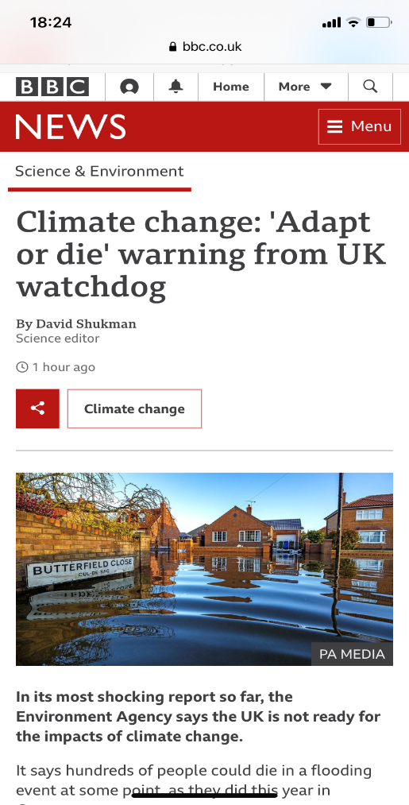
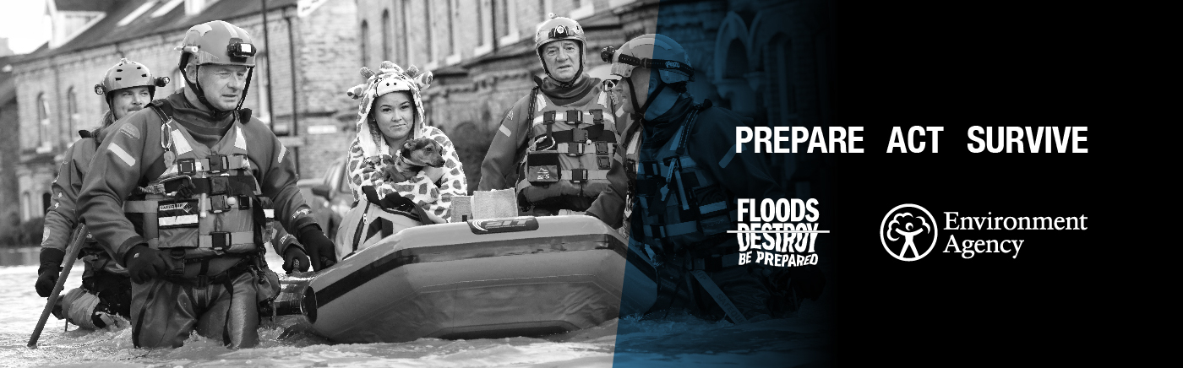
Is your business preparing for climate change?
In October 21, the EA published it’s third adaptation report “Living Better with a Changing Climate”
“business as usual” is not an option
we are helping businesses prepare
Notes:
In October 2021 the EA published it’s third adaptation report “Living Better with a Changing Climate” . Reporting is a requirement for arms length public bodies such as ourselves under the Climate Change Act 2008.
Our adaptation approach falls under 8 themes – and I would like to draw your attention to two of them
The first one is thinking differently – “business as usual” is not an option
Climate impacts are inevitable, and our thinking must change faster than the climate.
And second, we are helping businesses prepare – with flexible and climate-proof regulation and advice.
Climate change will exacerbate environmental risks both to and from regulated industries.
We are helping industries to manage these risks by providing advice and, where we have powers to do so, adjusting our environmental permits to account for climate change.
We will also support the development of more flexible regulatory approaches to accommodate rapid environmental change.

Slide 4
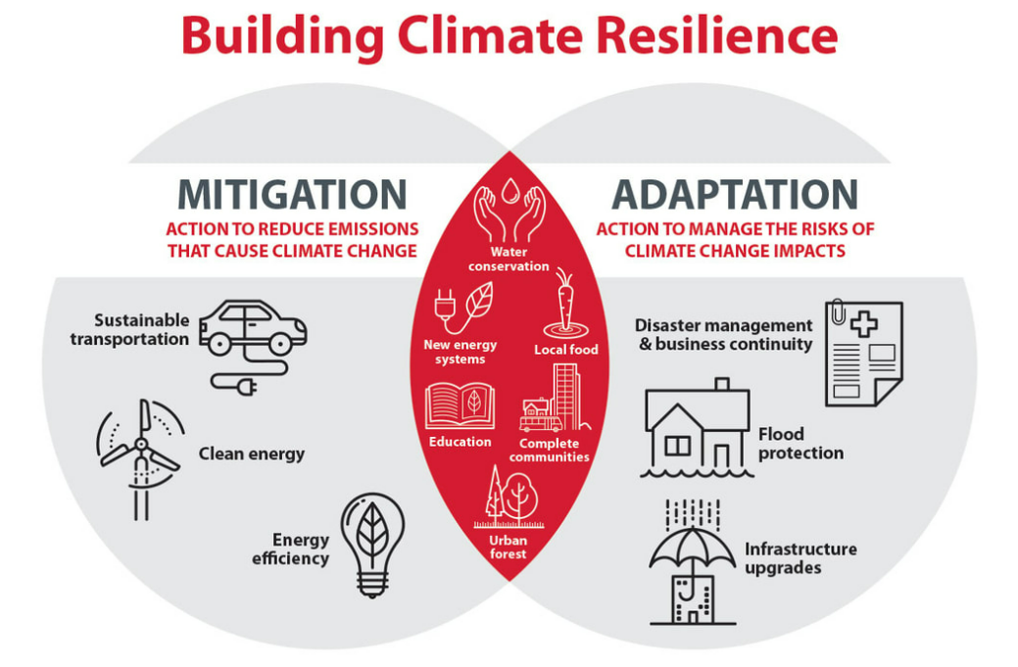
Resilient net zero = mitigation + adaptation
Climate mitigation, resource efficiency and adaptation sometimes seen as separate issues
Encourage ‘integration’ or ‘systems thinking’
Consider climate impacts in short, medium and long term on transition to Net Zero
Notes:
Quick reminder of the focus here: adaptation is about being prepared for gradual changes in our climate as well as the increasingly extreme weather events. So plan for chronic as well as acute changes.
Mitigation is the reduction of greenhouse gases with the aim of slowing down the rate of climate change.
Becoming resilient to climate change is often described as two sides of the same coin………..
Some commentators will say the middle ground is becoming larger; we need to ensure that sites transitioning to a net zero future, do it in a sustainable and resilient way……….

Slide 5
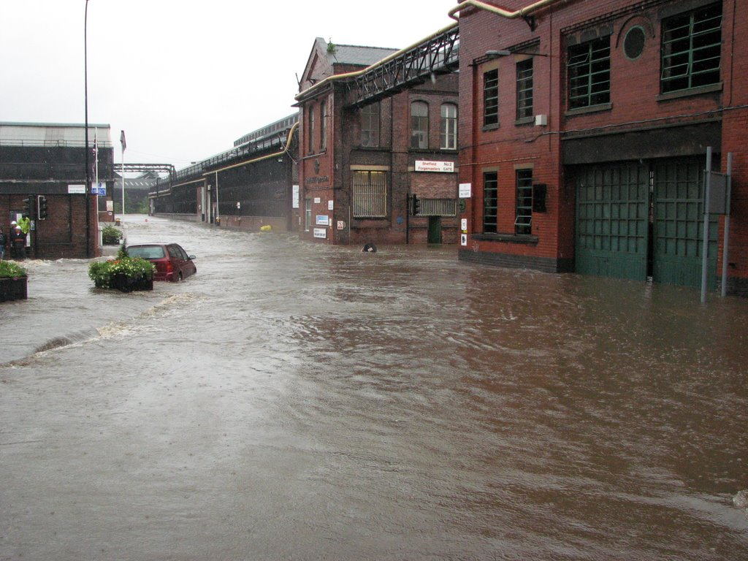
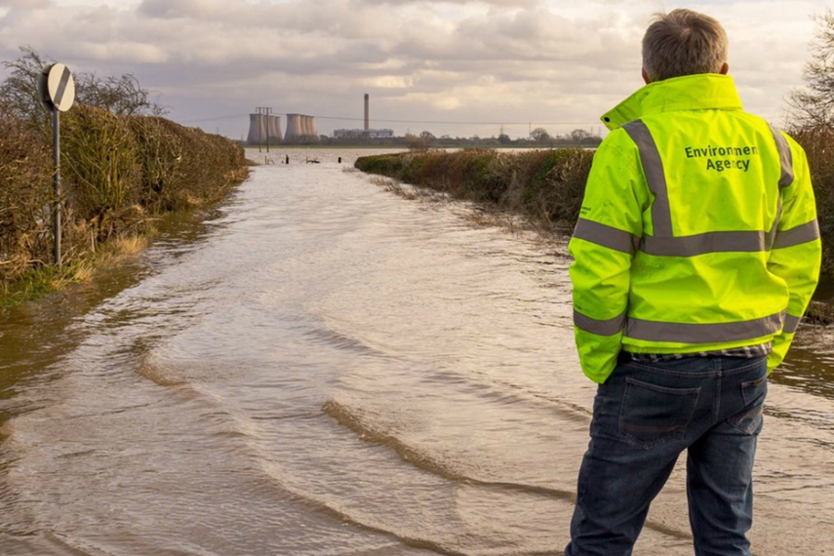
Climate change is influencing how we regulate today……..
From 31 August 2022, EPR guidance on developing a management system has been updated to focus on an existing requirement to consider a changing climate
Guidance is available on gov.uk
        🔗 Develop a management system: environmental permits - GOV.UK (www.gov.uk)
    🔗Adapting to climate change: industry sector examples for your risk assessment - GOV.UK (www.gov.uk)
Notes:
Previously in 2019 we introduced a requirement for applicants to complete a CC risk assessment as part of the application process for a bespoke Environmental Permit.
In October 21 we updated our guidance to include 15 sector specific examples of a risk assessments to help individual operators and holders of environmental permits to consider the risks to and from their business from climate change.
In August 2022 we revised our approach moving the focus from permitting into compliance. I will explain why & how we did that and what support is available to support this revised approach.
This move was a direct result of some pilots undertaken in 2021-22 with an external consultancy looking to undertake a “gap analysis” at sites who volunteered to take part across England and Scotland. They looked at how well the site was structured and managed in order to support the consideration of CC adaptation under the ISO 14090 standard. The feedback from these pilots fed directly into our thinking and supported the use of aligning the approach with the ISO 14090 standard (and indeed ISO 14091 standard for the risk assessment) which helps companies to organise their thinking on how to consider CC risks and embed the resultant adaptation plan into their MS’s.
Much of the feedback from the pilots was along the lines of “we know we need to be doing something to address the risks to and from our business but were unsure where to start”. Another common theme was that site contacts could see the need for the work but were struggling to secure buy-in and support from senior leaders……….
More on that later.

Slide 6
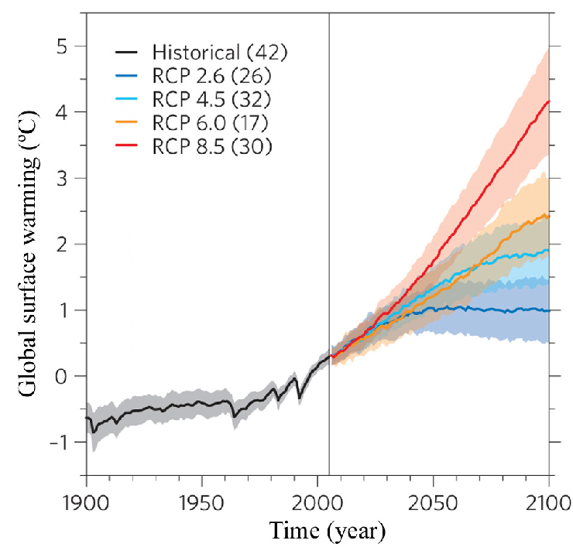
What is the ambition?
By 2026 operators will
Assess the risks associated with a 4°C rise by 2100
Plan to manage the risks associated with a 2°C rise by 2050, (~RCP 8.5)
Avoid Lock-in during transition to Net Zero
Approx 12,000 permitted sites (EA regulated)
Approx 400-500 permitted sites (LA regulated)
Predicted Warming for different Representative Concentration Pathways (RCPs)
Notes:
Adapting to climate change is a priority and we want to support regulated businesses to maintain compliance and so that they can cope with:
• an increased frequency and severity of extreme weather events as well as gradual changes to weather patterns causing unforeseen challenges
• disruption and failure of supply chains locally and globally because of climate change
• increased risks from mean global temperature rises of 2 oC by 2050 and 4 oC by 2100
We are keen to ensure our work is supported by some reasonably straightforward messages and guidance. By focussing on 2 and 4 degree rises we hope to avoid some of the potential challenges and pitfalls of getting into too much detail around which RCP operators should be utilising in their assessments.
This revised requirement applies to all holders of bespoke & standard rule EPR permits (installations and waste operations) and is being rolled out via Local Authorities to some 400-500 holders of Part A2 and SWIPs (small waste incinerator permits).
(RCP is Representative Concentration Pathways. Scenarios based on differing levels of emission reduction assumptions.)

Slide 7
Revised approach to adaptation within EPR
Updated our management system guidance to provide greater emphasis on the need for adaptation to be embedded with environmental management systems
  tweaked 03 04 23 to clarify existing operators need to complete a risk assessment by April 2024
Builds on learning from ISO 14090 pilots of 21-22
Maintain & updated sector specific risk assessments Adapting to climate change: industry sector examples for your risk assessment
Work with others to develop the tools and support needed to deliver the revised approach
  Revised guidance documents: supporting guidance and good practice guidance template (published 03 04 23)
  Adaptation training for regulatory Officers now available
Notes:
Revised approach builds on our existing guidance for management systems on .gov.uk which says ‘Aim to write your climate change adaptation plan in line with the ISO 14090 standard.’
The ISO 14090 pilots mentioned earlier were fundamental in our thinking. Some key findings were that many recognised they needed to be better prepared for climate change but that they struggled with how to do that and secure senior management support. Whilst we can never mandate the use of a standard such as ISO 14090, we are pointing to it in our supporting guidance as we believe it offers a helpful framework to follow and for sites that already hold ISO14001; it is designed to dovetail directly into their existing MS. Indeed, there are developments to support that process happening at the moment with a white paper….
Many participants in the pilot study also sited a lack of sector specific examples or knowledge of risks as a blocker to progress………….
We have now revised our guidance on management systems to provide greater focus and emphasis on the need to embed climate change adaptation within MS’s. We are now clearly stating that we require every applicable site to have at least completed a risk assessment by April 2024. Again, not manadatory but the ISO 14091 standard on completing climate change adaptation risk assessments is a useful standard to follow alongside our example risk assessments.
We have committed to updating the sector specific risk assessments regularly with industry’s help…. These were re-published in April 23 specifically to ensure that they captured the learning from the extreme weather events of the 3 February 2022 storms and summer heatwaves in 2022 . There is a specific example risk assessment for the power sector but others will be relevant. The examples cover summer maximum daily temperatures, winter daily temperatures, daily and average winter rainfall, sea level rise, drier summers, river flows and storms.
We have now also published more detailed supporting guidance onto GOV.UK on 3rd April last year on how to comply with the revised requirement within existing management systems. This supporting guidance follows the structure of ISO14090.
We have also worked with trade associations and partner environmental regulators across Scotland, Wales and Northern Ireland to deliver a UK wide good practice guidance template document. This is now with Trade Association’s and professional organisations for their use when producing their own guidance for their members. It is deliberately structured in a way that aligns with the ISO standard. It is hoped that sector specific examples can be added to the template as organisations seek to use it. Tech UK or some on the call may wish to utilise the good practice guidance template which is available as a word document on request……….
None of this can be fully delivered and supported without improving our own capacity and capability in this area. By working with others (including other regulators) we have developed detailed training for regulatory Officers to improve our ability to support you with climate change adaptation. This is now available for our Regulatory Officers to undertake: Learning Option: Climate change adaptation training for regulatory officers (environment-agency.gov.uk) we have now shared this training with local authorities and other devolved administrations who were not involved in the trials.
All of this is best supported by working collaboratively to deliver across sectors.

Slide 8
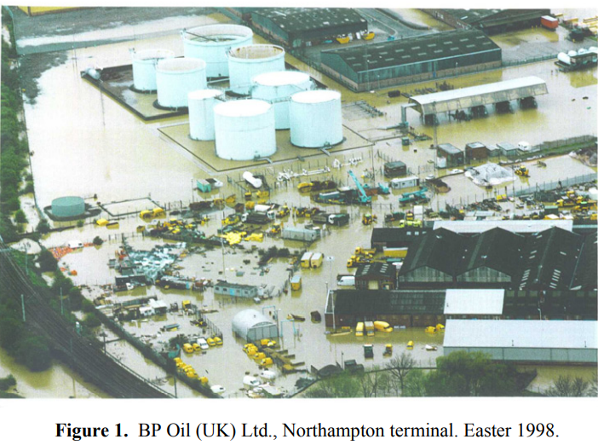
Phased approach for sectors
Different starting points
Challenges – resources and capability
Resilience of national critical infrastructure
Proportionate to nature and scale of hazard and vulnerability
Tiered risk assessment
Questionnaire sent out to gather intel & results being reviewed
Notes:
We are keen to ensure that adaptation planning within EPR is proportionate to the level of risk. The ISO 14090 standards does just that. So the more complex a site, the more detailed the risk assessment and resultant plan we would expect to see. We are also recognising that everyone is likely to be in differing starting places. The message is very much that we are on a journey to improving the resilience of those we regulate together and its in all our interests to help regulated communities to be better prepared for CC and extreme weather events.
We have produced supporting FAQ’s for Officers to guide them through the implementation period.
A questionnaire has been used to gather intelligence at a sector level to inform action planning to support sectors to improve their resilience to climate change impacts. It takes the shape of a Teams Form and is currently being completed on a voluntary basis by those we regulate within EA for England. The results at a sector level will help inform what further support is likely to be needed at an individual sector level.

Slide 9
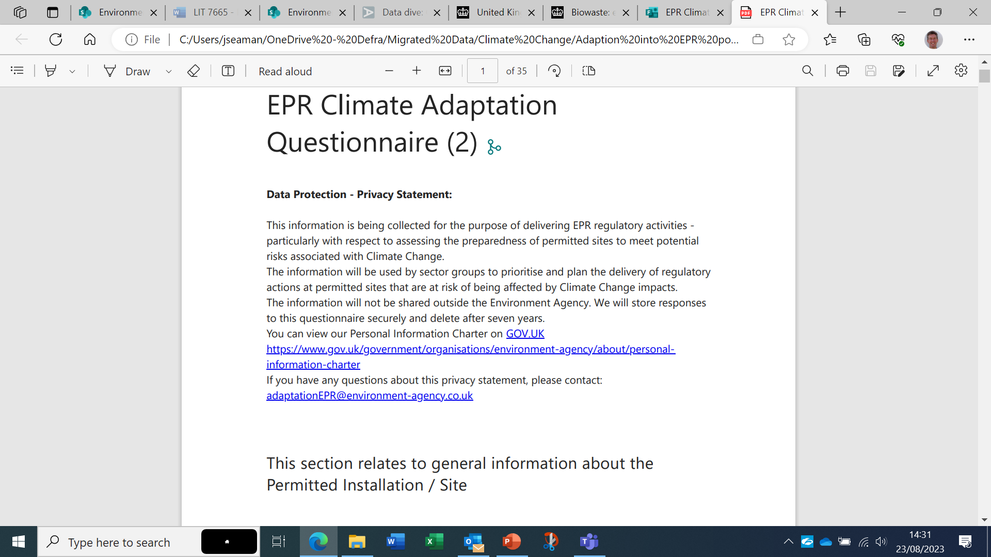
EPR Climate Adaptation Questionnaire
Notes:
The questionnaire is intended as an intelligence gathering exercise to help inform local Area and sector teams what and where support is best targeted over the coming couple of years (remembering the 2026 compliance deadline) and help us tailor that support across for different sectors. ONR and COMAH competent authority have sent similar questionnaires out in recent months, and we are working to prevent overlap/ duplication.
Results can be shared in due course on request.
I will now hand over to my colleague Mike Nicholas who will talk about some of those wider drivers aimed at helping improve the resilience across a range of sectors as well as a more detailed look at some of the climate impacts we are already seeing as a result of extreme weather event………………..
Q’s 1-5 are about your site and how you manage risks such as those brought by climate change.
Q’s 6 – 14 are about your knowledge on CC adaptation and sources of support.
Q’s 15 – 38 are specifically looking at the wide range of climate impacts that you are likely to see if not already and what risks they pose to your compliance and site generally.
Q’s 39 to end are available for you to note evidence/ documents you hold that help demonstrate what you have considered to date.
We are quite expecting sites to come back and say: “we haven’t really considered any of this yet, but we know we need to………” or we see other drivers for us to be considering adaptation more generally across our business (insurance, TCFD etc) but were not sure where to start………”

Slide 10
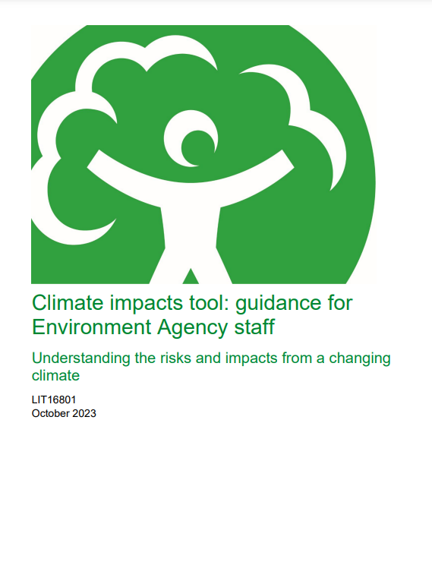
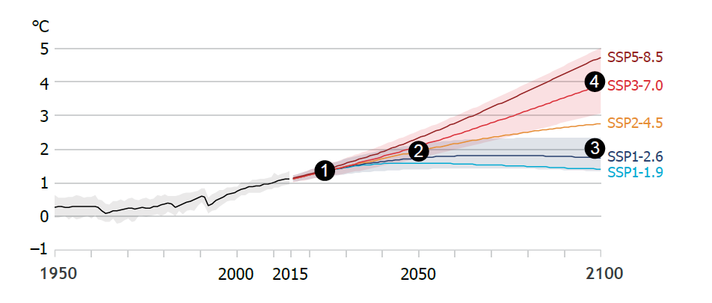
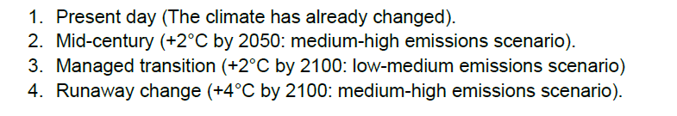
Published on gov.uk

Slide 11
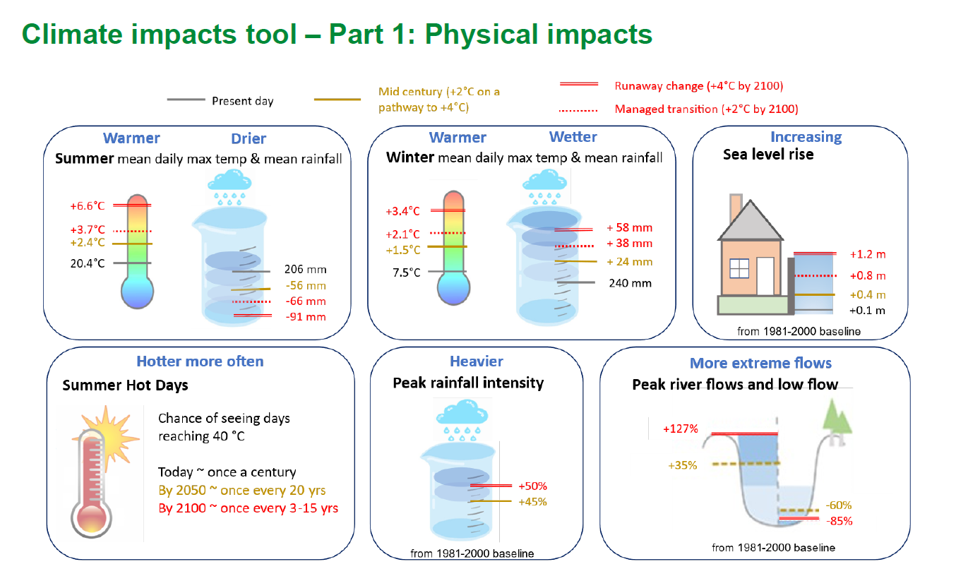
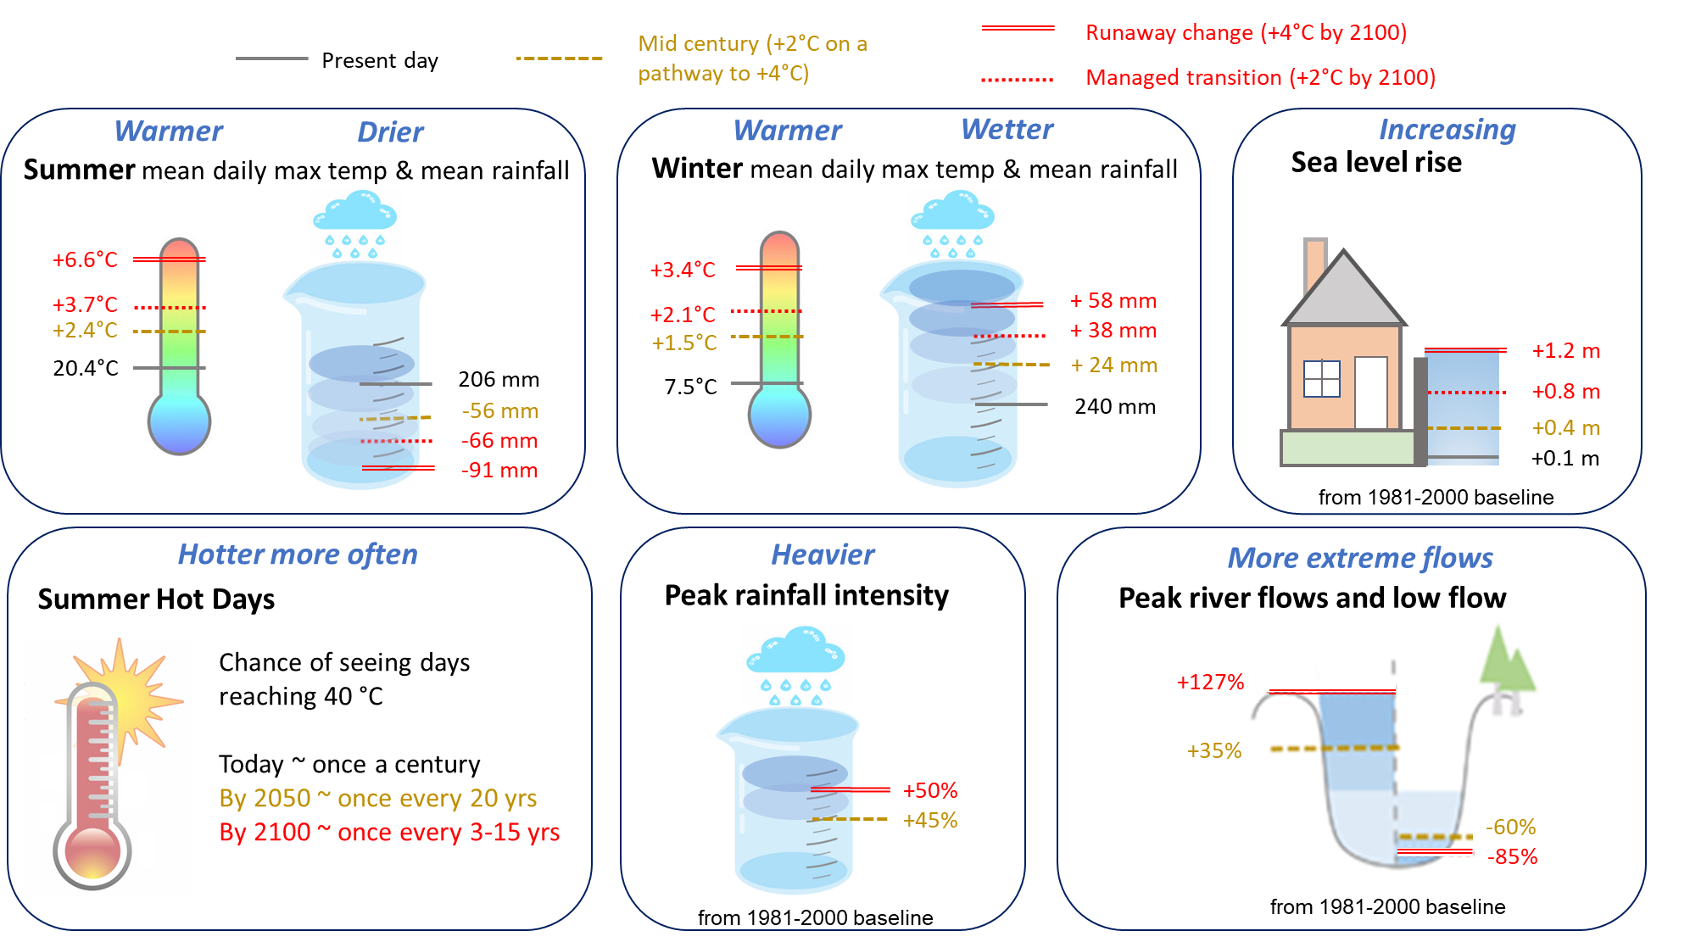

Slide 12
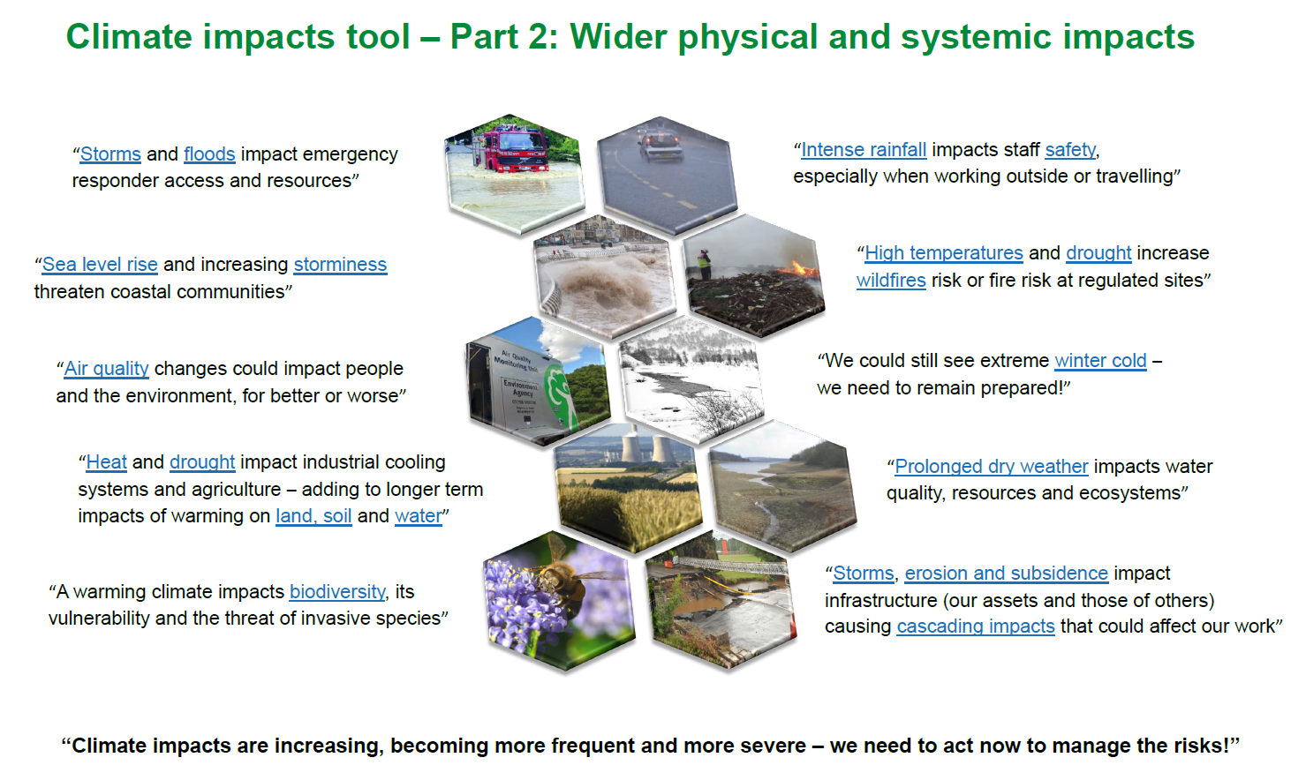

Slide 13
How can natural hazards impact businesses & environmental protection?
Possible failures / degradation
High temperature / Heat wave
  Insufficient process cooling, particularly where using ambient air as coolant;
  Process equipment / instrumentation overheating and malfunctioning;
  Increased fire risk / material decomposition / material auto-ignition;
  Impact on workforce / reduced human performance;
  Increased wildfire risk (either direct impact to establishment or indirect impacts – utilities/emergency response)
Prolonged dry weather / Drought
  Impact on cooling water or fire water availability;
  Increased vulnerability of environmental receptors;
  Subsidence / ground movement impacting on equipment supports and containment system integrity.

Slide 14
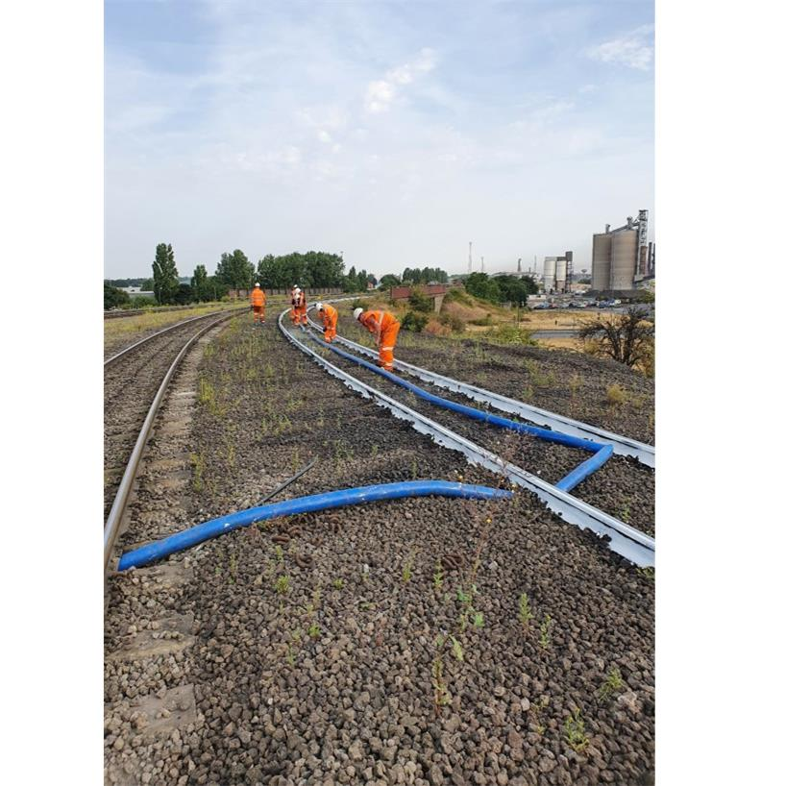
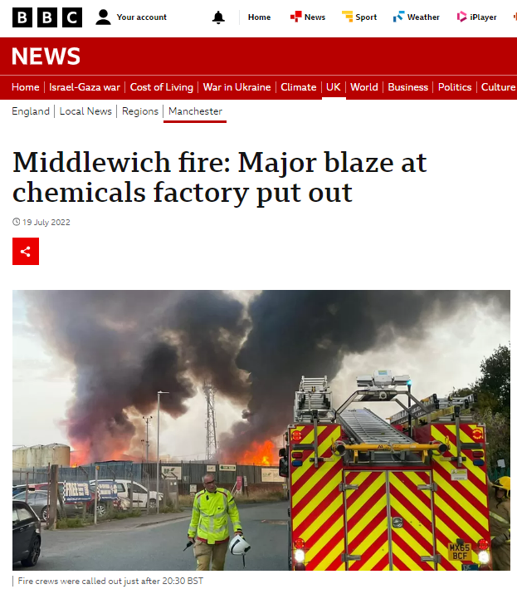
Notes:
During that first heatwave of July this year, one site team at a large steel works responded to a site emergency regarding railways buckling, impacting molten metal movements across the site. This severely impacted site operations as direct result of the extreme temperatures. Many, many other sites have and rely on rail infrastructure for raw material movements and production distribution.

Slide 15
How can natural hazards impact businesses & environmental protection?
Possible failures / degradation
Flooding
  Floating of vessels or impact damage to equipment causing loss of containment (potential multiple losses);
  Loss of power / utilities / control and communication systems;
  Compromising secondary/tertiary containment and drainage integrity/functionality;
  Hampering emergency response due to unavailable resources or access/egress issues.
High winds / Storms
  Structural damage either directly or due to wind-blown debris;
  Access restrictions hampering emergency response;
  Wide area power / communications systems loss.
Sea level rise
  Increased risk of local sea/estuary defences failing and sites flooding;
  Increased forces on jetties/coastal structures due to changes in marine/estuarine currents.

Slide 16
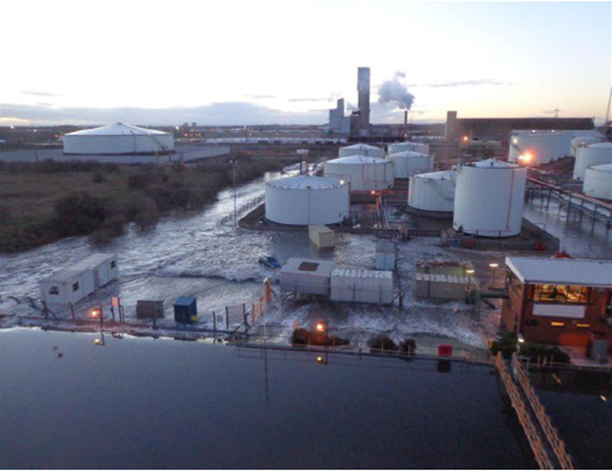
Notes:
East Coast surge 2013. A storm surge coinciding with high tides caused the River Tees to rise. It flowed over and eroded the dykes built to protect the local residents. The flooding reached 1.8 m above ordnance datum.
See: https://www.aria.developpement-durable.gouv.fr/wp-content/files_mf/10FD_east_UK_CV_GB.pdf
A petrochemical site, a cement works, and a petrochemical terminal were all flooded that day.

Slide 17
How can natural hazards impact businesses & environmental protection?
Possible failures / degradation
Heavy Snowfall
  Access restrictions hampering process operation / maintenance;
  Weight on structures causing structural collapse / loss of containment;
  Loss of power / utilities / control and communication systems;
  Compromising secondary/tertiary containment and drainage integrity/functionality;
  Flooding impacts following thaw;
  Hampering emergency response due to unavailable resources or access/egress issues.
Ice / prolonged cold
  Freezing of process pipework causing no /low flow and associated scenarios / causing potential pipework damage and loss of containment upon thaw;
  Instrumentation faults and malfunctions leading to loss of process control;
  Metal fatigue / other equipment damage causing failures and malfunctions;
  Access issues or freezing of fire systems impacting emergency response.
Notes:
Recent examples of prolonged cold followed by rapid thawing causing unexpected issues (apart from flooding)

Slide 18
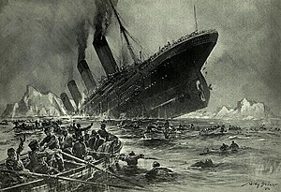
Notes:
Everybody is familiar with the sinking of the Titanic, but do they know why it sunk? I’m not just talking about it hitting an iceberg. It’s because the composition of the steel for the hull wasn’t equipped for the cold temperatures. Primarily, the steel became brittle when it was exposed to the cold water, and the colder it got the more brittle it became. When it finally hit the iceberg, the steel fractured much more readily than it would have at warmer temperatures.
Clearly our knowledge and thinking has improved greatly since then but has it moved quickly enough??......................

Slide 19

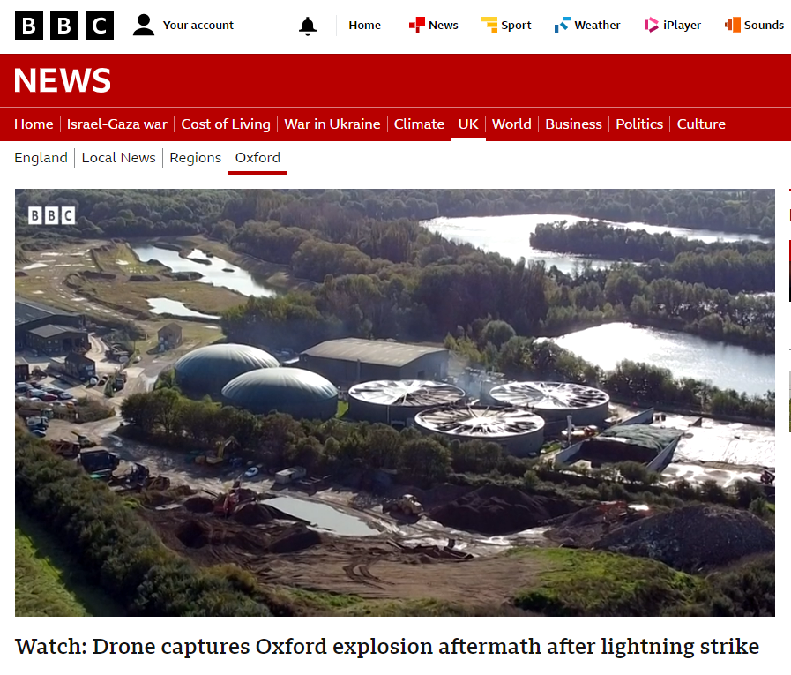
“Creating a net zero nation
resilient to climate change”
Notes:
Everybody is familiar with the sinking of the Titanic, but do they know why it sunk? I’m not just talking about it hitting an iceberg. It’s because the composition of the steel for the hull wasn’t equipped for the cold temperatures. Primarily, the steel became brittle when it was exposed to the cold water, and the colder it got the more brittle it became. When it finally hit the iceberg, the steel fractured much more readily than it would have at warmer temperatures.
Clearly our knowledge and thinking has improved greatly since then but has it moved quickly enough??......................

Slide 20
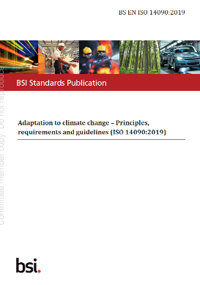
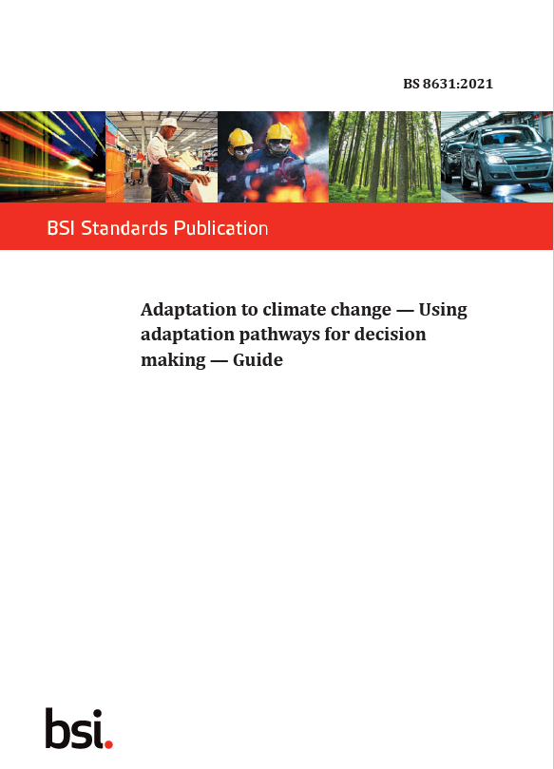
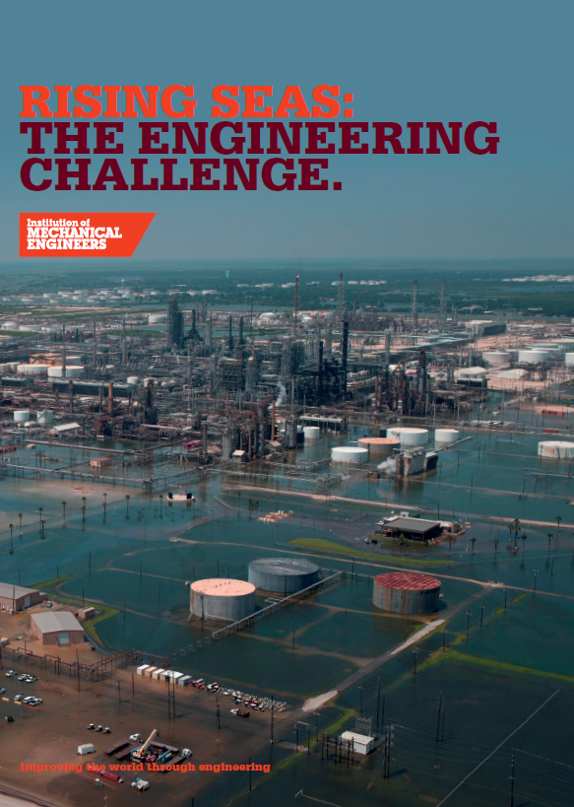
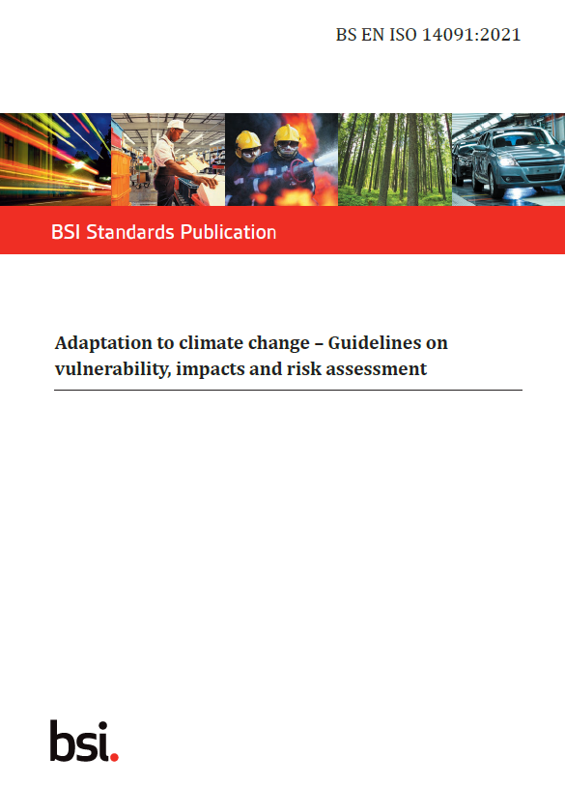
Available guidance
Continual improvement in adaptation
Plan
Do
Check
Act
and much more…

Slide 21
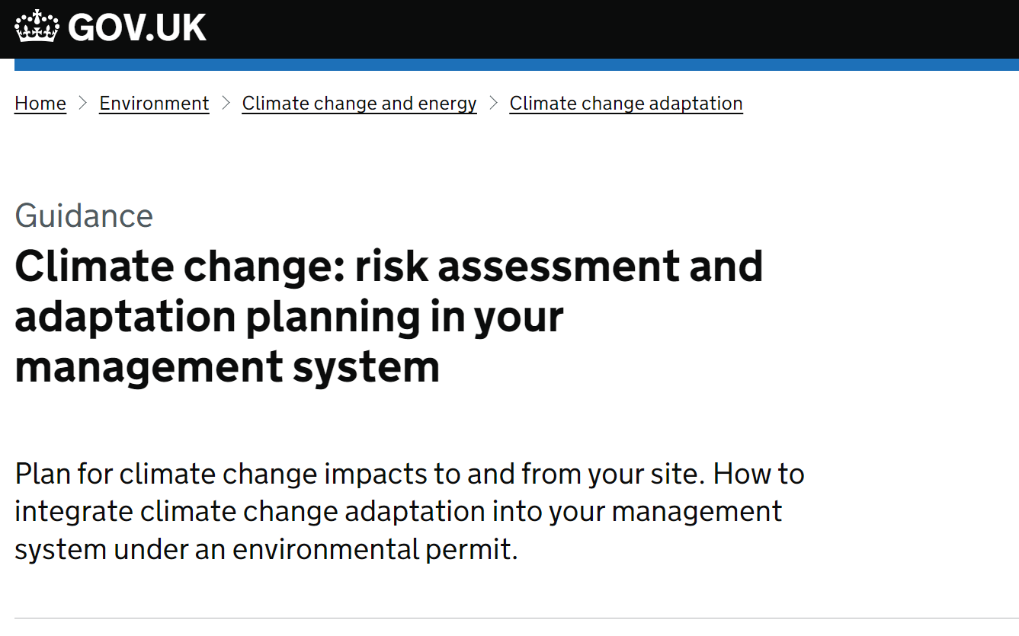
Available guidance

Slide 22
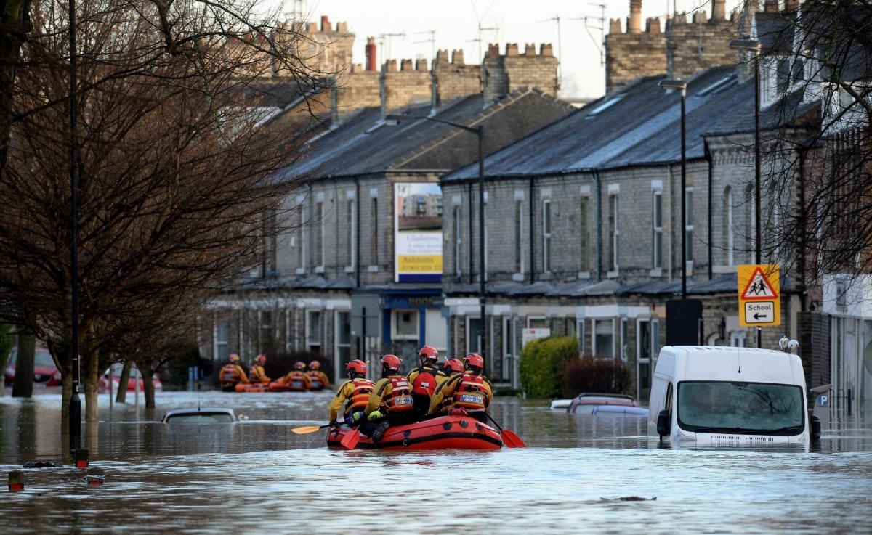
“Our thinking needs to change faster than the climate”
Notes:
To conclude:
Things are moving at pace and at scale – the EA don’t have all the answers to climate change but with industry and regulator collaboration, we will succeed in creating a net zero nation, resilient to climate change.
Thank you.

Slide 23
