Slide 1



Industrial Strategy:
Digital and Technologies Sector Plan

Slide 2





We have committed to a 10-year plan to deliver certainty and stability
Strategic, growth focused
Easing investor journey
Long-term stability
Open, free and fair trade
Being clear-eyed about the highest opportunity growth-driving sectors.
Reforming the business environment to ensure it is stable, supportive and encourages business investment and new growth opportunities.
Aligning with underlying commitments on economic security, net zero and regional growth.
Addressing frictions and reducing barriers to investment, making it simpler and cheaper for companies to scale and invest.
Key themes from the Industrial Strategy consultation include people & skills; innovation; energy & infrastructure; regulation; crowding in investment; international partnerships & trade; and the interaction of government and business.
Creation of Industrial Strategy Advisory Council, which will become a statutory body to advise, monitor and evaluate our growth strategy.
A strategy developed in partnership with business, regional and devolved governments, and the wider stakeholder community.
International from the start and aligns to Trade Strategy.
Industrial Strategy thinking should be grounded in the global and economy context and leverage our trade and diplomatic networks across DBT and FCDO.
The Industrial Strategy is a central pillar of the Government's wider Growth Mission.

Slide 3
Key growth sectors and growth mission policy levers
In prioritising high growth and strategic sectors, we have considered current and future strengths as well as impacts on wider strategic goals.
The Industrial Strategy will apply three cross-cutting lenses – our wider strategic objectives
Advanced Manufacturing
Creative Industries
Digital and Technologies
Financial Services
Professional and Business Services
Life Sciences
Defence
Clean Energy Industries
+ Foundational Sectors
Delivering growth across the UK​
Innovation
Measures to crowd in investment
Growing the economy in a way which makes the UK more secure and resilient​
Through this sectoral lens, the Industrial Strategy will inform the full range of Growth Mission policy levers across HMG policy areas to deliver sector-specific and cross-cutting measures.
People and skills
Regulatory environment
Energy and infrastructure
International partnerships and trade
Helping the UK deliver Net Zero​

Slide 4

A 10 Year vision for the Digital and Technologies Sector
By 2035, our vision is for the UK to be one of the top three places in the world to create, invest in and scale-up a fast-growing technology business. We will aim to secure the UK’s first trillion-dollar technology business. ​
Build our sovereign capability in the most strategically important technology areas.​
Targeting business investment in the sector as a key measure of success and aiming to have more investment in commercial research and development (R&D) in the sector than any other country globally (excluding USA and China) by 2035.

Slide 5
Digital and Technologies sector plan – the
approach
Delivering reforms to improve the business environment for digital and technology businesses:
  Boosting R&D investment
  Increasing access to finance
  Creating a skilled workforce
  Enhancing infrastructure
  Delivering pro-innovation regulation
  Securing international partnerships
Prioritising and investing in “frontier technologies” where the UK has world leading strengths
Supporting core Government objectives on (1) economic security and resilience (2) regional growth and (3) net zero

Slide 6
Frontier Technologies
We will take steps to unlock growth in frontier technologies where we see the highest potential for growth.
These have been identified through rigorous, cross-government analysis and stakeholder engagement.
The six frontier technologies build on UK strengths and comparative advantage.
Advanced Connectivity
Technologies (ACT)
Artificial Intelligence
Cyber Security
Engineering Biology
Quantum Technologies
Semiconductors

Slide 7
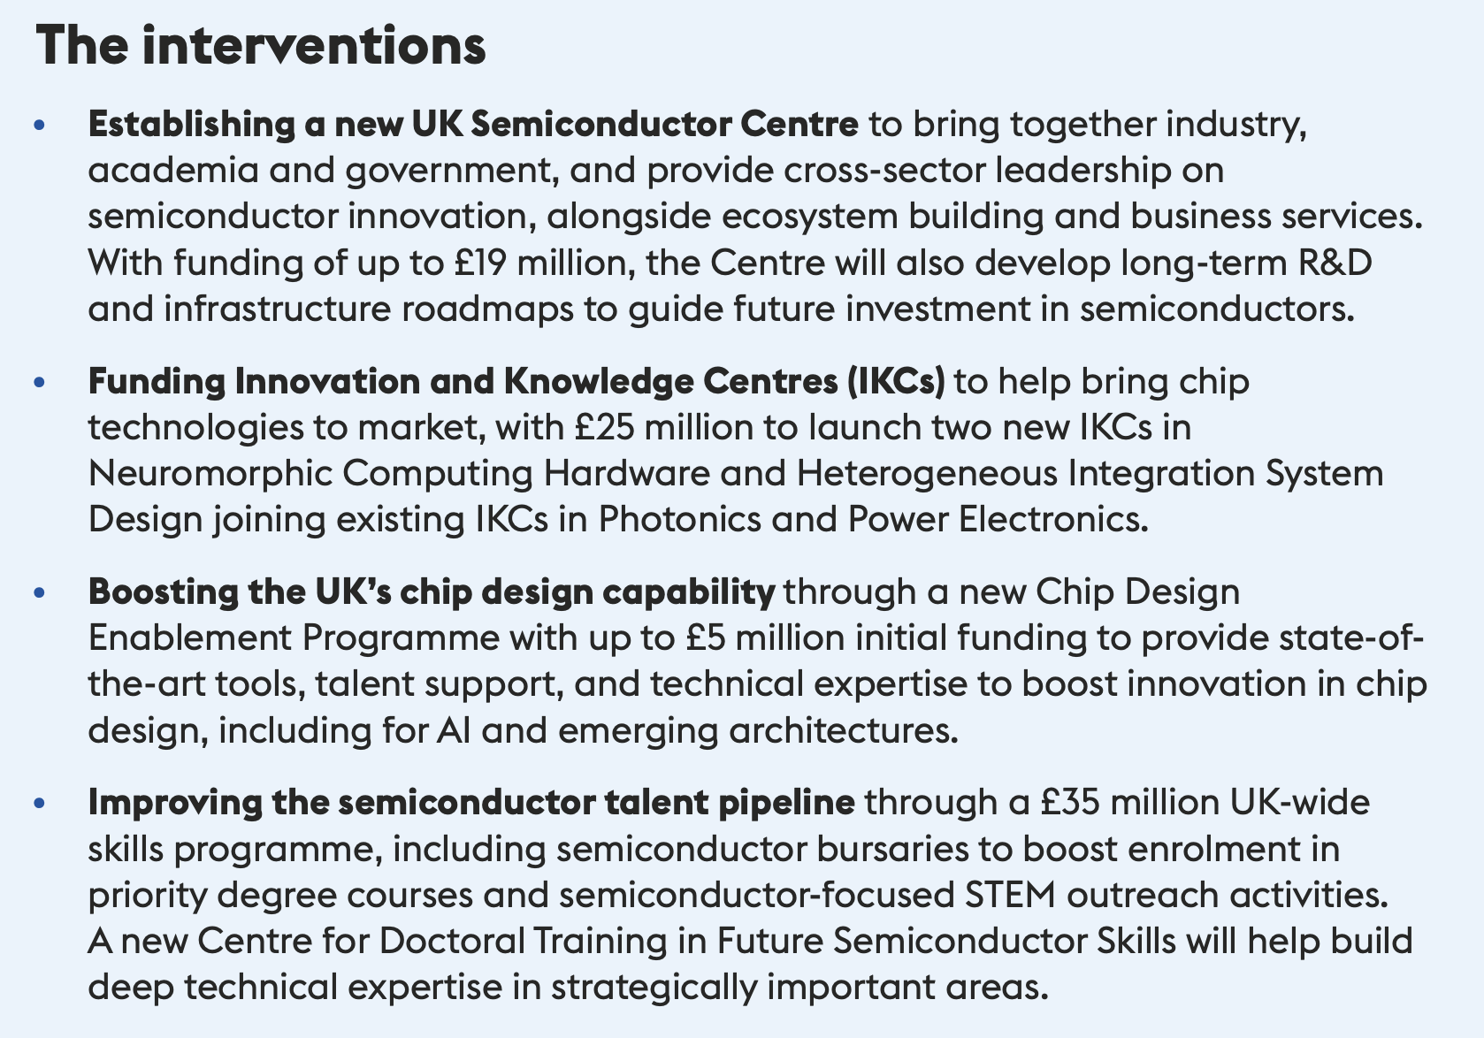
Frontier Technology: Semiconductors
Semiconductors
Our expertise in chip design, compound
semiconductors, materials science, equipment manufacturing, and R&D puts us at the cutting edge of innovation and enables the UK to be the
first to pioneer next-generation chips
Approach
Developing a strategic and joined up approach to R&D and enhancing the innovation ecosystem to improve commercialisation, prioritising areas with high-growth potential and wide-ranging cross-sector applications.
We will prioritise strategic measures to enhance national security and strengthen semiconductor supply chain resilience, and collaborate internationally as a reliable, trusted partner in the global semiconductor ecosystem

