Slide 1

Challenges and opportunities with data in the UK fire sector

Slide 2

Topics
Current Data Landscape in UK Fire Services
Data Collection methods & tools
Data Management Practices
Data Sharing
Opportunities and Future Directions

Slide 3
Current Data Landscape in UK Fire Services

Slide 4

Types of data collected
Incident Data
  Fire services collect data on incidents, including the type of incident, location, and severity. This data is used to identify trends and patterns, and to inform decision making and resource allocation. Also includes response times.
Property Data
  Fire services collect data on properties, including the type of property, its age, and any relevant building information. This data is used to inform risk assessment and resource allocation.
Demographic Data
  Fire services collect data on demographic information, including age, gender, ethnicity, and socio-economic status. This data is used to identify areas of higher risk and to inform resource allocation and risk assessment strategies.
  Visits Data
  As well as incidents, fire services carry out safety visits at both domestic and non-domestic properties.

Slide 5
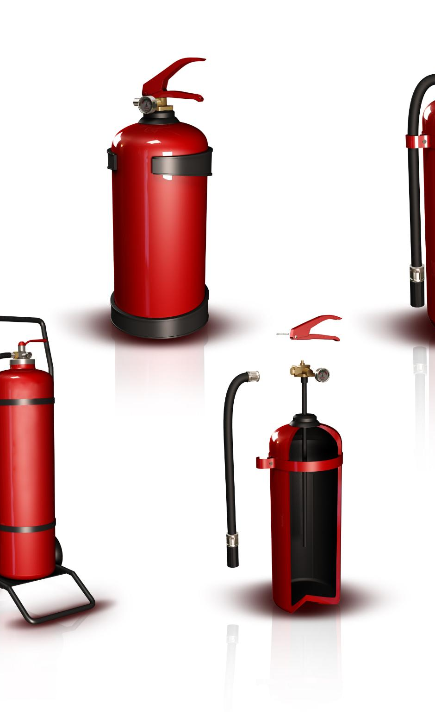
Data collection methods and tools
Paper Is Out (mostly)
Digital Is In
  Fire services use a number of applications to gather data, including PowerApps, MS Forms and other systems tailored towards the specific job types.
Drones
  Some fire services use drones for data collection, which allows for real-time monitoring and analysis of fire incidents.

Slide 6

Data management practices
Data Quality
  NFCC are about to release a methodology for assessing and improving all data
Standardization of Data
  NFCC are working on a set of Data Entry Conventions to standardise the way data is collected from one dataset to another, and from one fire service to another
Information Governance
  Fire services generally have good practices for complying with the Data Protection Act

Slide 7

Integration of data from multiple sources
Collecting data from multiple sources
  UK Fire Services collect data from a variety of sources, including other emergency services, government agencies, and the public but there is more to be done.

Slide 8
Opportunities for Improvement with Data

Slide 9

Advanced Data Analytics for Decision Making
Machine Learning
  Machine learning techniques can be used to analyze data from various sources including IoT devices, in-house datasets and external data sets to identify patterns and trends that can help fire services to make more informed decisions.
Generative AI
  Fire services are already making some use of this in small, localised ways

Slide 10

Predictive modeling and risk assessment
  Predictive modelling and risk assessment can help fire services to identify areas of high risk and allocate resources accordingly. This can help to prevent fires and reduce the impact of incidents.

Slide 11

Leveraging Cloud Computing for Data Storage and Access
Secure Data Storage
  Cloud computing provides secure data storage for fire services, offering better protection against data loss, theft or cyber attacks.
Scalable Data Access
  Cloud computing offers fire services scalable data access, enabling them to manage and share larger amounts of data more efficiently across services.

Slide 12
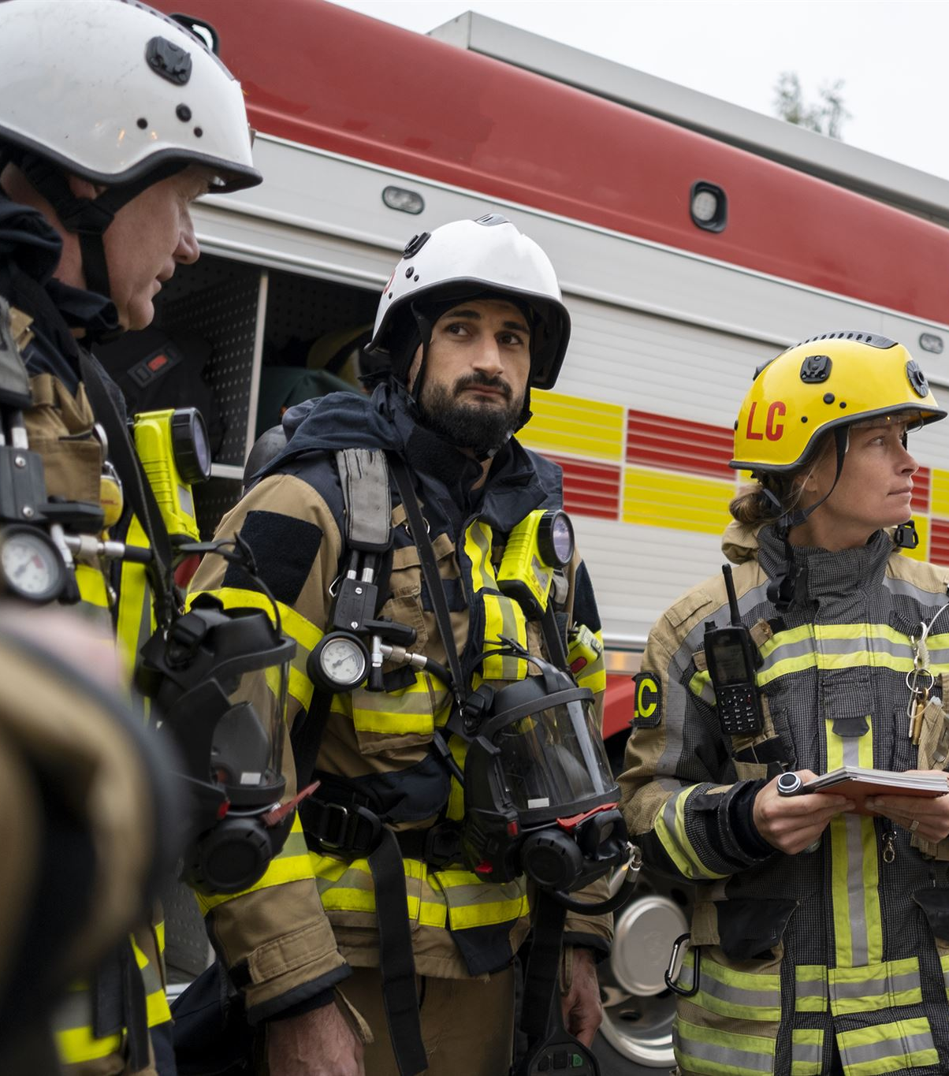
Developing a data-centric culture within fire services
Training Programs
  Training programs can help to develop a data-centric culture within fire services, ensuring that staff are equipped with the necessary skills to collect, manage, and utilize data effectively. We want to produce training materials for data literacy that are tailored to different types of people such as firefighters
Adoption of Best Practices
  The adoption of best practices can help to ensure that fire services are collecting, managing, and utilizing data in the most effective way possible, leading to improved decision-making and outcomes. These include the Data Quality Methodology and Data Entry Conventions.

Slide 13
Conclusion
  Data plays a vital role in the UK Fire sector, informing decision making and improving operational efficiency. By utilizing data, fire services can provide better outcomes for citizens and improve their overall performance.

