Slide 1
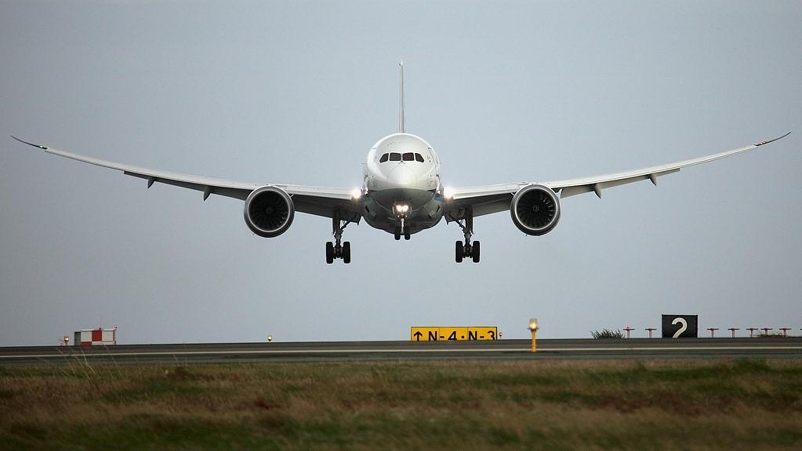

Global experts in flight control assemblies & components
Notes:
https://unsplash.com/photos/CTd5_C7p__8

Slide 2
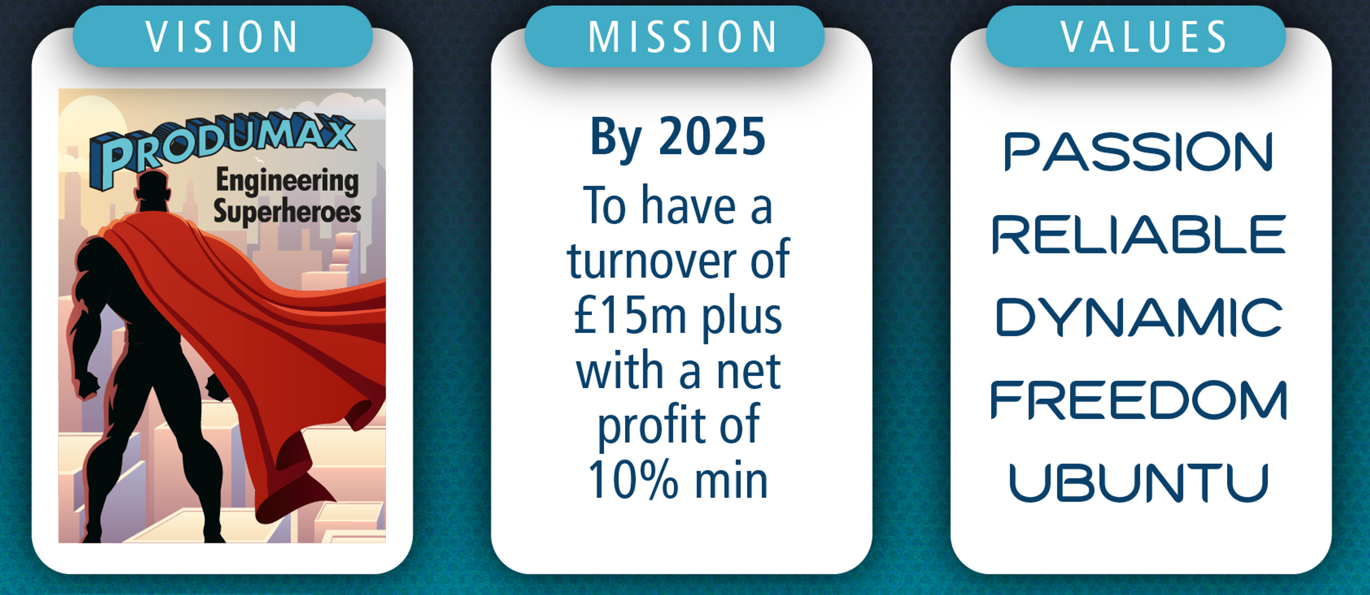
Values led, mission focussed, one vision

Slide 3
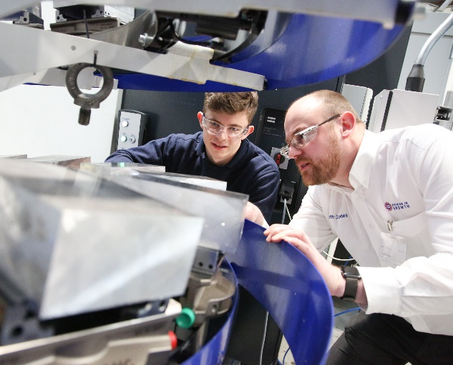
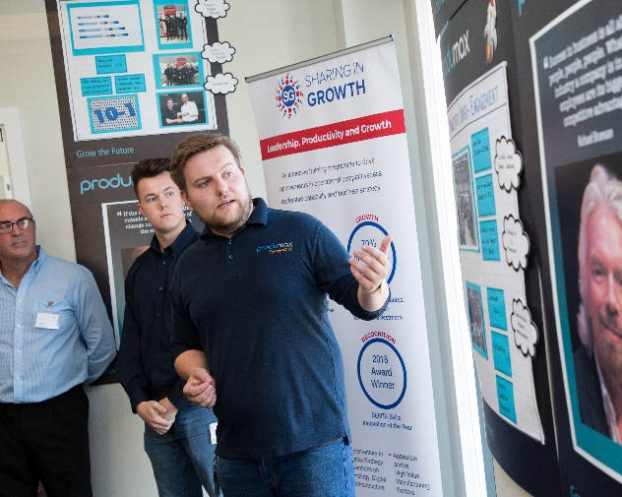


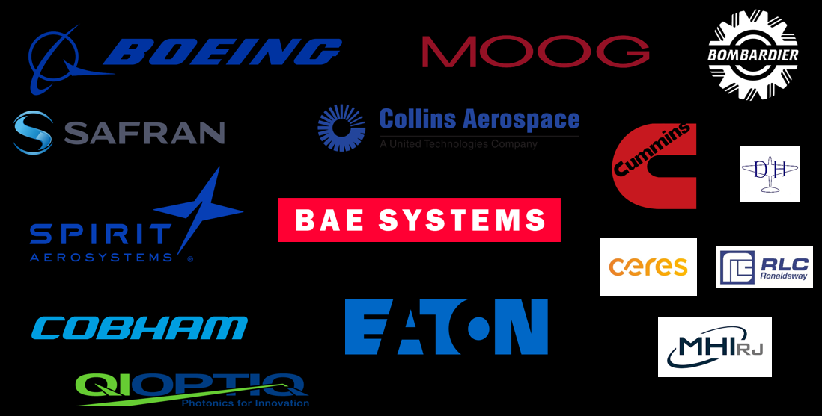
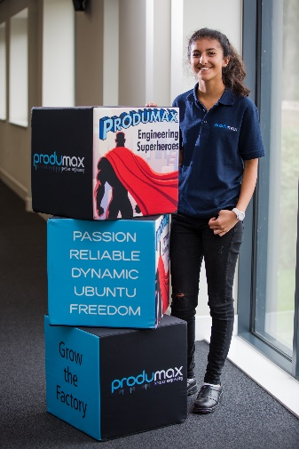
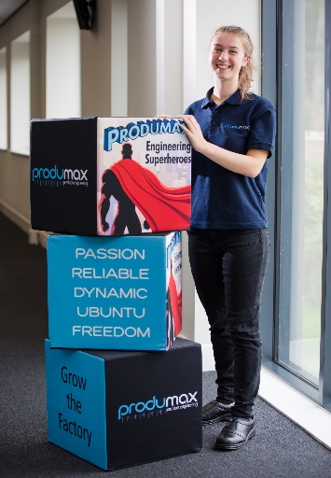
Produmax is…
Single Source
Young & Talented
Global supply of critical products across aircraft platforms.
Premier bidder status at Boeing
Award winning apprenticeship & leadership programmes creating diverse team with 40% under 35
Technically Excellent
Engagement Driven
Adaptive machining, automation & robotics, digital twinning, complex products, APQP
Vision, mission and values led driving world class employee engagement
Notes:
https://unsplash.com/photos/iLLgR2hjwFU
https://unsplash.com/photos/vWchRczcQwM
https://unsplash.com/photos/n4_Q2dDYy80
https://unsplash.com/photos/HJckKnwCXxQ

Slide 4
