Slide 1
Defensive Cyber Industry Update
Future Requirements
OFFICIAL

Slide 2
FORWARD VIEW: IMPORTANT NOTES
We recognise that it is helpful to regularly signpost our potential future requirements, our plans in terms of routes to market, our projected timelines and other information that can help you, our supplier base, decide which projects and programs you will bid into.
However please be aware that the information included in this update is our best estimation of future requirements, timelines and delivery routes.
Any or all of these elements could change, including but not limited to withdrawal of requirements, changes to routes to market, procurement timelines and contract durations.
Thank you for you continued engagement.
The Defence Digital Commercial Team (Cyber)

Slide 3
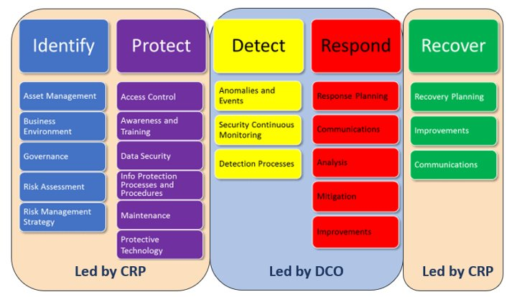
The Defensive Cyber Programmes are:​
Defensive Cyber Operations (DCO) Programme​
Cyber Resilience Programme (CRP) ​
Between them they address cyber risk across the MOD. They will also help deliver the secure cyber foundations needed for the Digital Backbone, set out in the Digital Strategy for Defence.
National Institute of Standards and Technology (NIST) Cyber Security Framework
OFFICIAL

Slide 4
Cyber Resilience Programme
Themes and Projects
Awareness, Behaviour & Culture
Secure Digital Foundations
Resilient by Design
Cyber Vulnerability Fixes
Cyber Confident
Protective Tooling
Secure by Design
Cyber Risk Interventions
Secure in Depth
Active Cyber Defence
Policy & Architecture
Vulnerability Research
Defensive Cyber Futures
Behavioural Testing
Network Asset Visibility
Cyber Attack Recovery Planning
NIST Compliance Assessments
Secure at Reach
Patch Management
Supplier Security Audit
OFFICIAL

Slide 5
Cyber Resilience Programme
Upcoming Procurements
Theme | Project | Procurement Title | Duration Yrs. | Route to Market | ITT Release | Contract Start
 | Cyber Confident | Cyber awareness Training, Family & Dependent days and Deployment Briefing | 3 months | TBC | Jan-22 | Feb-22
 | Behavioural Testing | Behaviour/ Media | 2+1 | CCS | Jan 22 | Apr-22
 | Training | Training | 2+1 | CCS | Jan 22 | Apr 22
 | Cyber Confident | Enduring Cyber awareness Training, Family & Dependent days and Deployment Briefing | 2 | TBC | TBC | TBC
 | Behavioural Intervention | USB Intervention – Hardware & Support Contract | TBC | TBC | TBC | TBC
 | Enterprise Patching | Enterprise Patching | TBC | DOS 5 | Jan-22 | Mar-22
 | Patch Management | Patch acquisition and Delivery Service (PADS) (Modernising Patching) BETA Phase | 3 | DOS 5 | Mar-22 | May-22
 | Network Asset Visibility (NAV) | Network Asset Visibility (NAV) | 3 | TBC | Mar-22 | Jul-22
 | Secure in Depth | Secure in Depth Resource | 6 + 3 months | DOS 5 | Jan-22 | Feb-22
 | Cyber Attack Recover Planning (CARP) | Cyber Attack Recover Planning (CARP) | TBC | TBC | TBC | Mar-22
 | Supplier Security Audit | Audit Delivery | 2+1 | CCS | Jan 22 | Apr-22
 | “All Resilient by Design projects” | Support Services Group | 2+1 | DOS 5 | Jul-22 | Oct-22
 | Defensive Cyber Futures | Benchmarking | 3 | TBC | Aug-22 | Oct-22
 | Vulnerability Research | Bug Bounty Service | 3 | CCS | Jan-22 | Apr-22
 | Secure @ Reach | Mobile Device Mgmt. | 3 | TBC | Sep-22 | Oct-22

Slide 6
Defensive Cyber Capability (DDC) Core
Project SHUKRA
Cyber Security Operations Capability (CSOC)
18 functional areas
Cyber Mission Data
Mission Configurable (deployed) DCC
Tradecraft
DCC in Complex Environments (DICE)
Individual Cyber Training Environment
Enrichment and Sensing
Segregated Network
Cyber Threat Intelligence
Collective Cyber Training Environment
Cyber Vulnerability Investigations
OFFICIAL

Slide 7
Defensive Cyber Operations Programme
Upcoming Procurements
Theme | Project | Procurement Title | Expected Route to Market | Expected Date to Market
 | Cyber Vulnerability Investigations (CVI) | Cyber Vulnerability Investigations (CVI) Management Unit (CMU) | CSS3 | ITT Issued Dec-21
 | Defensive Cyber Capability (DDC) Core | DCO Cyber Situational Awareness Fusion Architecture (CySAFA3) (2022-2026) | Competition | ITT Issued Dec-21
 | N/A | DCO CSS – Close Support Partner (2021-2023) | DOS | ITT Issued Jan-22
 | Project Shukra | DCO SHUKRA – Managed Training Service | CSS3 | Jan-22
 | Project Shukra | DCO SHUKRA CVLE (Cyber Virtual Learning Environment) | DOS | Jan-22
 | Cyber Threat Intelligence | DCO Threat Intelligence Feeds | TePAS | Feb-22
 | Defensive Cyber Capability (DDC) Core | DCO Phase 13 Bill of Materials | TePAS | Q1 2022
 | Cyber Vulnerability Investigations (CVI) | DCO CVI Investigators (2021-2023) | CSS3 | Q1 2022
 | Enrichment and Sensing | Corelight Licence | G-Cloud | Q1 2022
 | Enrichment and Sensing | Elastic Licence | G-Cloud | Q1 2022
 | Enrichment and Sensing | Lumeta Licence | G-Cloud | Q1 2022
 | Defensive Cyber Capability (DDC) Core | DCO Phase 14 Bill of Materials | TePAS | Q2 2022
 | Defensive Cyber Capability (DDC) Core | DCO Platform as a Service – Core UK (2022-2024) 2+1+1 | Tech Services 3 | Summer 2022
 | Defensive Cyber Capability (DDC) Core | DCO Facilities as a Service (2022-2024) | Crown Hosting | Jan-23
 | Defensive Cyber Capability (DDC) Core | DCO ISOPODS | TBC | TBC
 | Defensive Cyber Capability (DDC) Core | DCO Phase 15 Bill of Materials | TePAS | TBC
 | Cyber Mission Data (CMD) | DCO Cyber Mission Data (CMD) – Specialists (Pod 2) | DOS | TBC
OFFICIAL

