Slide 1

Introducing Omnispace
December 2022

Slide 2







Introducing the world’s first global hybrid mobile network
Using 5G NTN to deliver mobile connectivity for consumer,
enterprise, government and IoT users worldwide
Redefining mobile connectivity for the 21st century
Notes:
Hybrid is the future solution for Mobile
We are uniquely positioned to be the infrastructure augmentation to MNOs to deliver
They have the network on the ground and we are providing a piece of their infrastructure
Omnispace sells services through existing MNO channels, and enables “enhanced” enterprise-grade wireless services for high value users

Slide 3
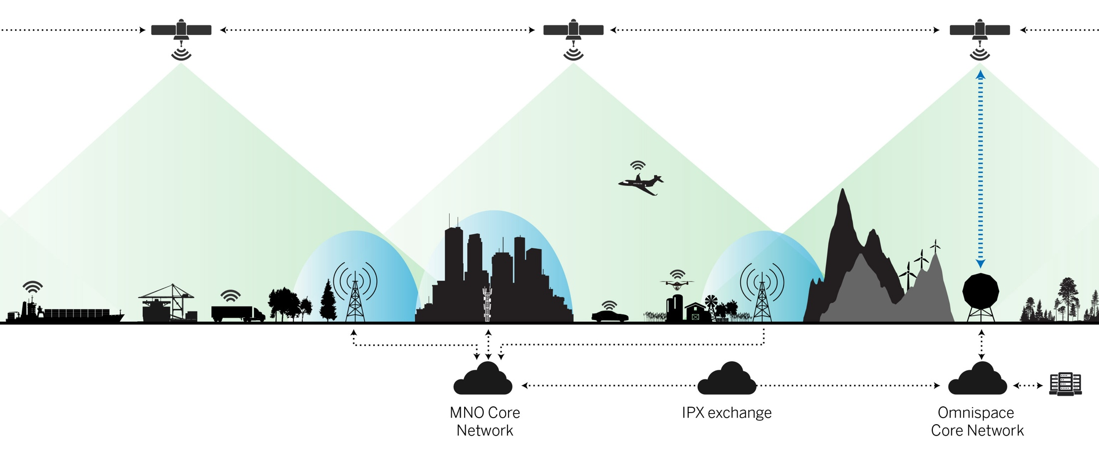
Omnispace Enables Ubiquitous Mobile Connectivity
5G hybrid architecture combines global NGSO coverage and mobile network roaming
Terrestrial Network Operations
When the device is in the MNO’s terrestrial
coverage area it will connect to the MNO’s Network
Satellite Network Operations
If the device is outside MNO coverage or roaming outside of the “home network” it will connect through the Omnispace network

Slide 4




Enhancing Services for Existing MNO and IoT Customers
Services
Customers
Enterprise
Data
Voice
IoT
Consumer
Government
Global Voice & Data Communications for Consumer, Enterprise and Government Users
Notes:
Enterprise Value
-Subscribers
Revenue
Coverage
Margin
Omnispace is reimagining mobile satellite connectivity, offering a disruptive new solution that will enable innovative mobile devices, true mobility for assets on the move, and global coverage for challenging regions.
Beyond global coverage to deliver the mobile experience and enhanced functionality users desire.

Slide 5

Market Opportunities Beyond Imagination

Slide 6
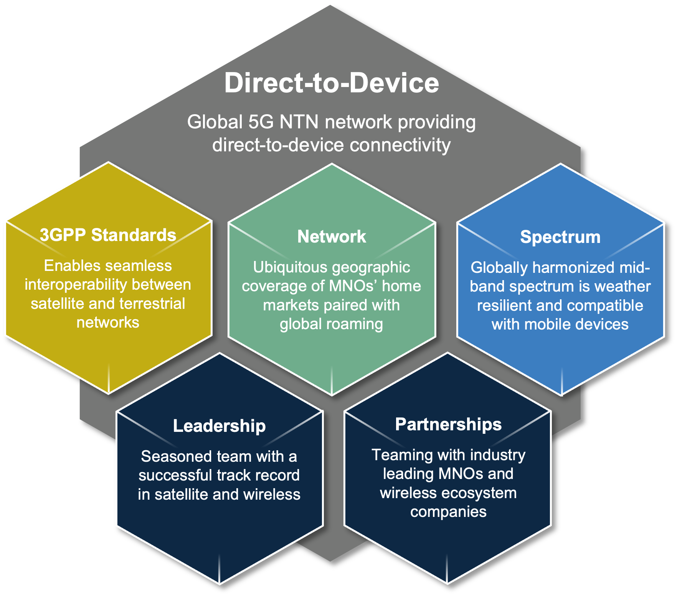


The Only Standards-Based Global 5G NTN Network

Slide 7


5G NTN Technology
3GPP is standardizing seamless interoperability between terrestrial and non-terrestrial networks (NTN)
  NTN is being developed as an enhancement to 5G standards
  Enables mobile devices to seamlessly roam
  between terrestrial and NTN networks
  The 5G NTN standard will support mobile
  broadband and IoT solutions
  NGSO network architectures are a primary
  focus of NTN standards activities
3GPP Release 17 (5G NTN Standard) to be published in 2Q22,
paving the way for commercial availability of NTN devices in 2023

Slide 8



5G NTN Device Ecosystem
User terminals will be able to utilize standard chipsets
leveraging economies of scale of the broader 5G ecosystem, lowering costs and expanding addressable markets
Omnispace’s S-band frequencies have been standardized at 3GPP (Band n256) and support 5G services globally
Omnispace’s frequencies are the baseline for 5G NTN analysis at 3GPP (sub-6GHz), and can be supported with no hardware changes in 5G chipsets

Slide 9























Omnispace Mid-Band Spectrum is Ideal for NTN Operation
Low Band
Mid-Band
High Band
600 MHz
900 MHz
1.7 GHz
2.2 GHz
2.3 GHz
5.8 GHz
600 MHz
700 MHz
Cellular
GSM 850
PCS
MSS 2 GHz
AWS
WiFi 2.4
2.6 GHz
WiFi 5
SMR
GSM 1800
IMT 2000
UMTS
WCS
BRS/EBS
CBRS
NGSO
Constellation
Omnispace’s NGSO Satellite Network*
2 GHz S-band
Service Links
Rural/Remote
Public Safety
MSS
MNO Partner’s Cellular Network
Feeder Links
IoT
CGC
Maritime
MSS & IoT
Gateway Network
Mobile Broadband & MVNO CGC
Connected Car
MSS/CGC
*Omnispace’s NGSO satellite network delivers direct-to-device connectivity to augment the performance of partner MNOs” cellular networks
Connected Car
CGC/MSS

Slide 10

@Omnispace
Omnispace.com
Shahrokh Khanzadeh-Amiri
Email: samiri@omnispace.com
Mobile: +447393533137

