Slide 1


Climate Change Agreement for techUK
Note 16: Data centre CCA eligibility
August 2021
Introduction
The data centre market in the UK can be split roughly into two sub-sectors: colocation and enterprise. Colocation, or “colo” operators provide the infrastructure – security, constant electricity supply, broadband connectivity and an environment in which temperature and humidity is controlled to suit servers. They then sell or lease space within those specialised facilities to companies who install and manage their own IT equipment. The term colocation comes from the fact that these customers share or “co-locate” their IT operations in one purpose built facility.
Enterprise operators are those who use their data centre provision for their own purposes – i.e. for their own corporate IT functions (in the case of banks and supermarkets and government departments). Enterprise data centre operators may build their own data centre facilities or locate their data centres within colo facilities – Many companies do both. Some companies operate enterprise data centres but also sell some colo space to other companies, and this is a logical option for enterprise operators who find themselves with spare capacity.
Energy Intensity criteria:
The criteria for data centre sector inclusion in the CCA scheme is on the basis of energy intensity. The sector had to show that the value of energy used is >= 3% of production value PROVIDED they meet an import penetration test of 50% or more. Otherwise they show the energy used is >=10% of production value (essentially turnover). The latter calculation was applied as the former is difficult to calculate.
Generally, this test of energy intensity only had to be met once for the sector as a whole. After that anyone who carries out the same activities is deemed eligible. Enterprise data centres couldn’t show that the energy used in the data centre is >=10% of the production value (turnover) just for the data centre, i.e. not including any of their other business activities, as they don’t treat their data centres as businesses in their own right.
For this reason, there needs to be a contract with a third party for white space and/or IT equipment, with turnover, to meet the sector eligibility criteria. The next page contains a simple ‘decision tree’ to check eligibility.
Climate Change Agreement for techUK Page 1 of 3 Data centre CCA eligibility

Slide 2
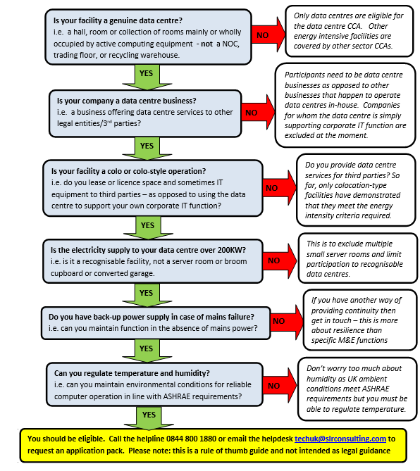
CCA Decision Tree
The Climate Change Agreement for data centres is currently restricted to data centre businesses operating colocation or colocation style facilities that serve third parties. Dividing the sector in this way has created confusion. If you are taking over ownership of a data centre holding a CCA this simple decision tree should help you establish whether your facilities are still eligible to remain in the scheme.
Climate Change Agreement for techUK Page 2 of 3 Data centre CCA eligibility

Slide 3
For further information please contact SLR’s techUK CCA helpdesk:
+44 (0)844 800 1880
techUK@slrconsulting.com
or visit www.techuk.org/developing-markets/data-centres.html
The full suite of techUK CCA Guidance Notes are listed below and can be accessed via contacting the helpdesk or visiting the website.
Guidance Note | Title
1 | What is a CCA
2 | Transferring Ownership of a CCA
3 | techUK CCA Administration Charges
4 | Completing HMRC PP10 and PP11 Forms
5 | Timetable of techUK CCA Activities
6 | Obligations under your CCA including audits
7 | Reporting data at each Target Period
8 | How CCAs interact with other schemes
9 | Glossary and Abbreviations
10 | What happens if...
11 | Submetering and base year
12 | Measuring Generator Fuel
13 | State Aid Transparency reporting
14 | Penalties for non compliance
15 | Application Documentation
16 | Data centre CCA eligibility
Climate Change Agreement for techUK Page 3 of 3 Data centre CCA eligibility

