Slide 1

Exploring whether D2D MSS can share terrestrial IMT spectrum
October 2023

Slide 2
What is on the agenda?
Who is Access Partnership?
What is D2D satellite service?
D2D MSS and terrestrial IMT coexistence in the same band

Slide 3

Who is Access Partnership?
6
140+
LONDON
WASHINGTON
BRUSSELS
ABU DHABI
Offices worldwide allow us to offer both a global and local perspective
Employees with deep understanding of areas ranging from policy to legal and engineering
SINGAPORE
200+
35
JOHANNESBURG
jurisdictions where we devise strategies to
overcome technical, regulatory, and political barriers
The number of languages – from Arabic to Mandarin – spoken by our teams

Slide 4






About Access Partnership
Experts in regulatory and technical affairs.
Spectrum leaders at ITU
Global footprint
Multidisciplinary research
Unique experience in managing D2D projects

Slide 5
What is Direct-to-device (D2D) satellite service?

Slide 6
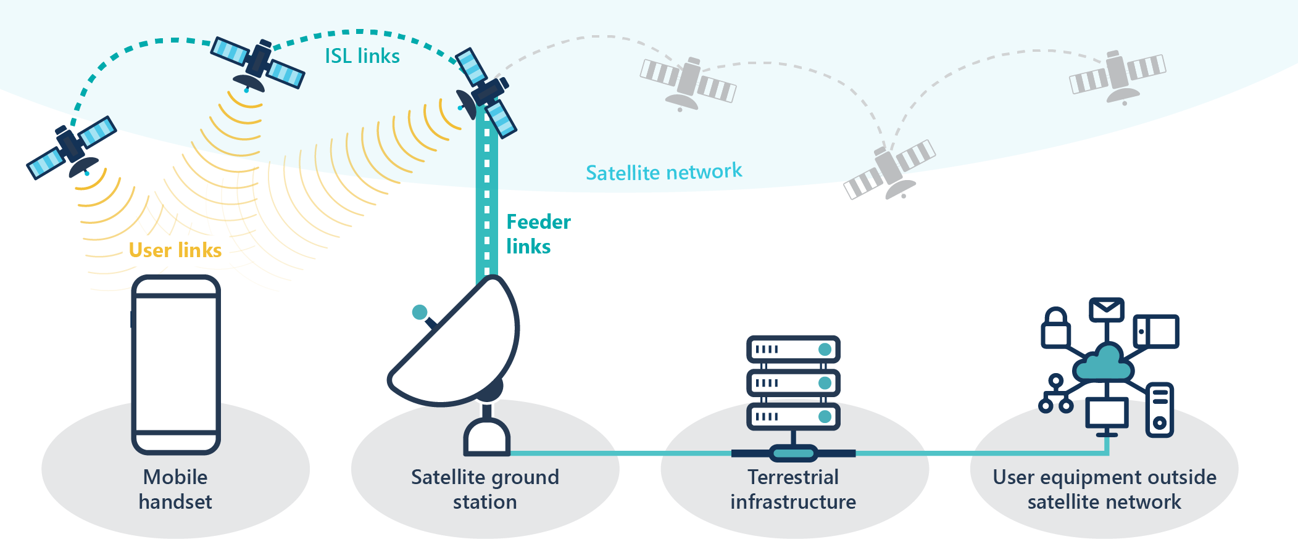
The Future of Smartphones: Direct-to-Device (D2D) satellite services
Dubbed direct-to-device, this new paradigm brings satellite capability to devices
The impact of the emerging D2D market goes beyond just connecting people.
It has the power to transform economies, boost GDP, and increase productivity.
The communication journey in a D2D context follows:
a user initiates communication via satellite
the satellite relays the transmission to a ground station; which
processes and routes it to a global destination.

Slide 7




What you need to know about D2D satellite service?
Providing complemental coverage when devices are out of cellular coverage
Important Considerations
  Achieve Universal Coverage by complementing terrestrial IMT coverage
  Deployment compliant with ITU RR
  NGSOs and frequency bands <3 GHz fit better for D2D
  Ensure non-interference through studies
  Importance for global connectivity goals

Slide 8
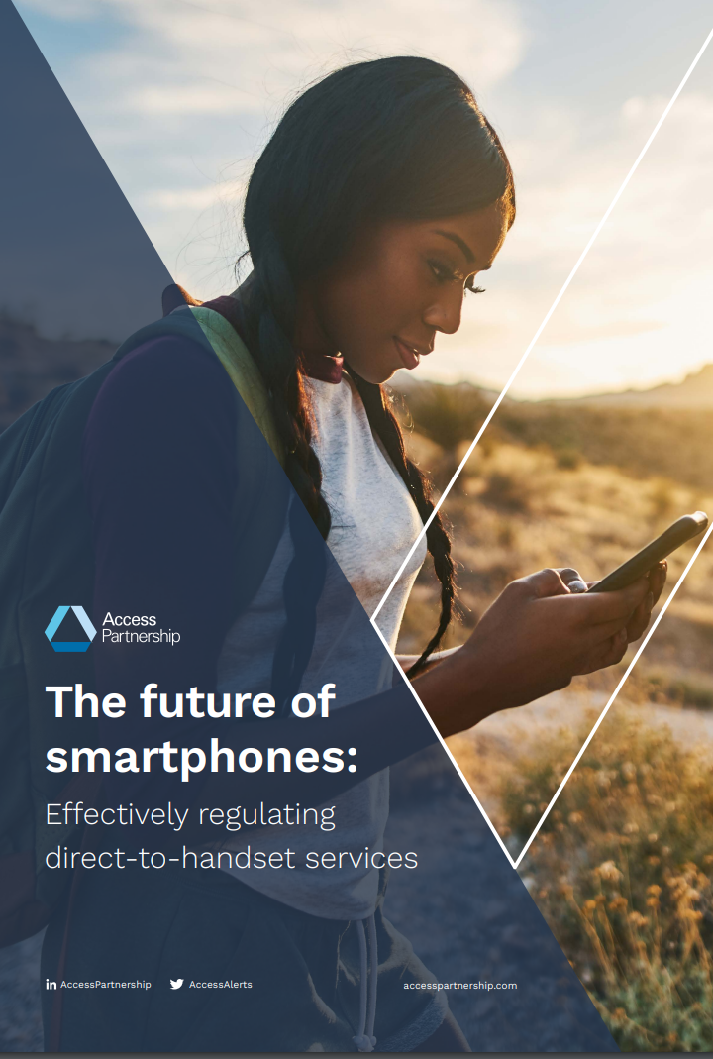
The D2D Opportunity
Access Partnership conducted extensive research around this technology
Public Value & Decentralization: accessible and affordable connectivity.
Extending connectivity for governments and the private sector in various use cases.
Key Finding
enhanced D2D services require additional spectrum (MSS)
Disaster Response & Recovery: Saving lives through supplemental emergency services connectivity.
Link to the document

Slide 9
D2D MSS and terrestrial IMT coexistence in the same band

Slide 10
How to achieve coexistence?
Satellites could deploy dynamic spot beams with ability to turn on and off
Use steeper roll-off from the boresight of the satellite antenna to decrease sidelobe interference and increase resilience to interference
Dynamic frequency management could be considered
Actual activity factor and polarization difference should be used in coexistence assessment
Mobile phones activate/request satellite connectivity only when out of coverage of terrestrial IMT and WiFi
Mobile phones should have the capability to deactivate the satellite connectivity function in unauthorized country (geofencing)
MNOs and satellite operators should work closely in attempt to avoid using the bands allocated for D2D MSS for terrestrial IMT in rural areas where coverage overlap more likely to take place. Sharing network planning information may be necessary to improve coverage and coexistence.

Slide 11
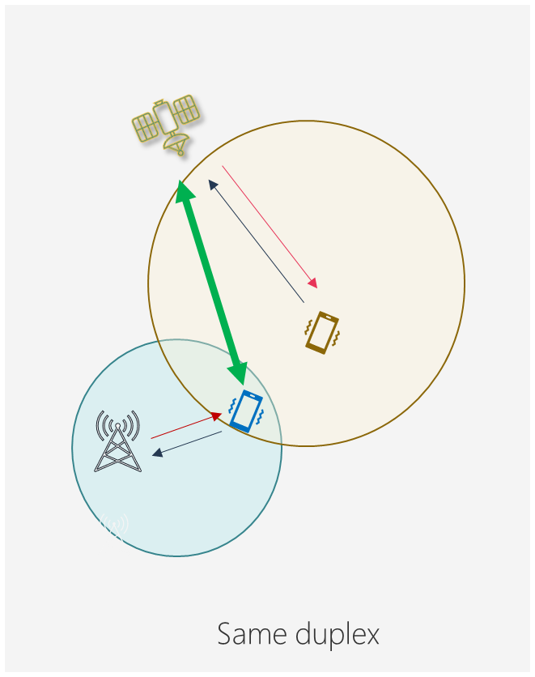
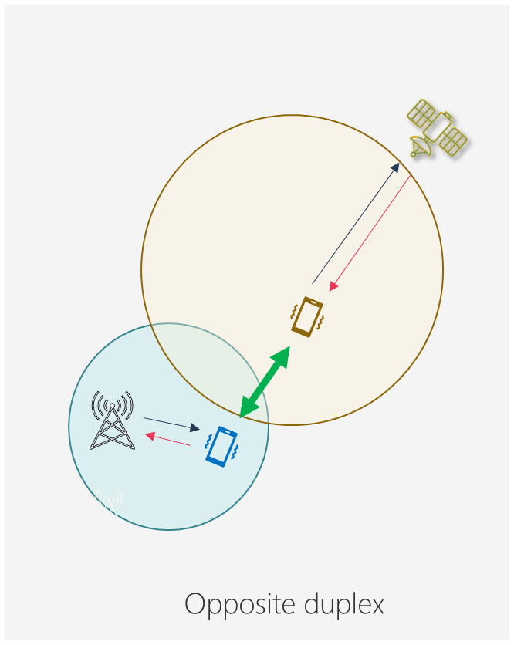
Reverse duplex operation could minimise the geographical spacing needed between terrestrial and satellite usage
If the same direction of transmission is used the key interference is from satellite downlink into the cellular handset receiving terrestrial downlink
For the opposite direction interference is from a handset transmitting to the satellite interfering with a handset receiving terrestrial transmission
Handset-handset interference is generally limited by terrain and relatively low transmit power levels allowing operation closer to the edge of coverage

Slide 12
Thank you!
Q&A
Tural Aliyev
Senior Engineering Manager
tural.aliyev@accesspartnership.com
accesspartnership.com
@AccessPartnership

Slide 13

North America
Washington DC
Europe
London
Brussels
Middle East
Abu Dhabi
Africa
Johannesburg
Asia-Pacific
Singapore
Suite 512
1730 Rhode Island Ave N.W.
Washington DC 20036
USA
Tel: +1 202 503 1570
washingtondc@accesspartnership.com
4th Floor, The Tower
65 Buckingham Gate
London, SW1E 6AS
UK
Tel: +44 (0) 20 8600 0630
london@accesspartnership.com
Square de Meeûs 37
4th Floor
B-1000 Brussels
Belgium
Tel: +32 (0)2 791 79 50
brussels@accesspartnership.com
Al Wahda City Tower, 20th Floor
Hazaa Bin Zayed The First Street
PO Box 127432
Abu Dhabi, UAE
Tel: +971 2 815 7811
abudhabi@accesspartnership.com
119 Witch-Hazel Avenue
Highveld Technopark
Johannesburg
Gauteng, South Africa
Tel: +27 72 324 8821
Asia Square, Tower 2
#11-01
12 Marina View
Singapore 018961
Tel: +65 8323 7855
singapore@accesspartnership.com

