Slide 1
ROV research brief Dave Hodges 29th April 2025

Slide 2
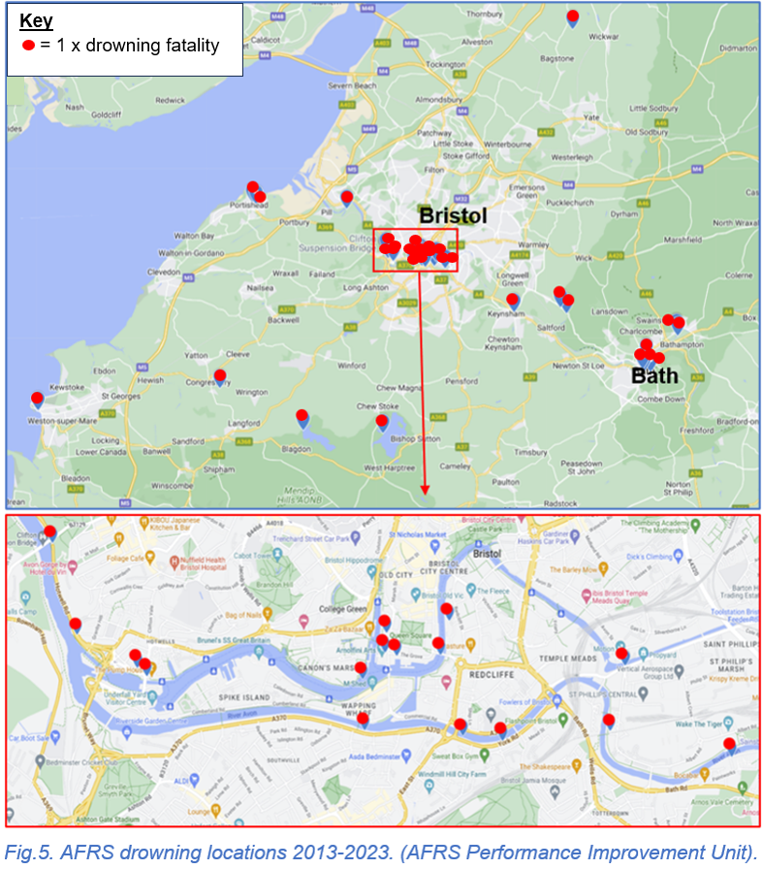
Avon FRS water incidents 2014-2021
- 297 water rescue incidents - 90.9% in inland waterways - 33 accidental fatalities.

Slide 6
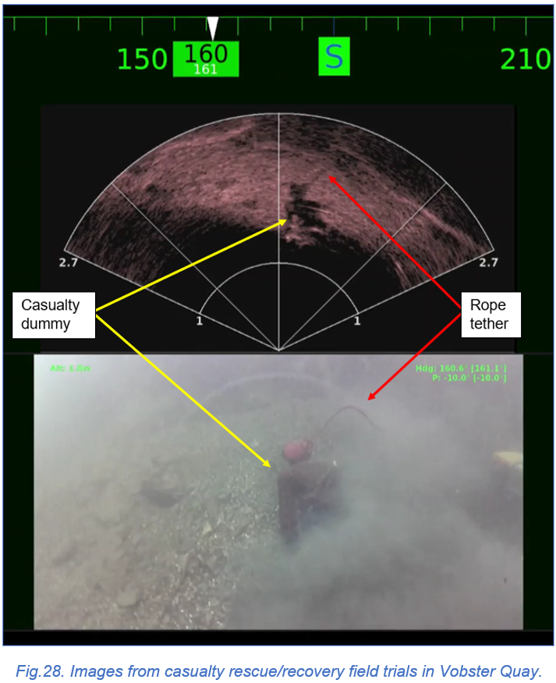
Sonar
- Manikin at 12m depth - Split screen sonar and HD camera - Child size manikin clothed.

Slide 7
Any questions...?

