Slide 1


Climate Change Agreement for techUK
Note 08: How CCAs interact
with other schemes
August 2021
Carbon and Energy Policies
Climate Change Agreements (CCAs) are just one of a suite of carbon and energy policies introduced by the UK Government to reduce energy consumption and hence carbon emissions. CCAs are one of the ‘oldest’ policies having been introduced in 2001 when the Climate Change Levy (CCL) was introduced. Since 2001, a number of other carbon and energy reporting schemes have been introduced. In recent years, the Government has tried to prevent overlap between the schemes, however, there remains complex interactions between the schemes.
The purpose of this guidance note is to summarise the other schemes and explain what companies with a CCA need to know about them. The table below provides a high level overview of four government policies where energy and carbon data is collected and reported upon. A fifth scheme ‘CRC’ concluded in March 2019 and detail on this is contained later in this note
* A large enterprise is classed as a company that has ‘more than 250 employees’, or, ‘a turnover exceeding €50m and a balance sheet exceeding €43m’.
Climate Change Agreements | CCAs are voluntary and only available to sites undertaking an ‘eligible’ process. A company agrees to reduce the energy consumption or carbon emissions at the site in return for both a discount on the Climate Change Levy and for that energy to be exempted from the Carbon Reduction Commitment.
EU/UK Emissions Trading Scheme | EU ETS was mandatory for all sites undertaking specific processes or having a large amount of combustion equipment. EU ETS was a ‘cap and trade’ scheme; i.e. a site is set a cap on the CO2e it can emit and if it was over that allowance it needed to secure more allowances in a trading market to cover its actual emissions. Following Brexit, EU ETS is now replaced with UK ETS, with exception of Northern Ireland electricity generators which remain in the EU ETS by virtue of the Ireland / Northern Ireland Protocol.
Energy Savings Opportunity Scheme | ESOS is mandatory for any organisation that contains at least one company that is classed as a ‘large undertaking’*. A qualifying organisation must measure their buildings and vehicle energy use over a 12 month period and assess the potential for energy savings across at least 90% of the total energy consumption.
GHG Director’s Report | All FTSE XXX companies must calculate their Greenhouse Gas (GHG) emissions in tonnes carbon equivalent (CO2e, also known as their carbon footprint) annually and include in their Director’s Report. The CO2e emissions cover all sources of greenhouse gases (e.g. energy, transport, waste, refrigerants, agriculture, etc).
Climate Change Agreement for techUK Page 1 of 4 How CCAs interact with other schemes

Slide 2
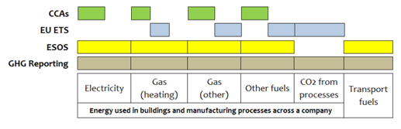
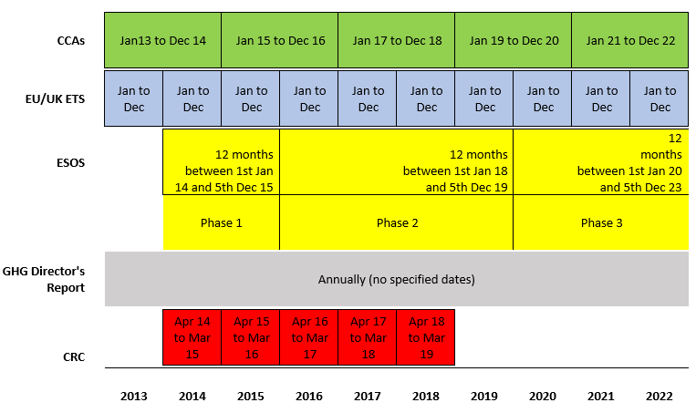
Overlaps between the policies
The diagrams below illustrates for a typical company which energy sources are reported under each scheme.
As illustrated above, energy covered by a CCA should not also be reported in UK/EU ETS, but it could also be included in ESOS or a GHG report.
Other differences
The five schemes highlighted also use different reporting years as illustrated by the diagram below.
Climate Change Agreement for techUK Page 2 of 4 How CCAs interact with other schemes

Slide 3
Carbon Reduction Commitment
Further information
If you, or think you could be, affected by the other carbon and energy policies, please find links below to accessing further information or please do not hesitate to contact the CCA Help Line as we are knowledgeable about many of these schemes.
CCAs
https://www.gov.uk/climate-change-agreements--2
CRC
https://www.gov.uk/crc-energy-efficiency-scheme-qualification-and-registration
UK ETS
https://www.gov.uk/government/publications/participating-in-the-uk-ets/participating-in-the-uk-ets
EU ETS
https://www.gov.uk/participating-in-the-eu-ets
ESOS
https://www.gov.uk/energy-savings-opportunity-scheme-esos
GHG Reporting
https://www.gov.uk/government/publications/environmental-reporting-guidelines-including-mandatory-greenhouse-gas-emissions-reporting-guidance
The government is looking to simplify this policy landscape and if there are consultations relevant to techUK CCA companies we will make you aware of them via a news email.
Climate Change Agreement for techUK Page 3 of 4 How CCAs interact with other schemes

Slide 4
For further information please contact SLR’s techUK CCA helpdesk:
+44 (0)844 800 1880
techUK@slrconsulting.com
or visit www.techuk.org/developing-markets/data-centres.html
The full suite of techUK CCA Guidance Notes are listed below and can be accessed via contacting the helpdesk or visiting the website.
Guidance Note | Title
1 | What is a CCA
2 | Transferring Ownership of a CCA
3 | techUK CCA Administration Charges
4 | Completing HMRC PP10 and PP11 Forms
5 | Timetable of techUK CCA Activities
6 | Obligations under your CCA including audits
7 | Reporting data at each Target Period
8 | How CCAs interact with other schemes
9 | Glossary and Abbreviations
10 | What happens if...
11 | Submetering and base year
12 | Measuring Generator Fuel
13 | State Aid Transparency reporting
14 | Penalties for non compliance
15 | Application Documentation
16 | Datacentre CCA eligibility
Climate Change Agreement for techUK Page 4 of 4 How CCAs interact with other schemes

