Slide 1
Data Challenges in the Fire Service
Tim Bartlett
Analytics Manager
Performance and Analytics
timothy.bartlett@essex-fire.gov.uk

Slide 2
Identifying Risks: A Data Gap
Limited Data Access
Data silos across departments, agencies and Fire and Rescue Services
Data sharing between public and private sectors
Data availabilty
Information on demographics, housing and vulnerabilities
Data often outdated, missing or inaccurate

Slide 3
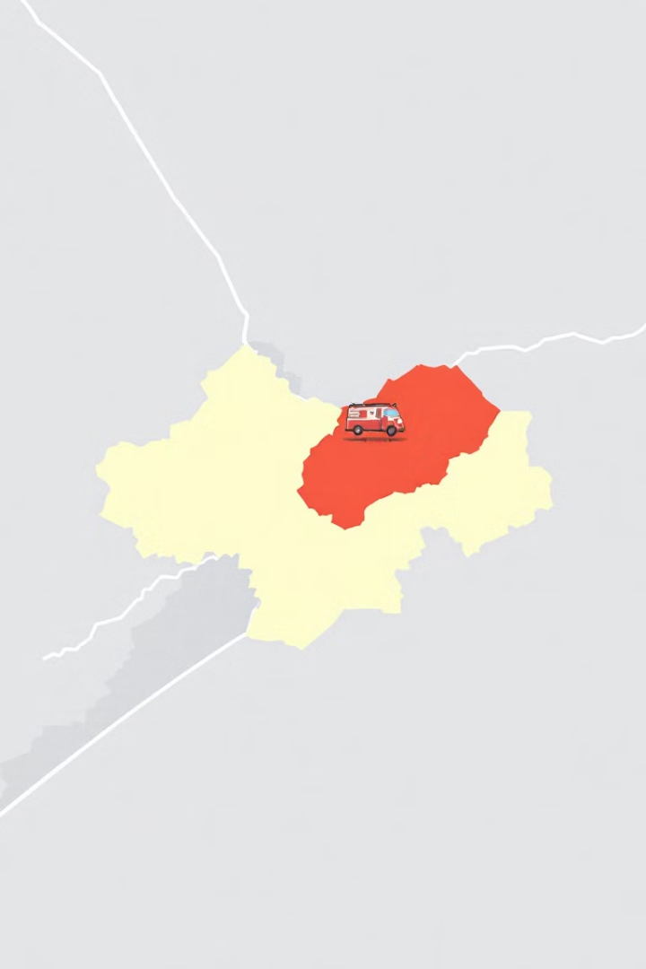
Improved Resource
Allocation
Identify High Risk Areas
Proactive Risk Mitigation
Mapping vulnerable residents based on age, health conditions, and socioeconomic factors
Tailoring prevention advice, programs and resources to specific needs
Deploying fire crews and resources efficiently
Data-driven Insights

Slide 4
Data-Driven Response and Analytics
Real-Time Incident Analysis
Predictive Analytics
Identifying potential areas of risk and predicting future incidents
Analysing live data during incidents to optimise response strategies
Response Time Optimisation
Improving the speed and efficiency of incident response

Slide 5
Partnerships for Enhanced Capabilities
Data Integration
Analytics Expertise
Technology Solutions
Connecting data sources from fire service, public sector partners and private sector
Leveraging expertise in data analytics, predictive modelling and AI
Exploring innovative tools for data management, incident response and community safety

