Slide 1
An INTRODUCTION to the

Slide 2
Introduction

Slide 3
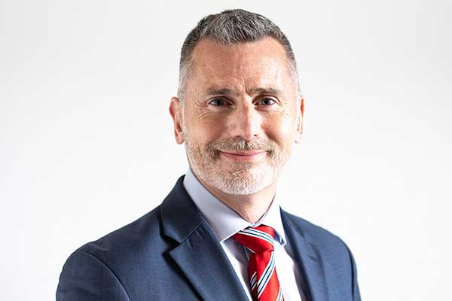
Mission & Vision
“Our mission is to ensure that robotic and connected autonomous systems, their software, and their communications are safe”
- Professor Miles Elsden, Director of the Institute for Safe Autonomy.
LAND | SEA | AIR

Slide 4
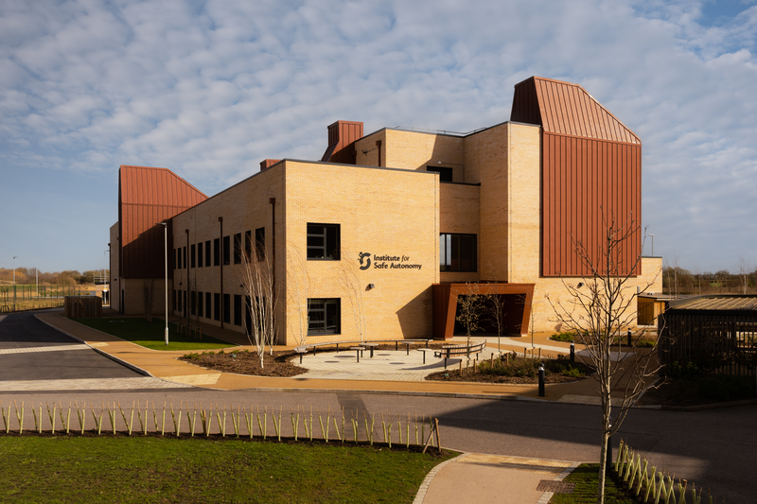
Key Facts & Figures
£15M purpose built ‘Living Lab’ with dedicated Solar Farm
£10.5M UK Research Partnership Investment Fund (RPIF) investment
>£50M programme in total
Circa 3,000 m² over 3 floors
Construction completed Summer 2022
Space for over 100 researchers
Researchers from physics, engineering, computer science, business and management, law and philosophy

Slide 5
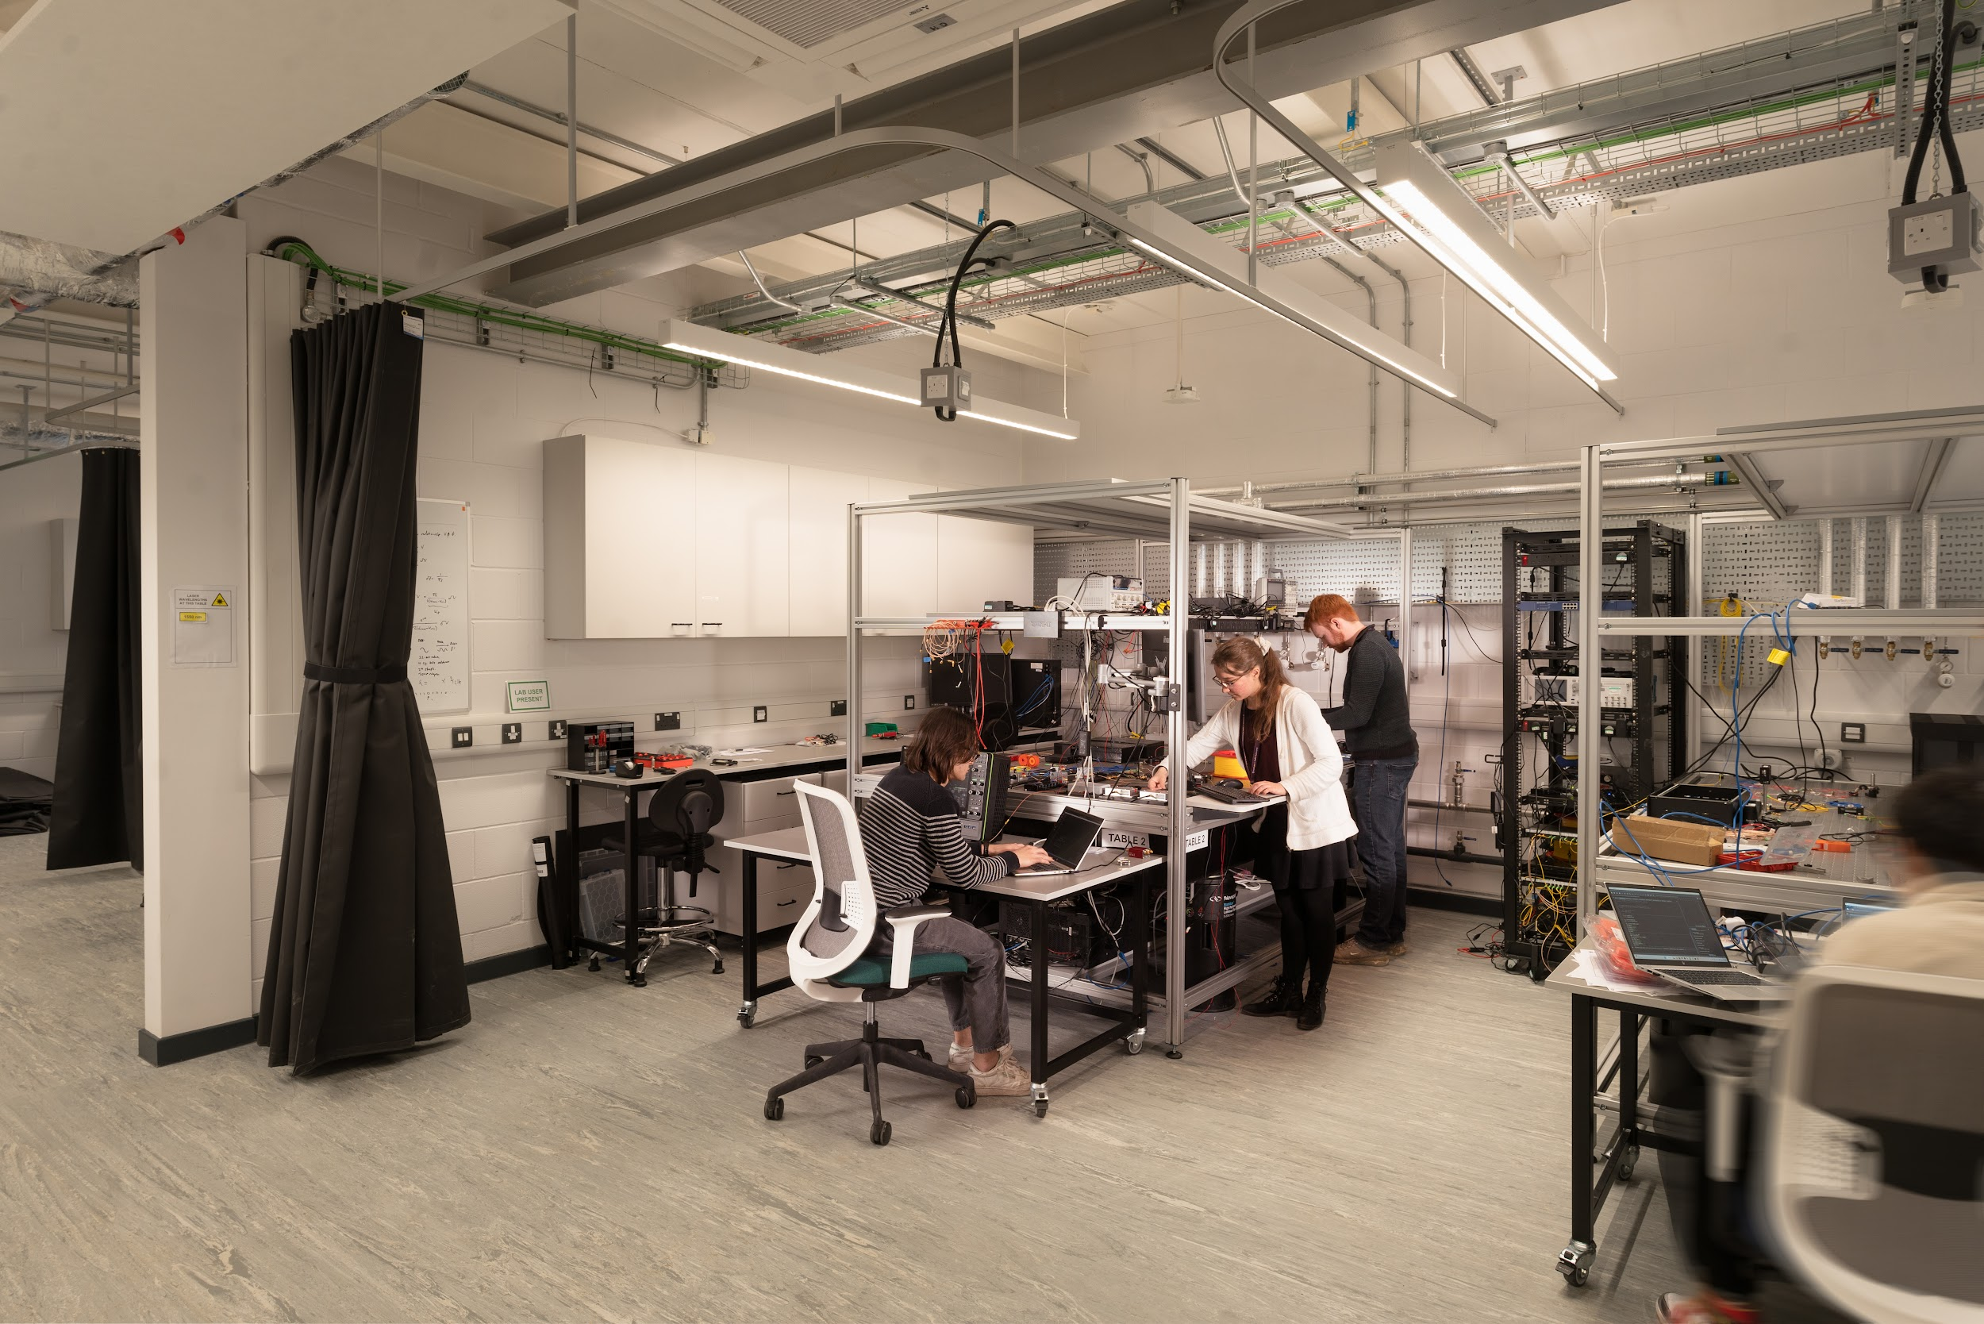
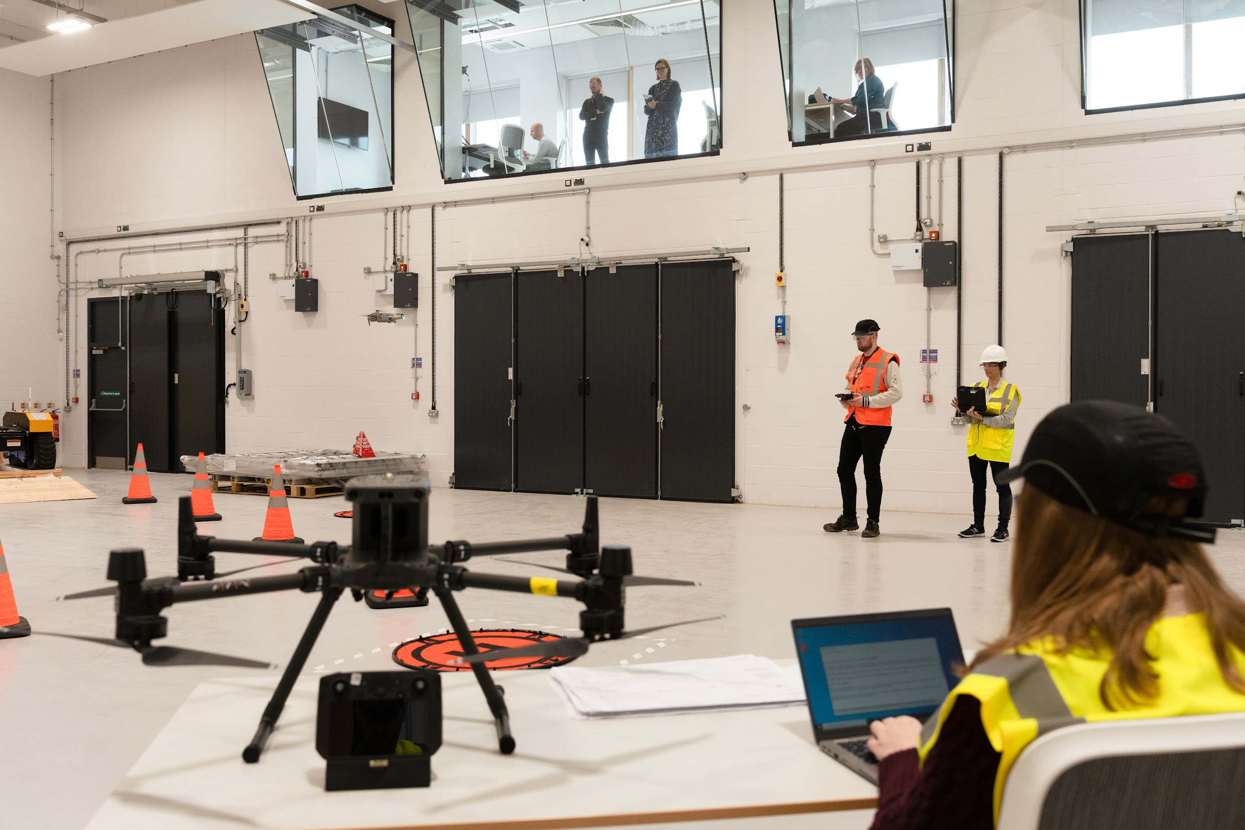
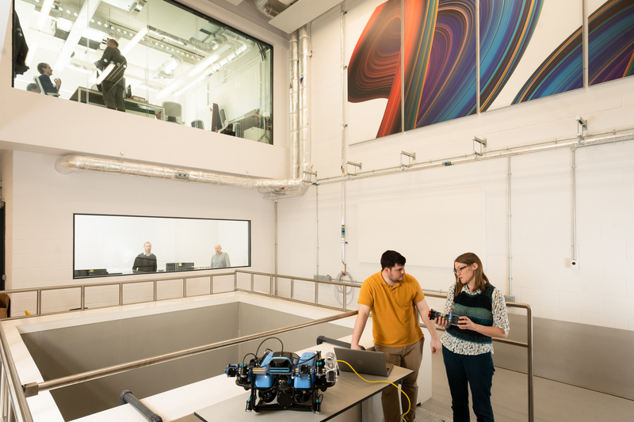
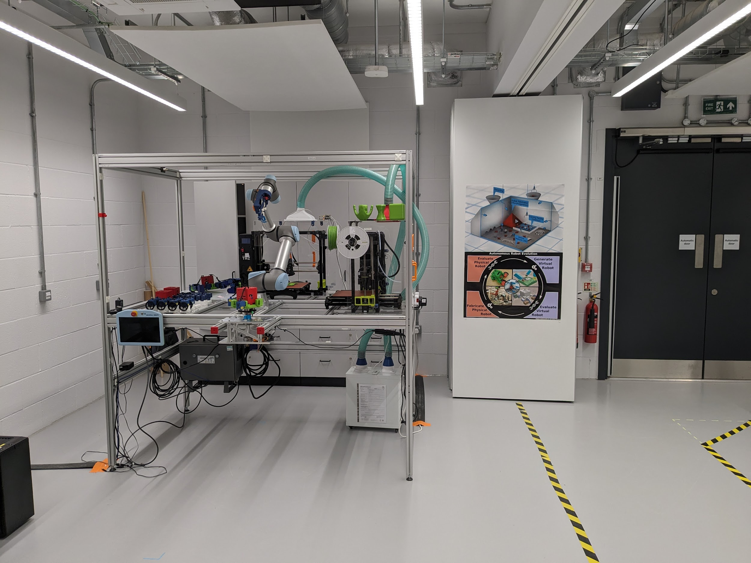
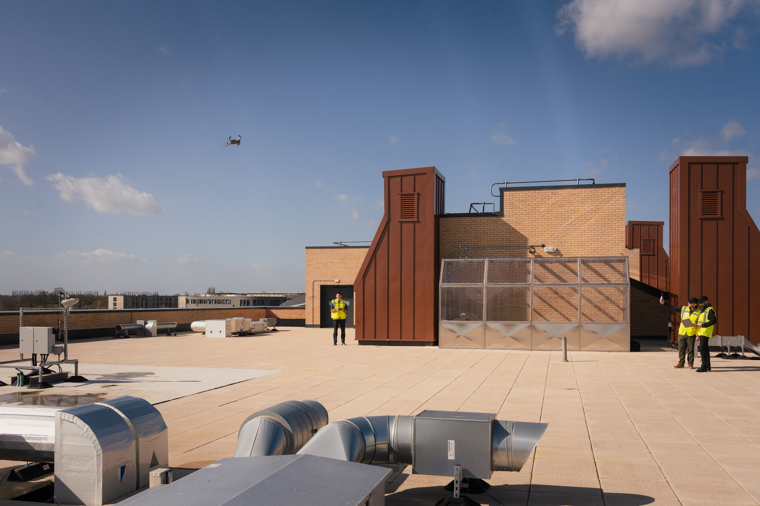
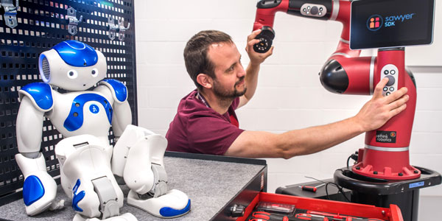
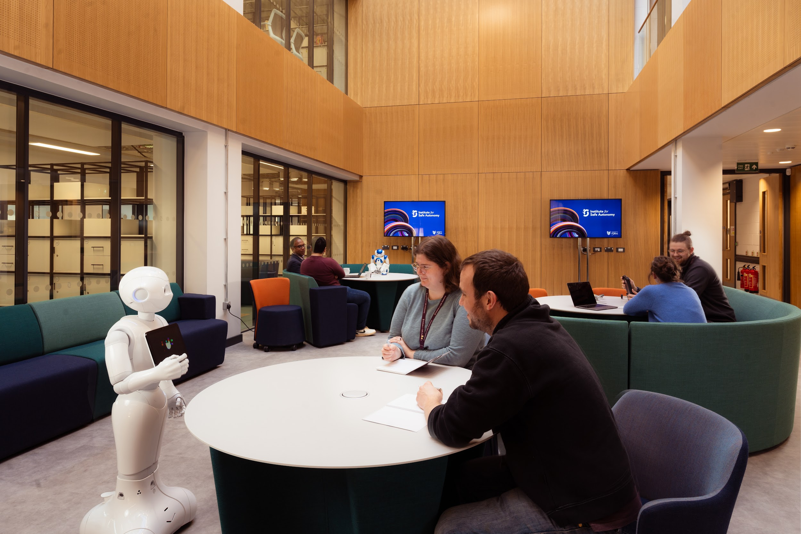
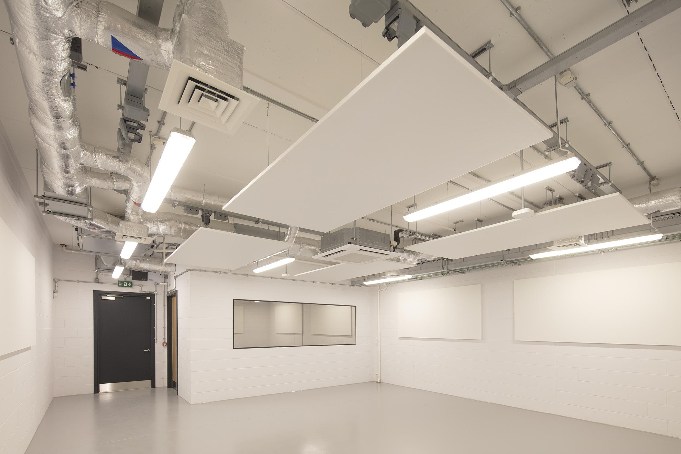
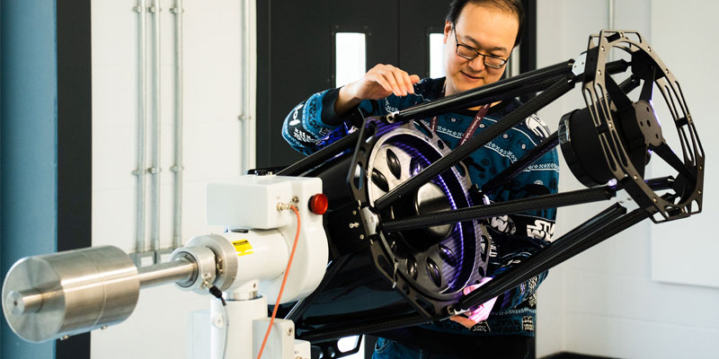
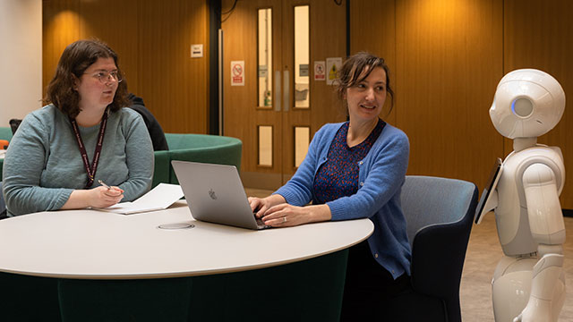
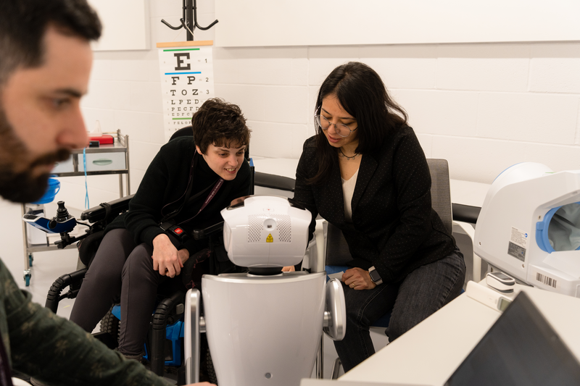
Facilities
Quantum communications lab
Test Space 1 - >300m²
Underwater lab - 18,000L tank
Robot labs
High Altitude Platform lab
1,400m², 200kW Solar farm
Technical Support facilities
Collaboration & Meeting space

Slide 6
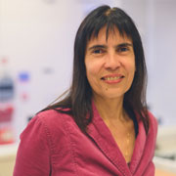
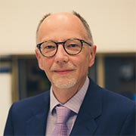
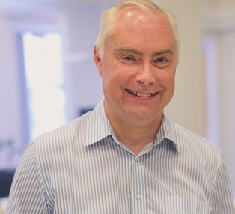
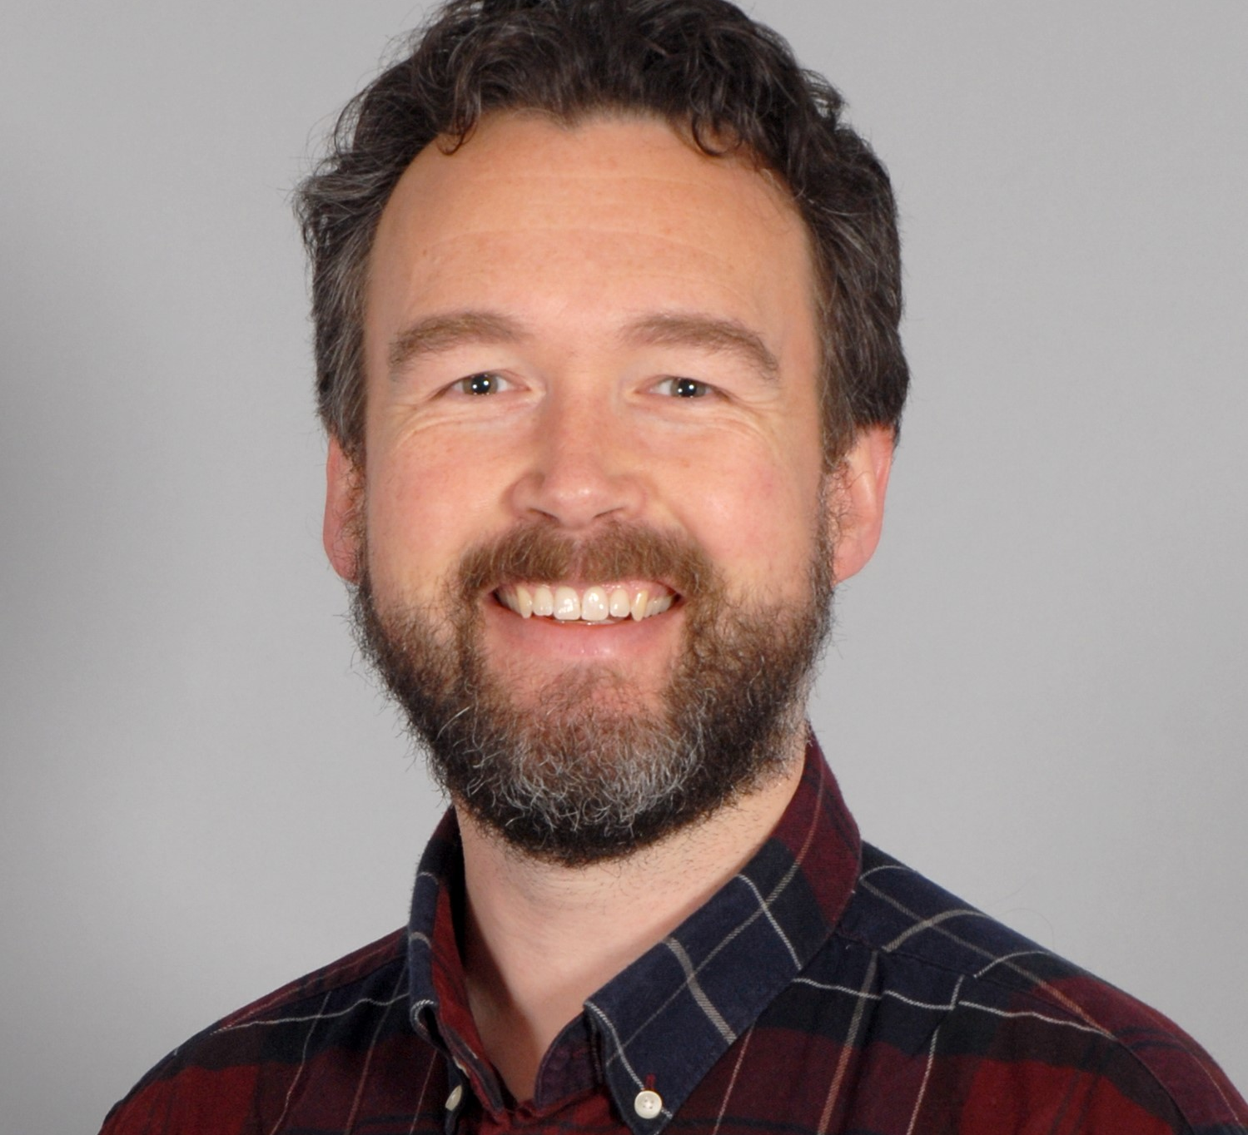
Research pillars
Design and Verification: design and verify safety-centred software and hardware, and ensure complex autonomous systems can be trusted in challenging environments
Assurance: evaluate, assure and manage the safety of autonomous systems, as they increasingly employ methods, such as AI
Communications: resilient communications systems and architectures for challenging environments - from array-based antennas to quantum technologies.
Society & Ethics: ensuring the deployment of complex autonomous systems is ethically sound, safe and socially acceptable
SAINTS - AI Centre for Doctoral Training: The UK’s only Centre for Doctoral Training in Safe AI

Slide 7
Thank you
John frankland
Senior Business Development Manager
Email: john.frankland@york.ac.uk
Tel: +44 (0)1904 3245022
Web: www.york.ac.uk/safe-autonomy/
LinkedIn: www.linkedin.com/company/uoyisa/

