Slide 1


Innovate UK
The UK’s innovation agency
Where are the women in the UK semiconductor sector?
Pathways for careers in semiconductors
Nuala Kilmartin

Slide 2

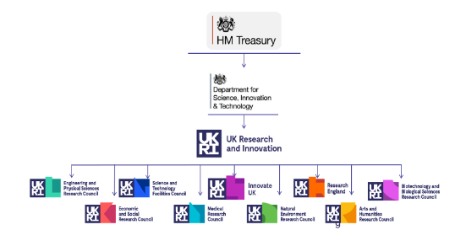

We are the UK’s innovation agency
As part of UK Research and Innovation (UKRI), Innovate UK is publicly funded
to drive innovation and productivity across the UK.
We work for you to create a better future by inspiring, involving and investing in businesses developing life-changing innovations.

Slide 3



A typical Innovate UK backed business raises
Our purpose
>30%
We drive productivity and economic growth by supporting businesses to develop and realise the potential of new ideas, including those from the UK’s world-class research base.
We connect businesses to the partners, customers
and investors that can help turn these ideas into commercially successful products and services, driving productivity, and supporting business growth.
more money
from the
private sector
Than similar businesses. Since 2007
Direct
business
benefit
£3.61
Our mission is to enable the creation and adoption of innovation across the UK.
For every £1 invested
Over a seven-year period. Based on the
most recent independent evaluation.

Slide 4
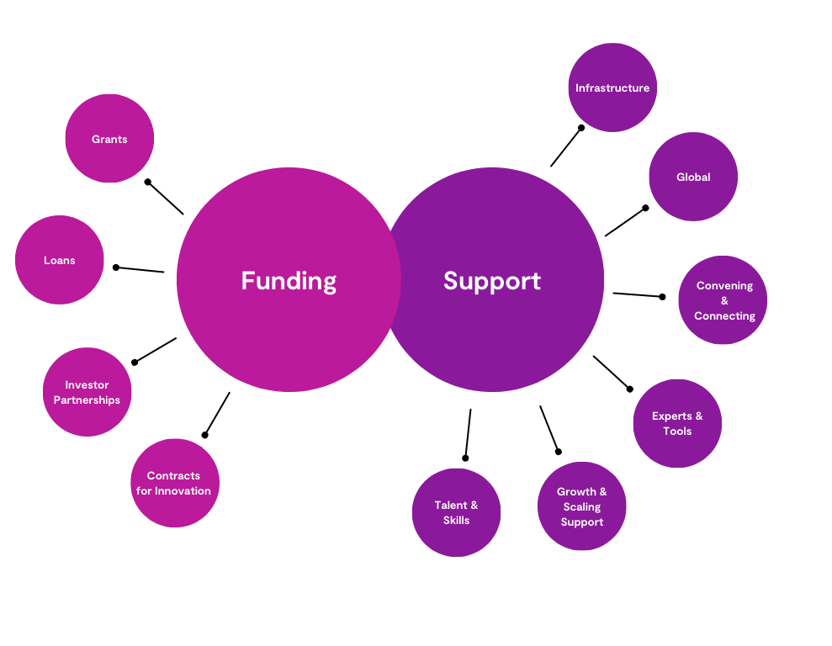











Funding & Support

Slide 5




Innovate UK established nine Catapults and
co funds them to provide a unique combination of
world-leading expertise facilities, and equipment to support business innovation and growth.
Notes:
A strong regional presence - From funding and advisory services to facility and technology access, Innovate UK and our partners offer innovation support to businesses everywhere in the UK.

Slide 6

Strategic Imperative
The UK semiconductor sector is fundamentally important to the nation's future, and addressing workforce challenges is
a strategic necessity.

Slide 7
Our Mission is Clear
Securing a robust “talent pipeline” is crucial for growing the UK Economy
Early Targeted Outreach of STEM Education
Mentorship & Sponsored Programmes
Revamp our Educational Ambition
Showcased Success Stories with viable Role Models
Encourage provision of Technical Upskilling and Leadership Programmes
Address Recruitment Practices
Review Workforce Polices

Slide 8
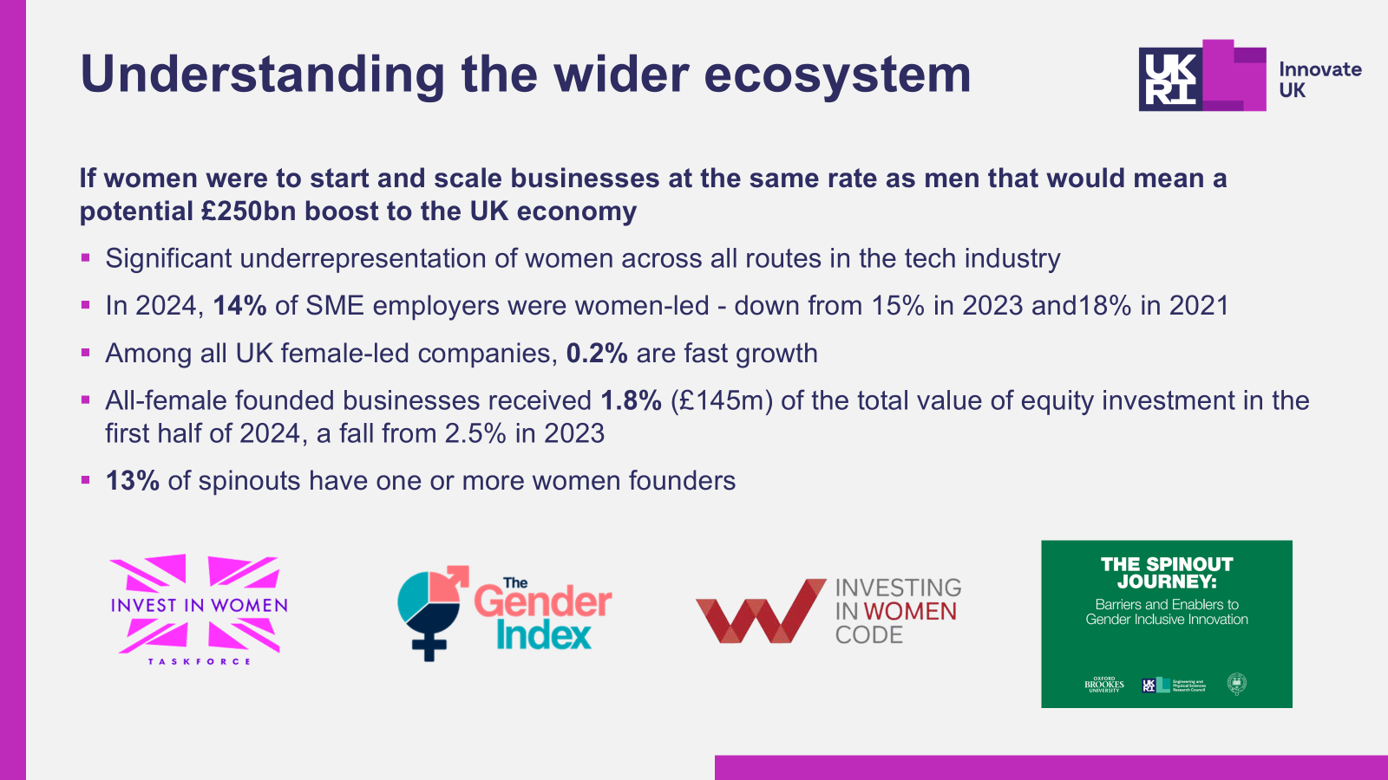
Understanding the Wider Ecosystem

Slide 9
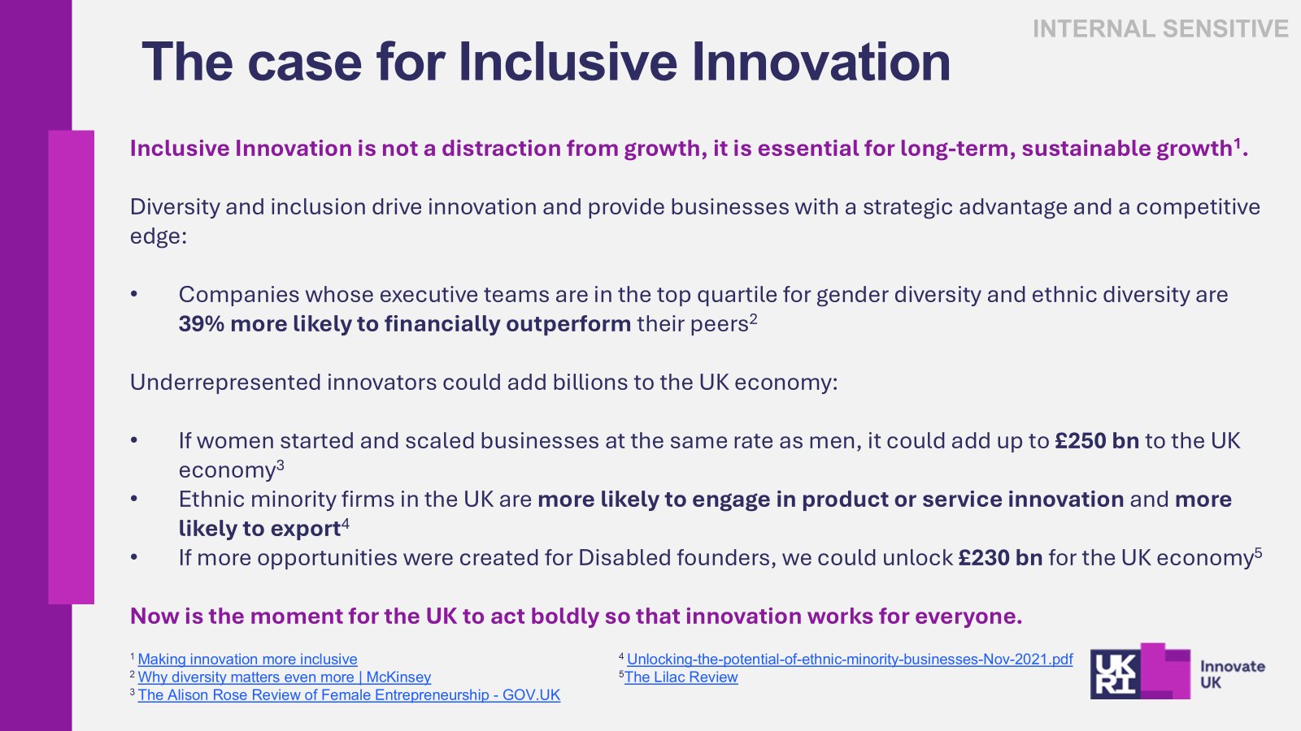
The Case for Inclusive Innovation
Inclusive Innovation is not a distraction from growth, it is essential for long-term, sustainable growth.
Companies whose executive teams are in the top quartile for gender diversity and ethnic diversity are 39% more likely to financially outperform their peers.
Ethnic minority firms in the UK are more likely to engage in product or service innovation and more likely to export.
If more opportunities were created for Disabled founders, we could unlock £230 bn for the UK economy.
Diversity and inclusion drive innovation and provide businesses with a strategic advantage and a competitive edge:
Now is the moment for the UK to act boldly so that innovation works for everyone.
Notes:
Underrepresented innovators could add billions to the UK economy

Slide 10


Women in Innovation Programme
…..catalyst for change
WE COMMIT TO CREATE OPPORTUNITIES FOR WOMEN INNOVATORS
WE COMMIT TO HOLD OURSELVES TO ACCOUNT
WE COMMIT TO ACCELERATE THE START-GROW-SCALE JOURNEY FOR WOMEN-LED BUSINESSES
WE COMMIT TO IMPROVE THE CLARITY AND CONSISTENCY OF OUR APPLICATION PROCESSES
WE COMMIT TO TRANSFORM HOW WE ASSESS APPLICATIONS
Our commitments represent our ongoing effort to empower women innovators and improve access to investment.
Notes:
The commitments include making improvements to the Women in Innovation Awards, our application and assessment processes and setting ambitious goals and specific measures for inclusion and representation in our future strategy. Focus on three of the high growth sectors in the Industrial Strategy and late stage start-ups with high potential to scale)

Slide 11
Thank you

