Slide 1


Slide 2
Creation
Call from UKSA Autumn 2020
Leeds University Bid
Supported by Leeds City Region LEP
Build the business case
Map the landscape – are we being ambitious enough?
Create an identity
Build the right team & the vision

Slide 3
Vision
Unlocking Space for the people and businesses of Yorkshire.
Connecting, promoting & guiding innovation.
Raising skills, raising aspiration.
Championing inclusion.
Delivering prosperity.

Slide 4





















Building the team
National
Virtual Space Campus
National government
Space Applications Catapult
High Value
Manufacturing
Catapult
.
Private Sector
4 LEPs
Regional
Private Sector
Private sector members representing the voice
of business across Yorkshire

Slide 5



Enabling technology with 3 key components
Upstream
Downstream
Skills
Notes:
Space Hub Yorkshire will look to enable Space technologies in the region with the three components below. Upstream mainly focuses on space manufacturing, downstream refers to space technologies that result in an application, product or service that benefits our everyday lives. Skills are an integral part of every sector and we look to increase the number of people within the industry, but also enhance their skillset through education, availability and guidance.

Slide 6
Why Space?

Slide 7

Astronomy
Frontier scientific discovery
Law & finance
Governance for space
Human Spaceflight
Exploring Space
Earth observation Watching over Earth with big data
Pioneering Technology
Advanced manufacturing
and instrument development
Downstream applications
Climate data services and the digital revolution
Flight control
Operating Spacecraft
Global Positioning Services
Navigating the Globe
Telecommunications Connecting the World
Rocket launch
Travelling to Space
Notes:
Cliché- but a the opportunities really are endless. You can see here the numerous applications for Space-related technologies, and this seems to be growing every year. As a cluster, we are now looking into the agri-tech opportunities for Space companies in the region, and vice versa – how those agri-tech companies can use their technology to support the development of the UK Space sector.
There are lots of ways companies that are sitting on the periphery of the space sector can get involved, and one of the most appealing is the funding opportunities. UKSA and ESA have lots of calls for funding that go live throughout the year and we’re able to help with applications and provide letter of support for applications if appropriate.

Slide 8

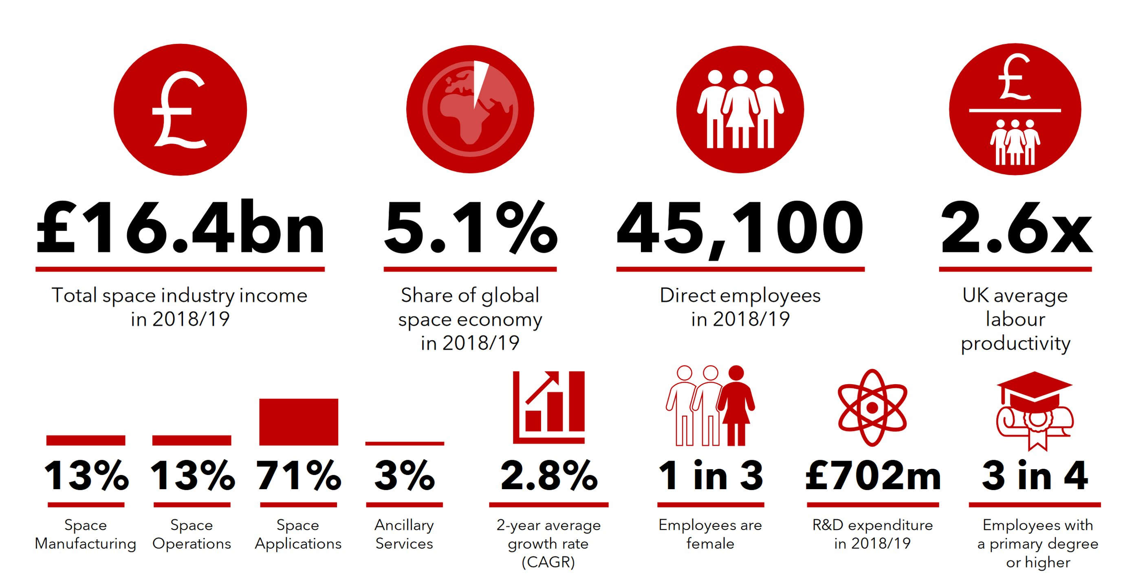
10% share of global space market in 2030 will deliver £40bn
50% of space income derived from exports
Size & Health of UK Space Industry 2021
Notes:
Here are some statistics on the Space industry in the UK, taken from 2021 but still just as relevant. There are massive opportunities for businesses looking to enter the sector domestically and internationally, as 50% of Space income is derived from exports. Working with partners such as the Department for Business and Trade can help streamline the exporting journey and provide assistance.

Slide 9
From Space
Applications Catapult
The future (by 2035)
Manufacturing facilities in space emerge e.g. Semiconductors
Robots in space service satellites and clean up
orbital debris
Global connectivity bridging the digital divide – VR & holograms everywhere
Persistent obs systems with advanced quantum powered analytics providing data for every part of life
Space systems monitoring greenhouse gases – driving policy to meet global
climate targets
The Biggest Transformation
Other sectors exploit space services e.g. health, energy, transport, finance
Notes:
Here’s an insight into the focus of the Satellite Applications Catapult will be, in 5 key areas. A couple of areas that Space Hub Yorkshire can proudly say are present in our region are Space monitoring systems, global connectivity technologies and to an extent – quantum communications, with the investment by York University into their Quantum Communications Hub.

Slide 10
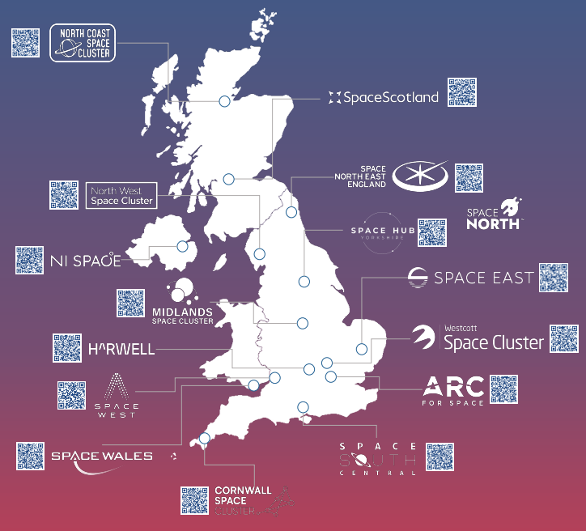
UKSA
Regional
Space Clusters
Notes:
15 clusters in total around the UK.
Space North

Slide 11
Why Yorkshire?

Slide 12



Greater than the sum of its parts
All parts of the space economy offer opportunities to level up across the whole of the UK, stimulating new centres of excellence and creating highly skilled, high value jobs.
Sector Space Covid Support Plan
Not just stainless steel & astronauts
Largest county in the UK
With Bradford, the youngest city in Europe
5.3m people (more than Scotland, NZ)
4 LEPs
6% of all UK companies
200k students at universities
Yorkshire
Notes:
A huge region with a huge opportunity. The number of students, companies and individuals can all play a part in the Space industry and it’s part of Space Hub Yorkshire’s role to communicate and engage with each stakeholder effectively. We are one of the largest Space Clusters in the UK and are always open to hearing from students, universities and industry leaders on what they would like to see with the development of the Space sector for the region.

Slide 13
Geospatial intelligence
Earth observation
Excellence in SAR
Connectivity,
quantum tech,
optical and
electronic engineering,
future telecoms, space
domain awareness
& secure satellite
comms
Ubiquitous connectivity
Quantum communications
Excellence in RF
Capture, interpretation &
value-adding use of space data
Enabled by machine vision, advanced computer techniques & core computer science capabilities
3 strategic themes
3 core economic opportunities
Development of
spacecraft systems, payload instrumentation & ground
infrastructure that supports
satellite comms, surveillance. Enabling better
quality data
Advanced manufacturing
Instrument design
Robotics
Based on regional capabilities
Academia & industry
Recognised overlaps
>50 world leading academic assets
>370 space relevant businesses
Source: Space Hub Yorkshire Strategy Document
Notes:
Touched on this earlier, but this goes into a bit more depth on the 3 strategic themes that we have identified for the region, based on the expertise of companies and universities. Can see that it is quite detailed, but that just illustrates the breadth of those capabilities across the Yorkshire landscape.

Slide 14
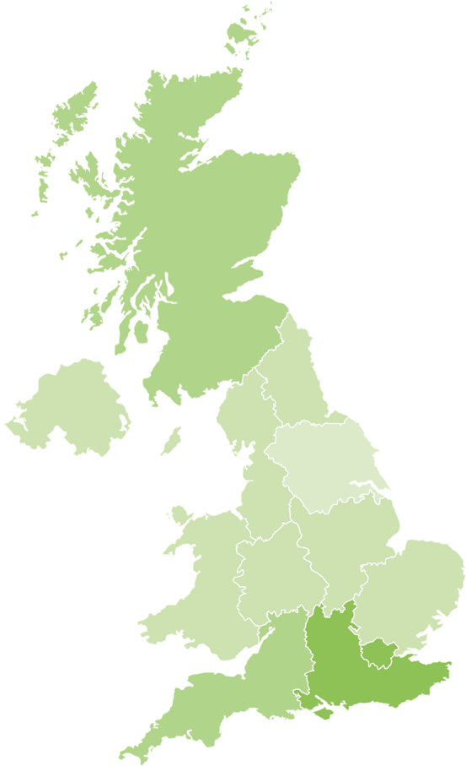
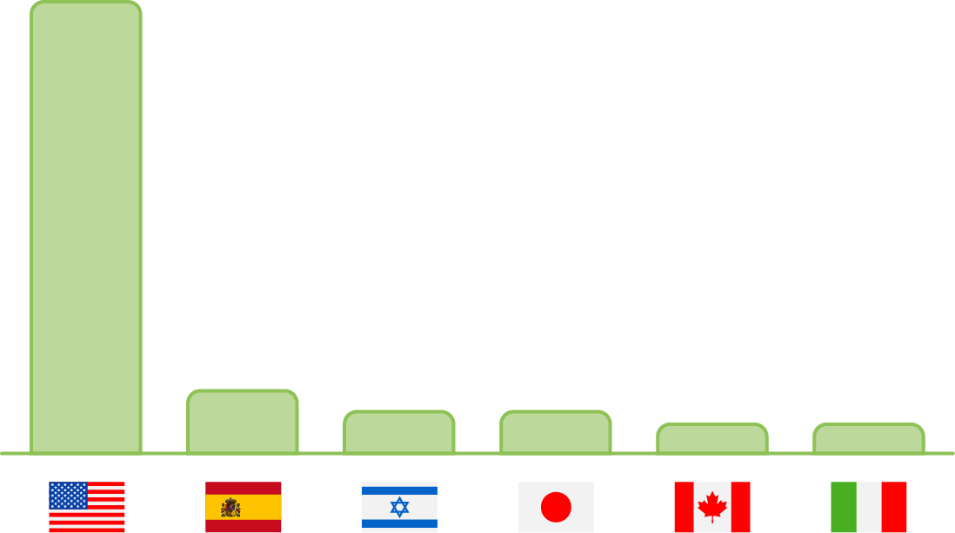
Inward investment
opportunities?
Most of FDI projects in the space sector land in the South East (London included). Within the South East, project density was highest in Oxfordshire (8), Greater London (6) and Hampshire (6). Oxford’s Harwell Science and Innovation Campus has attracted most of the large industry players.
Inward investment is key to driving prosperity
2019 Yorkshire FDI projects up 20% yoy (5% UK)
None of these were in space
Creating a destination for space is critical to achieving more FD
11
1
2
In Scotland. project density was highest in Fife (4) and Glasgow (3).
0
108
2
In the South West, project density was highest in Gloucestershire (2) and Bristol (2).
4
3
2
2
Target Markets for FDI
24
15
No projects recorded in Yorkshire.
7
10
10
7
7
Notes:
Another key driver of Space Hub Yorkshire is the FDI proposition. You can see here on the map that in 2019, there were 0 FDI enquiries related to Space to the LEPs. Now a lot of development has occurred since, but it’s partly our responsibility to increase the exposure of the region so that international companies look to relocate here. By promoting the talents and key thematic areas, we will look to attract inward investment so that the region can develop and continue to become a leader in the space sector.

Slide 15









Academic capability is strong
12 universities & 34 regional colleges
Yorkshire Universities
University Business Incubation/Acceleration
  14% of spin outs in England
50 space relevant research centres, groups & institutions
  Within earth observation & climate science
  Machine vision & advanced computing techniques
  Advanced manufacturing & precision engineering
  Electronic & optical engineering
  Materials science
  Quantum technologies
  Secure comms, surveillance & cyber security
Notes:
My main focus is developing the relationship with the Universities in the region, we have 12 University Partners and are now looking to develop the relationships with the colleges across Yorkshire and Humber. We want to promote the incredible academic capabilities, and create easier pathways for the younger generations to enter the Space industry.

Slide 16






















Innovation Landscape
Notes:
Can often be seen as quite complicated, so SHY look to connect the dots and hide the wiring for the end user.

Slide 17

SHY model…
CAMPUS
Virtual Space Campus
Yorkshire Universities
Skills, Outreach, Research
AGENCY
Works with ESA, UKSA, SAC, Innovate & other actors to promote & influence opportunity and attract inward investment
NETWORK
Provide a platform for info exchange and making connections. Build supply chains & promote adoption of innovation & best practice sharing

Slide 18














Uniquely connected

Slide 19




GreenSpace
Accelerating the use of Space technology and Earth Observation
Bringing finance and nature-based solutions together

