Slide 1
I’m an Engineer, Get me out of here
Invisible Internet Zone
Online, student-led STEM outreach and enrichment

Slide 2
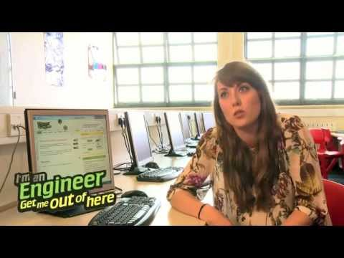
Online, student-led STEM outreach and enrichment
Profiles
Questions
Text based real time chat
Vote for engineer to win £500 prize
Labour Market Information
Teacher packs

Slide 3
Project aims
To support students’ science capital to help them see science and engineering as something ‘for them’
Reaches students aged 10 - 18
To provide greater equity for underserved students by prioritising and providing free to economically disadvantaged and distant schools
To improve engineers’ outreach skills and confidence creating the opportunity for more continued outreach activity

Slide 4
Zone objectives
To engage up to 2,000 students in engineering through showing them the people who make the internet work
Design engineers, operations, maintenance, research
Graduate routes, apprenticeships, vocational
Diversity of gender, ethnicity, educational background
To provide access and experiential training to up to 50 engineers helping data centres and other internet engineering organisations foster a culture of community engagement and collaboration
Participation in IAS Academy offered to all engineers
Delivered over four-week period in Autumn 2021

Slide 5
Zone requirement
Up to 50 engineers willing to commit at least 2 hours
Funding between £5,000 and £10,000 plus VAT

Slide 6
Background
Part of the I’m a Scientist family of online engagement from Mangorolla CIC, a not for profit Community Interest Company limited by guarantee.
Online engagement since 2003 engaging over 150,000 with over 2,000 scientists, 400 engineers and 1 astronaut.

Slide 7
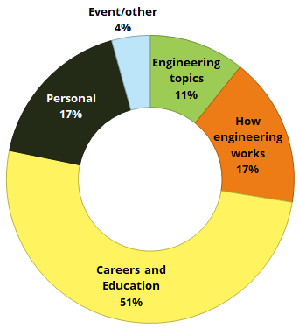
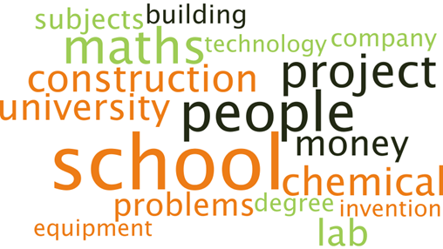
Sample word cloud of keywords in live CHATs
(I’m an Engineer Millisecond Zone November 2018)
ASK questions from past 12 months coded by theme: 51% Careers and Education focussed
(I’m an Engineer June 2018, November 2018, March 2019)

