Slide 1
techUK Semiconductor Scaleups Roundtable
Sean Redmond, Managing Partner, Silicon Catalyst

Slide 2
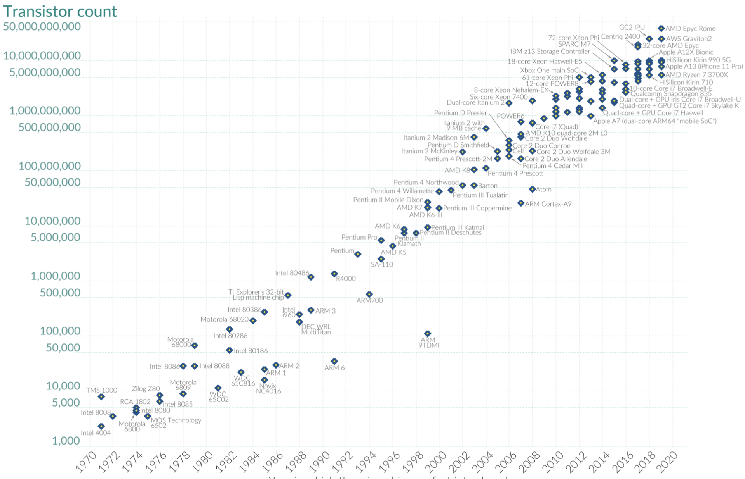
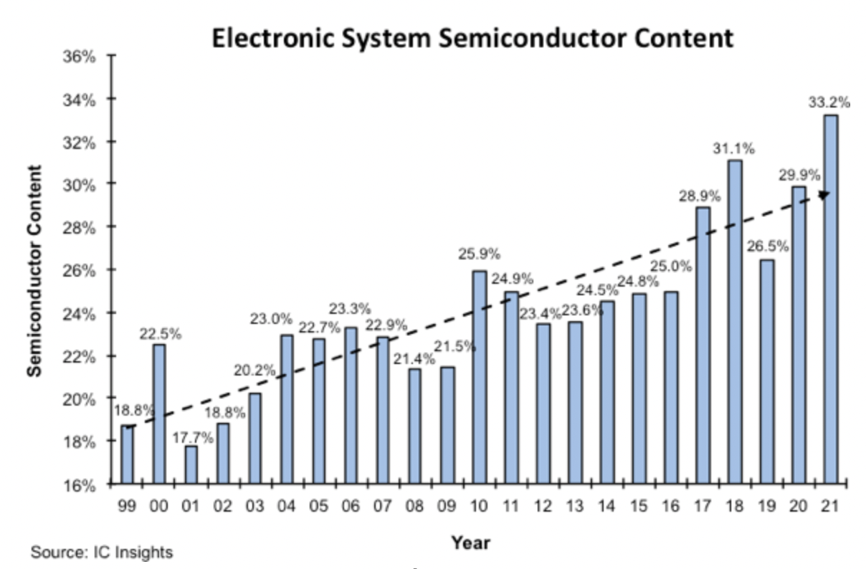
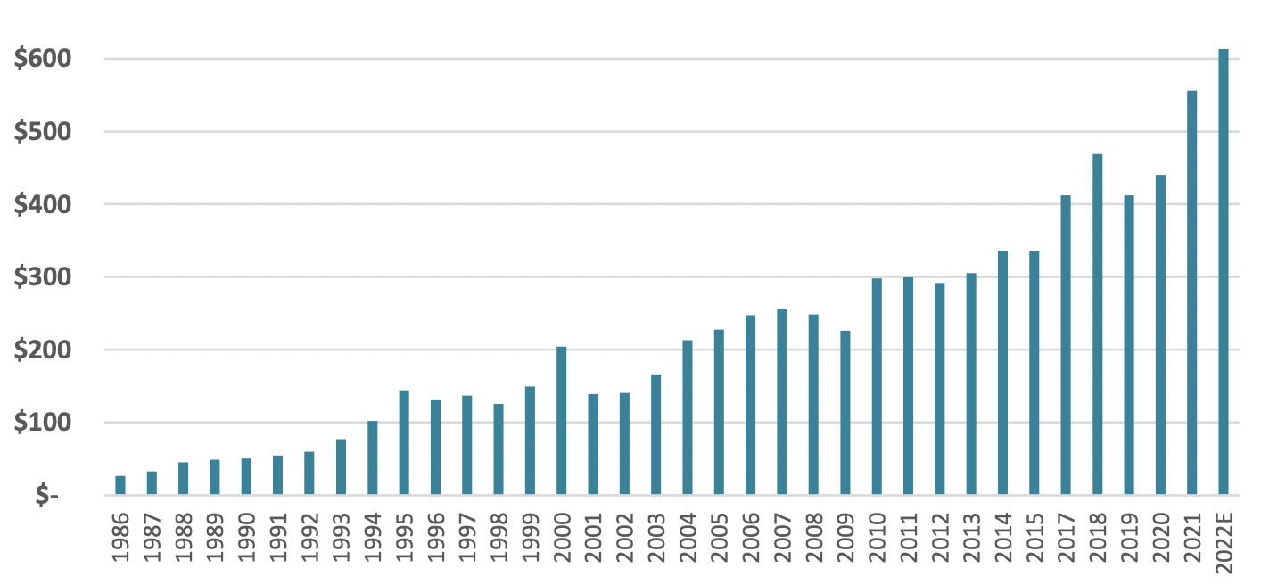
There has never been a better time for Semiconductors
- 16 of the top 20 market caps in tech
- 3rd most profitable industry
Transistors on a Chip
More R&D (innovation)
Lower
cost/function
$’s
Source: Wikipedia
Expanding applications (more semiconductors)
Semiconductor Revenue
Increasing semiconductor revenue
Source: WSTS

Slide 3
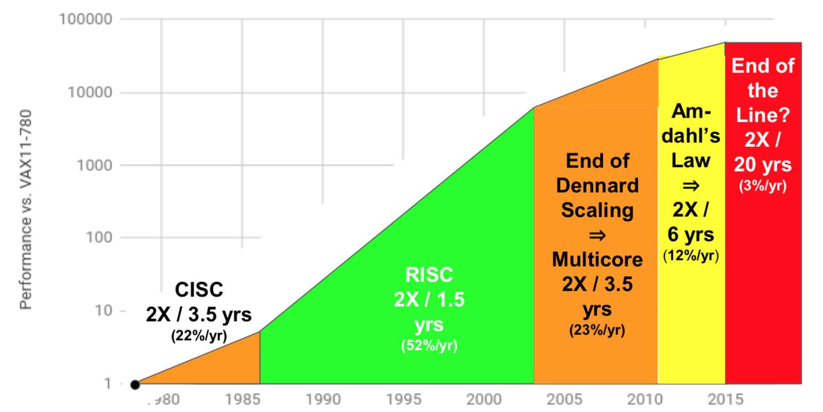
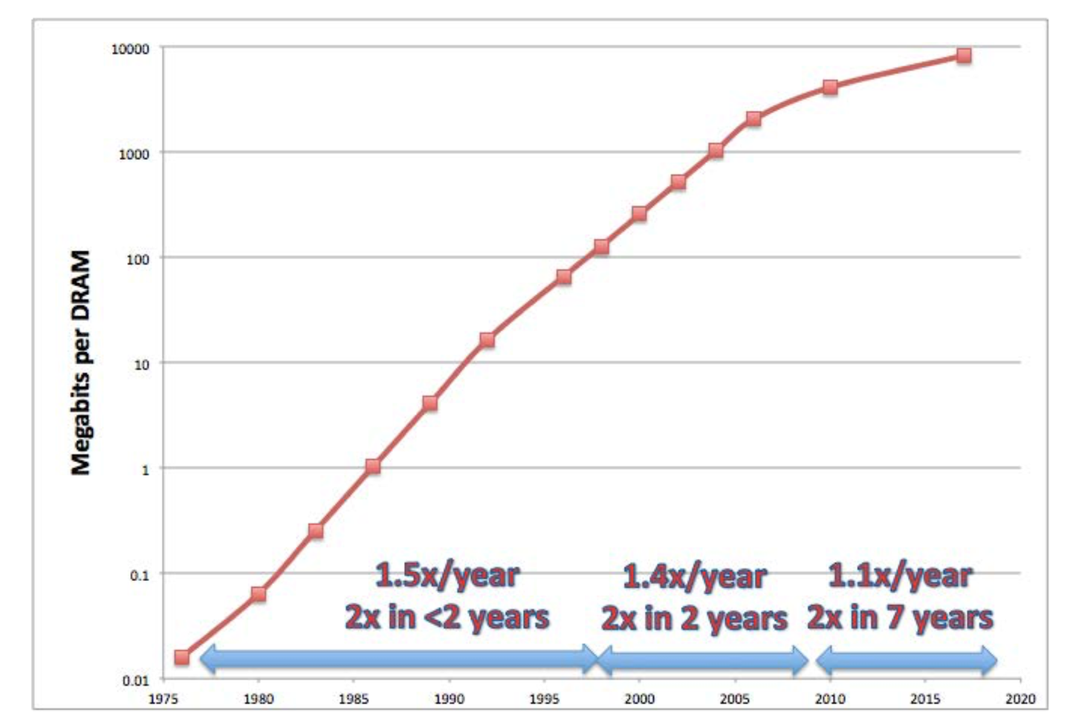
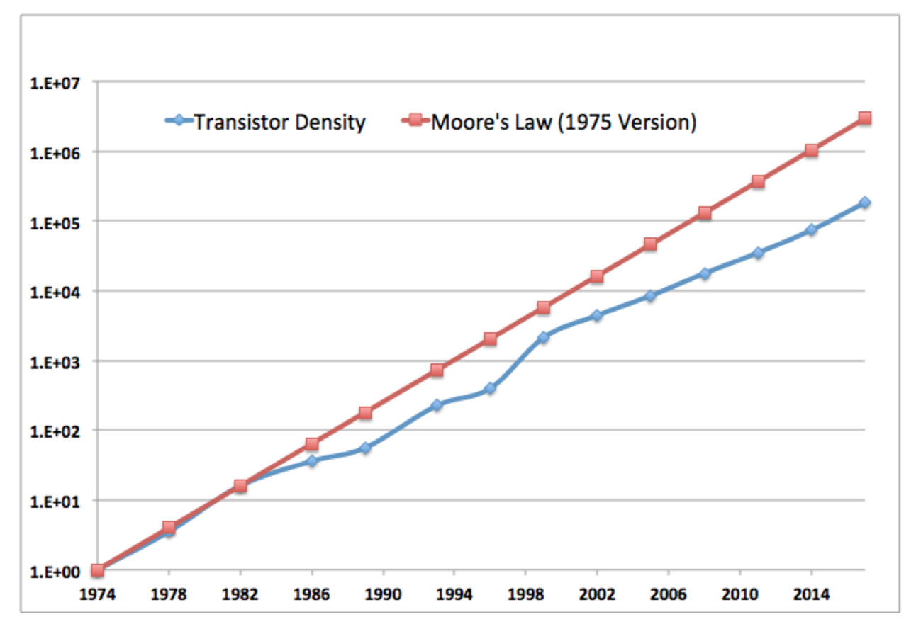
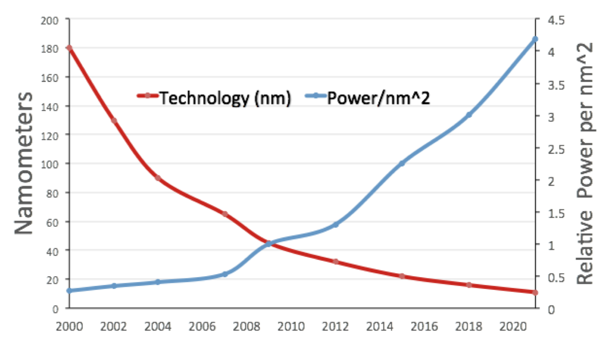
The 4 horse riders of the apocalypse => scaling
CPU single core performance
DRAM density roll off
Intel CPU density roll off
Transistor power takes off

Slide 4
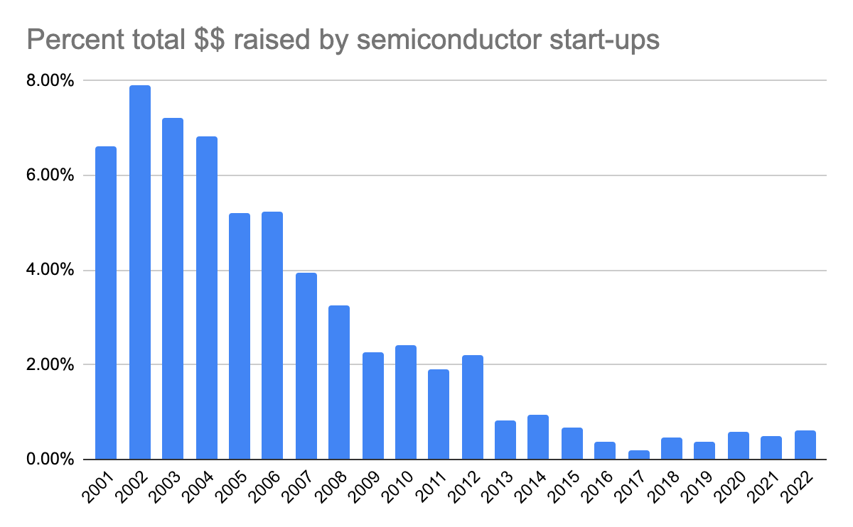
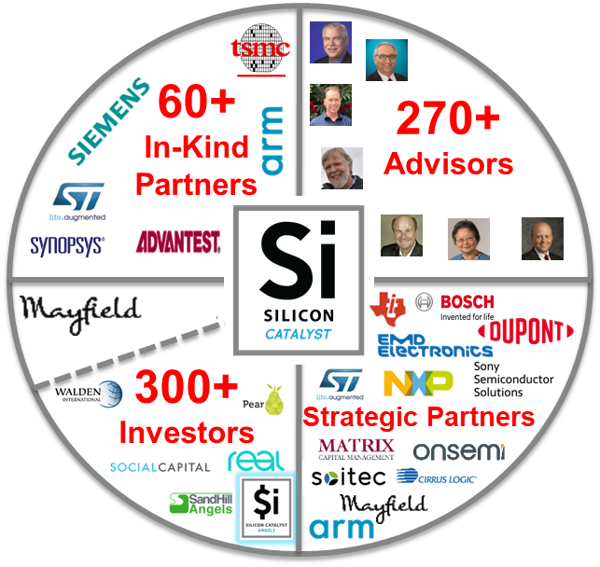
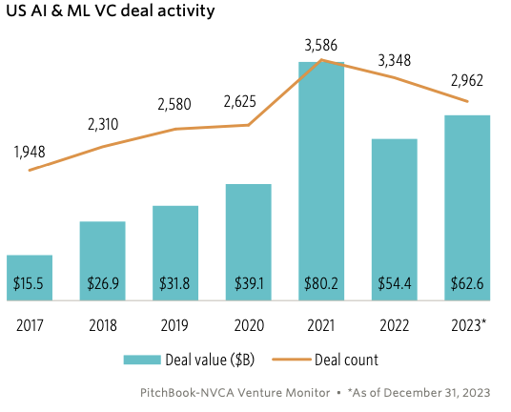
Venture Capital investment in semiconductors
VC investment in semiconductor startups as % of total VC funding
8%
6%
4%
2%
0%
Silicon Catalyst created
in this perfect storm

Slide 5
System companies becoming silicon houses
 | Apple | Google | Amazon | Microsoft | Meta | Baidu | Cisco | Huawei | Samsung | IBM
System
Chip Design limited
Chip Design extensive
Chip Mfg
Source: VLSI Research (modified)

Slide 6
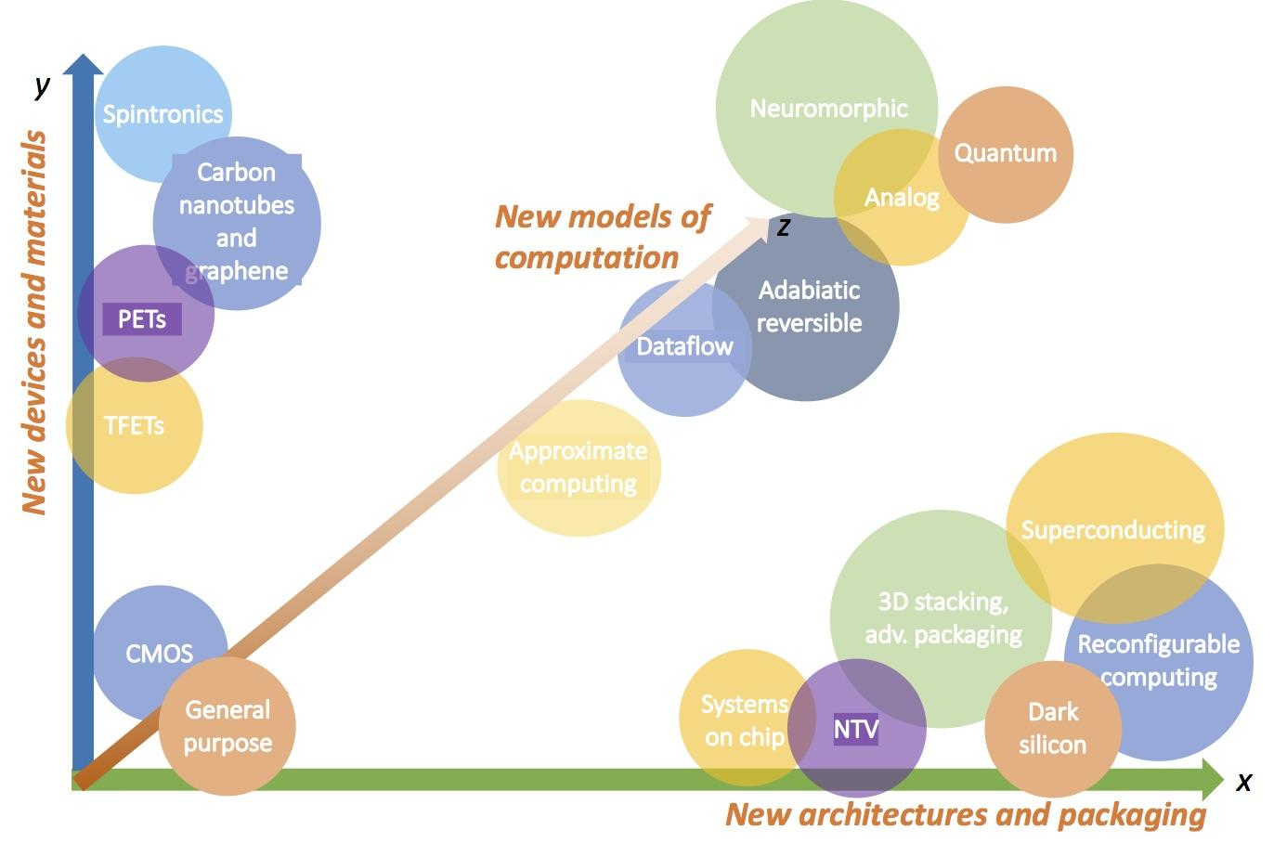
Semiconductor industry innovations are coming to the rescue
New Materials and Devices
20+ years (10 year lead time)
More Efficient Architectures and Packaging
The next 10 years
Notes:
Note: need to work on the

Slide 7
Silicon Catalyst: The World’s #1 Semiconductor Accelerator
A now proven ecosystem model for nurturing semiconductor start-ups
Training and advising
Providing access to EDA tools, Design IP & Foundry from In Kind Partners
Linking to the semiconductor ecosystem
Accessing and de-risking investment
ChipStart UK Startup incubator
Fully funded by UK government
No cost access to early-stage startups
Over 100 startups – portfolio >$1.9B valuation, >$500M raised
Good for Startups, Investors, Advisors… and the wider Economy

