Slide 1
Connectivity from the Sky
Matt Child
Chief Architect, Future Satellite Systems
Paul Febvre
CTO, Satellite Applications Catapult

Slide 2
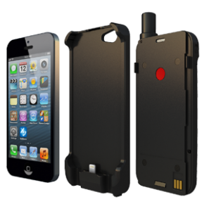
Satellite Direct to Handset
Challenges
  Handset emissions and receive sensitivity
    Governed by cellular network requirements
    Restricted by health & safety of electromagnetic field strength
    PFD, ModCod for satellites different to terrestrial 3G/4G &5G
  Satellite emissions and receive sensitivity requires high gain systems
    Large Deployable Reflectors “LDR”s
    Dense Phased Array antenna
  Restricted to lower frequency bands
    Link budget, propagation and atmospheric effects
    L, S and C-bands preferred
    Therefore bandwidth and throughput restricted
  Satellite preference for FDD in bands where only TDD permitted
  In-band and out-of-band Interference
  Circular vs Linear Polarisation
    Handsets contain vertical or horizontal isotopic antenna
  Poor indoor penetration
  Doppler shift compensation
  Satellite hand-over for LEO systems
  Device registration

Slide 3
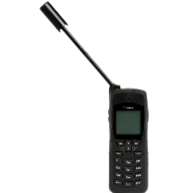
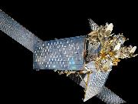
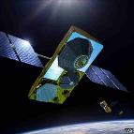
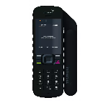
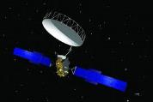
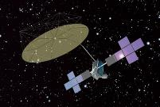
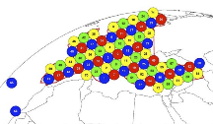
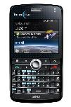
MSS Systems
Iridium
  L-band, 66 satellites, LEO at 800km
  Ka-band ISLs, Ka-band feeder
  OFDM waveform
Globalstar
  L/S-band, 22 satellites, LEO at 1400km
  C-band feeder
  IP-based WCDMA waveform
Inmarsat
  L-band, GEO
  C-band feeder
  GMR-1 waveform
Solaris Mobile*, Terrestar*
  S-band, GEO
  Ku-feeder
  GMR-3 waveform
* Both Terrestar and Solaris Mobile acquired by Echostar

Slide 4

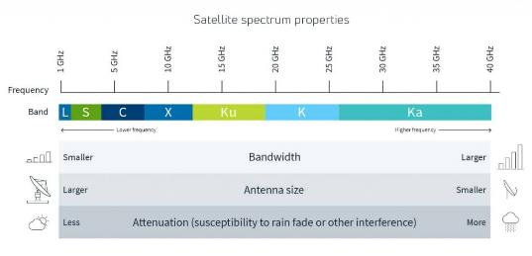
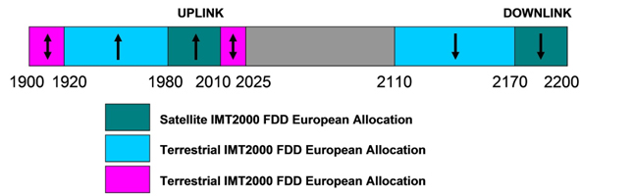
EU MSS S-Band (1)
In 2009, European Commission held a beauty competition for the rights to the MSS S-band spectrum across the EU.
The S-band spectrum up for grabs was the 2 x 30MHz in the 2GHz band, directly adjacent to the 3G UTRA band and uniquely, the licence also permitted the use of the spectrum for terrestrial services. This is known as CGC or Complementary Ground Component (or ATC in N America).
The winners were Inmarsat and Solaris Mobile, a JV between SES & Eutelsat and the spectrum was split as 2 x 15MHz (ul/dl) to each.

Slide 5
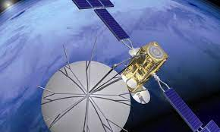
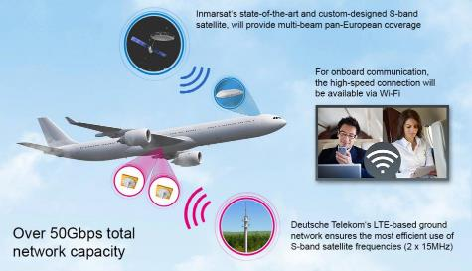
EU MSS S-band (2)
So what do you do with only 2 x 15MHz in a GEO orbit?
  Solaris Mobile’s BP was based upon exploiting the CGC licence with a satellite overlay, direct-to-handset for network extension, gap filler and blue light services
In fact, the BP was not realised as the Solaris Mobile satellite had a catastrophic failure on its reflector on the hosted payload operated by Eutelsat.
Inmarsat instead went on develop the European Aviation Network, EAN using LTE cells pointed vertically for in-flight Internet access
Solaris Mobile is now Echostar Mobile which operates a large and powerful S-band satellite, Echostar XXI, with around 100 beams across the EU.
Key points: S-band is low bandwidth and low(ish) frequency at 2GHz, licenced to integrate with terrestrial services adjacent to 3G/4G.

Slide 6

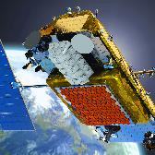
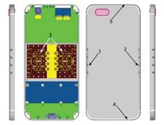
Key Technology Enablers
Beam Forming
  Phased Array Antenna
    At the RAN - mMIMO
    On board the satellite
    In the handset
    Interference mitigation
Emergence of high density LEO constellations
  More achievable link margins
Robust waveforms
3GPP evolution and Revision 17
  Potential for shared spectrum?
Satellite ready handsets
  iPhone 14 upwards with Qualcomm x65 modem and antenna pcb positioning
Lower cost access to space

Slide 7

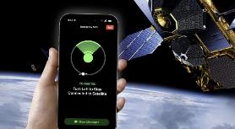

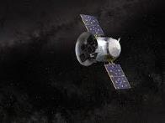
State of the Art
Globalstar
  Apple iPhone
  S-band emergency services
  5G Band n53 (2.4GHz)
AST
  64m² Phased Array
LYNK
  5G tower in space
Omnispace
  LEO Constellation operating in 5G spectrum. TBD
Starlink
  “Gen2 Starlink satellites will use a section of t-Mobile’s mid-band PCS spectrum, which T-Mobile owns nationwide and is contiguous. In order to communicate in cell spectrum with cell phones, the satellites will have large phased array antennas, roughly 25 square meters large. These antennas will be supplemental to the Ku- and Ka-band antennas on the satellites.” Musk

Slide 8









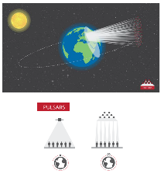
Bandwidth multiplier
Multiple Use Cases incl:
  Direct to HH
  VSAT Networks
  Military Secure Comms
5G integration
Secure
Agile
Resilient
Scalable
Low cost
Protects C-band
PULSARS Workshop
Pulsars
1 km
Node Cluster in Geostationary Orbit
Ka-band Feeder Links
5-10km Dia
GBBF &
Gateway
C, S or L-Band User links
Distributed Phased-Array
Phase Coherent Beamforming
Low-cost spacecraft
200kg, 250W
2m folding reflector
Multiple Steerable User Beams
100Mb/s per beam
Multiple users per beam
Aggregate EIRP = 60-80dBW
Beam Width <1° (1km dia)
G/T = 5-10dB/K
All parameters are indicative

Slide 9
Summary
To deliver the services the customer expects, the PFD needs to be equivalent to that delivered by the terrestrial mobile networks.
Defence of the satellite uplink bands for FDD mode of operation for 5GNR, requires standardisation and regulatory intervention.
Regulatory frameworks should accommodate regional variations to allow local regulators to adopt for their nations.
Standardisation of waveforms under ETSI should drive towards simple integration into handsets to lower cost through increase scale and maximise interoperability.

Slide 10
Connectivity from the Sky
Matt Child
Chief Architect, Future Satellite Systems
Paul Febvre
CTO, Satellite Applications Catapult
Thank You

