Slide 1
Terahertz Spectrum
Richard Moore – Ofcom, Spectrum Policy Principal
20 April, 2022

Slide 2
Agenda
Opportunities & challenges
Proposed approach to spectrum management
Next steps

Slide 3
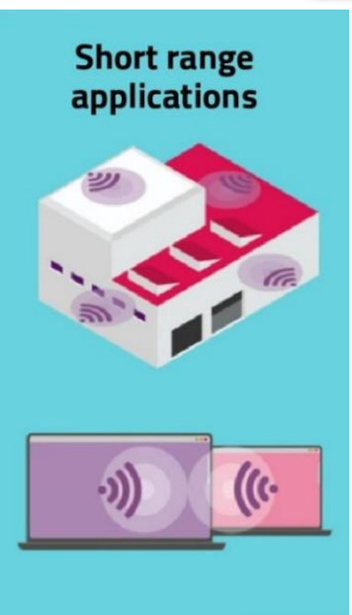
Current and potential future uses
Earth observation
High capacity
fixed, mobile & sat
6G?

Slide 4
Spectrum management challenges & opportunities
Fragmentation
Concentration of demand
Technical standards
International consensus
Risk of delay
Relatively sparsely used
Very narrow beams
AI enabled signal processing
Co-ordinated access
Cross sector benefits

Slide 5
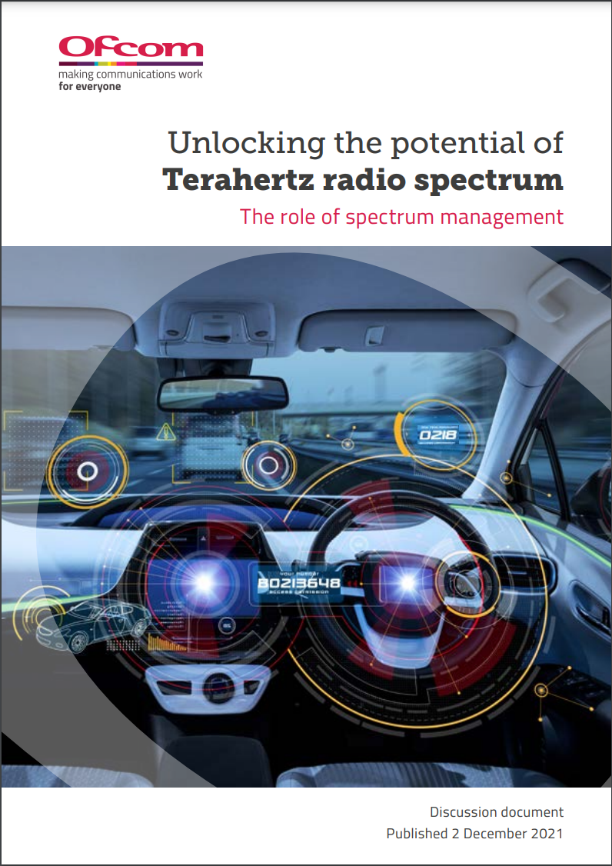
Proposed approach to spectrum management
“Our objectives and proposed approach for Terahertz spectrum are in line with [our spectrum management ] vision – our focus is on flexible and agile management of spectrum to support innovation and growth in the short and long run.”
“… we believe an approach to spectrum management that assumes sharing by default will be instrumental to make the most of the opportunities Terahertz spectrum presents.”

Slide 6
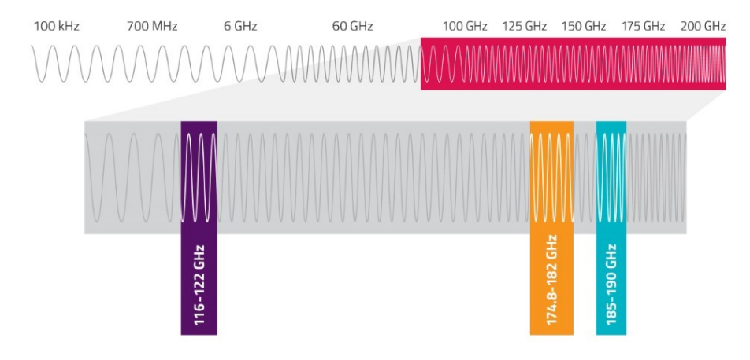
We're already providing access to spectrum above 100GHz via Shared Access licences
Spectrum Access: Extremely High Frequency Licences
https://www.ofcom.org.uk/__data/assets/pdf_file/0024/203829/100-ghz-statement.pdf

Slide 7
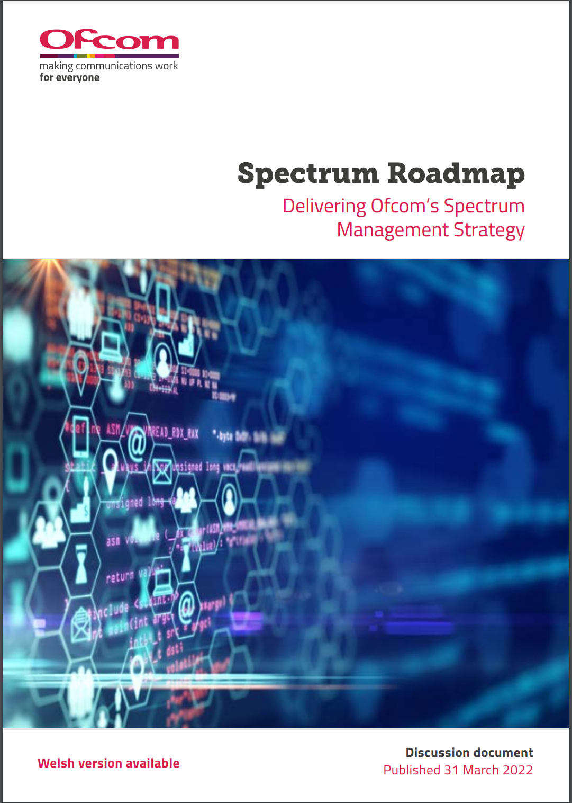
Proposed next steps
Continued engagement with academia and industry to understand & influence emerging technologies and standards
International engagement e.g. through CEPT and ITU
“We are keen to engage with […] passive band users (such as Earth Observation satellites) to identify actual use and confirm protection requirements.”
“…we plan to undertake a new review of how spectrum demand for fixed links in existing and new higher frequency bands (including W&D bands at sub Terahertz range) may evolve in the coming decade in light of future fibre roll-out…”

Slide 8
Thank you for listening

