Slide 1

@RBaptistaLeite
How to Fix a Broken System
The future of Health Systems and the Power of Technology
Ricardo Baptista Leite, MD
CEO, I-DAIR
ricardo.baptistaleite@i-dair.org
London, 12 September 2023

Slide 2



The response pillars of the portuguese NHS
CENTRADO NO CIDADÃO
PATIENT CENTRICITY
COBERTURA UNIVERSAL
UNIVERSAL COVERAGE
ACCESS
GLOBAL
ACESSO
GLOBAL
Free of Charge at Point of Care
QUALITY
TENDENCIA-MENTE GRATUITO
QUALIDADE
SERVIÇO
NACIONAL DE
SAÚDE
@RBaptistaLeite

Slide 3
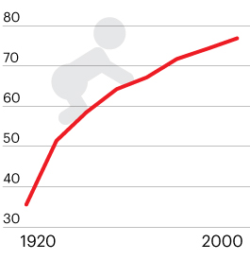
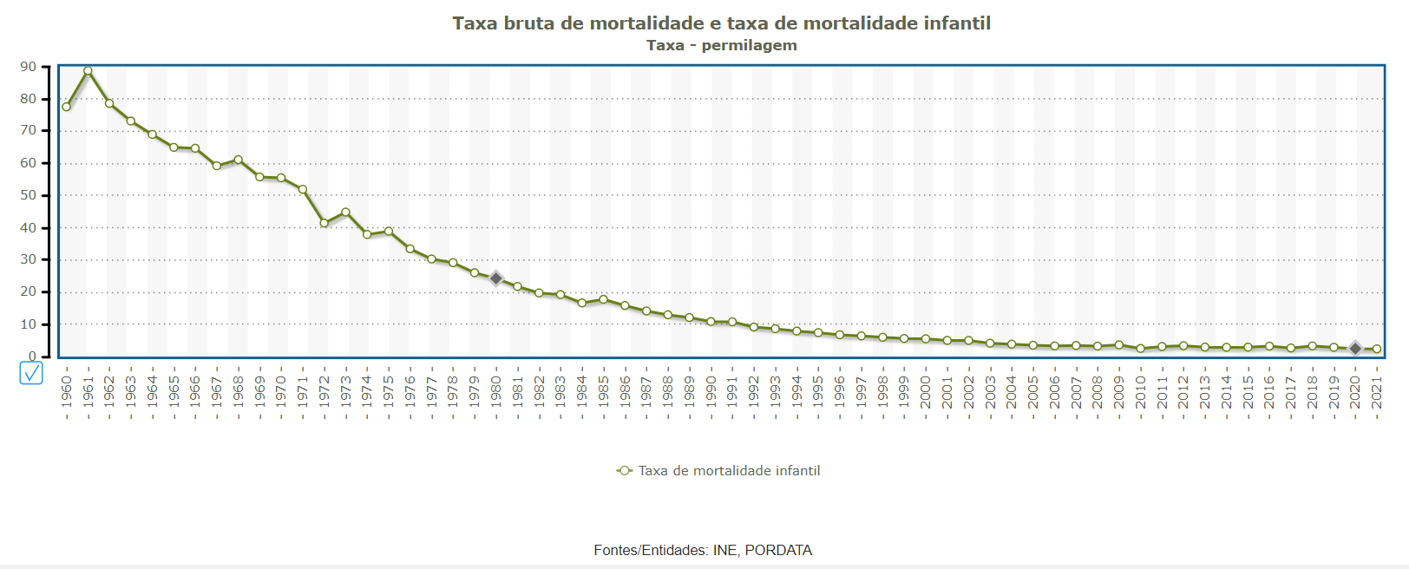

Life Expectancy at Birth
Evolution of Life Expectancy at Birth
in Portugal
Infant Mortality Rate, Portugal
@RBaptistaLeite
Source: Público/ Health at a Glance 2022

Slide 4
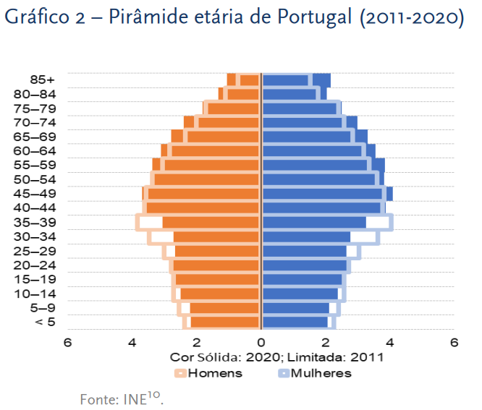
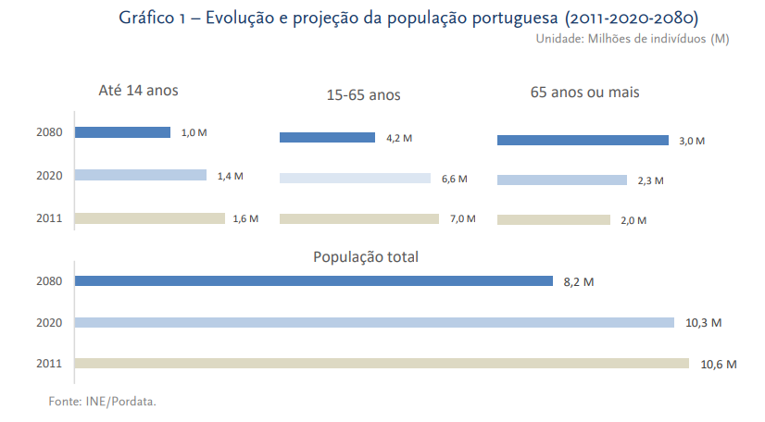
1
Alarming demographic trends
2011 – 2020 - 2080
Portuguese age pyramid (2011-2020)
Projected demographic evolution (2011-2080)
@RBaptistaLeite

Slide 5
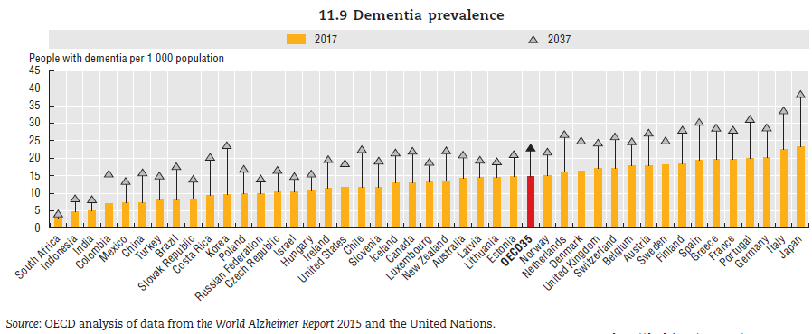
2
Dementia Prevalence
A rising trend with disruptive solutions yet to be found
@RBaptistaLeite

Slide 6
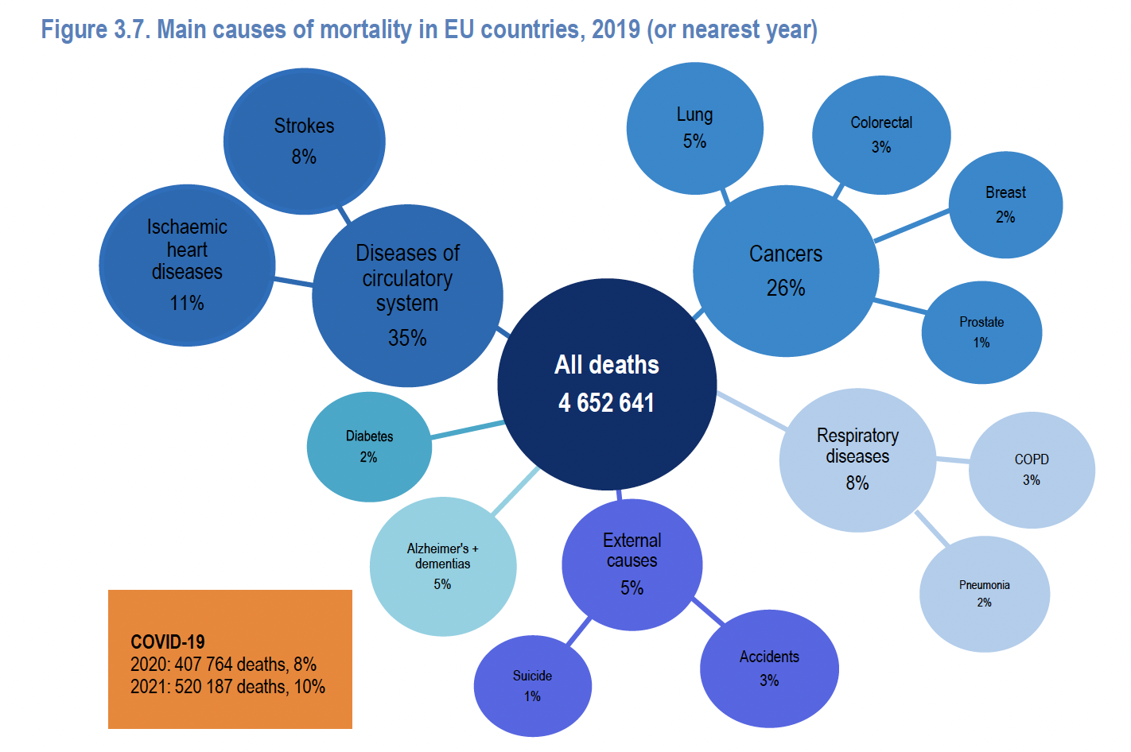
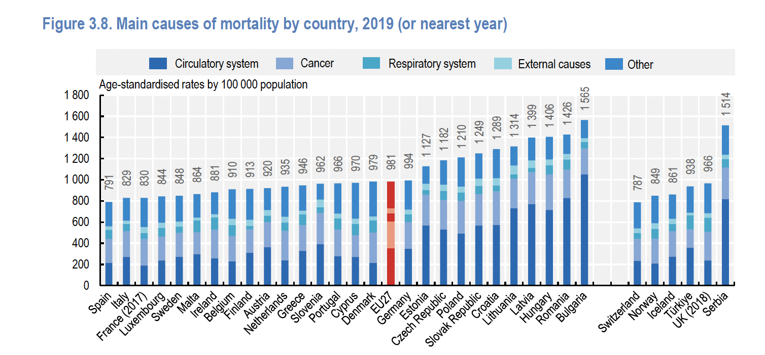
3
High (and increasing) prevalence of NCD
Cancer, cardiovascular and metabolic disease among the top killers and sources of disease burden with a rising tide of mental health challenges
@RBaptistaLeite

Slide 7
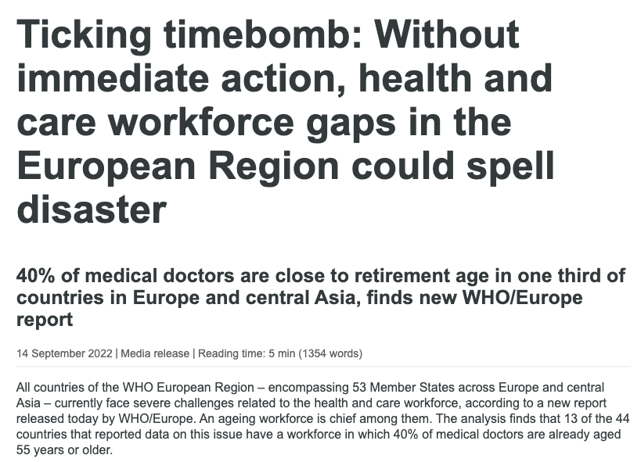
4
The increasing challenge shortages in Healthcare workforce
@RBaptistaLeite

Slide 8
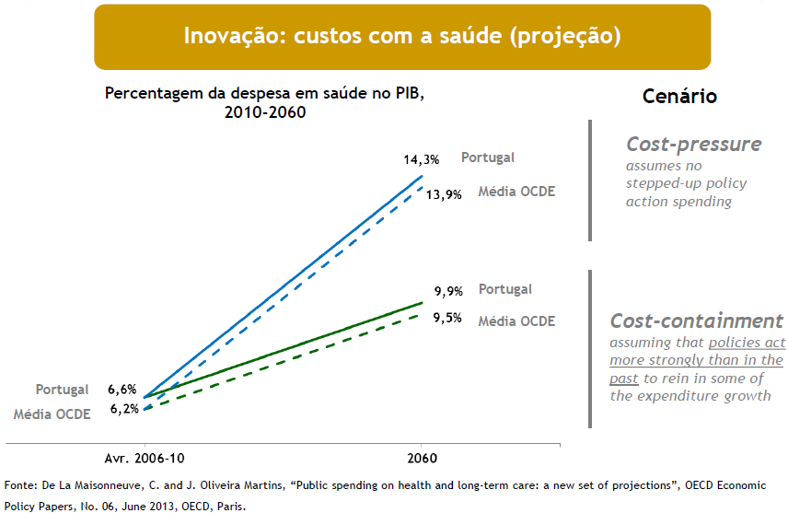
What does the future hold for Health Systems?
Financial Situation of the Portuguese NHS: What to Expect?
Raising Expenditure in healthcare (projection)
Expenses in healthcare (in % of GDP) 2010-2060
Scenario
OEDC Average
OEDC Average
OEDC Average
@RBaptistaLeite
Notes:
A redução no financiamento do SNS não é temporária, porque as restrições orçamentais não permitirão que as transferências do OE para o SNS aumentem significativamente durante muitos anos.

Slide 9
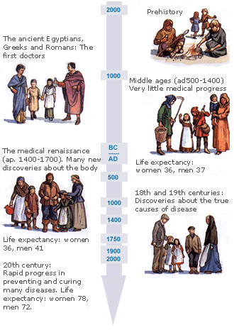

What does the future holds for Health Systems?
The Evolution of Medicine
Goals of Medicine
Promote health
Preserve health
Restore health, when compromised
Minimize suffering and malaise
@RBaptistaLeite
Notes:
Pre-history (before 3000 BC)
People blamed the gods for illness and disease as they had no doctors. But they made remedies from hebs and plants. Short life expectancy.
Ancient Egypt (3000-500 BC)
Medical knowledge was written down and passed on for the first time. Life expectancy increased from 30 for men and 24 for women in prehistory to 38 for women and 40 for men during the ancient civilisations of Egypt, Greece and Rome.
Ancient Greece (500-200 BC)
Hippocrates developed the four humours theory. The Alexandria medical school and library was founded.
Ancient Rome (200 BC - 500 AD)
Galen brought together Greek and Roman medicine in his writings. Concentration was on public health and preventative medicine rather than cures and theories of disease.
The Middle Ages (500 - 1400 AD)
Very little medical progress. Life expectancy of under 40 years for both men and women.
The Medical Renaissance (AD 1400-1700)
Many new discoveries were made about the body as well as new breakthroughs in anatomy, physiology and surgery.
The eighteenth and nineteenth centuries
Discoveries made about the true causes of disease in a time of great medical progress.
The twentieth Century
Rapid progress was made in medicine and health and in preventing and curing many diseases. Life expectancy increased to 78 for women and 72 for men.

Slide 10

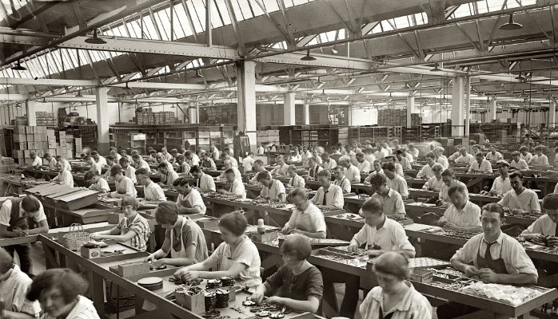
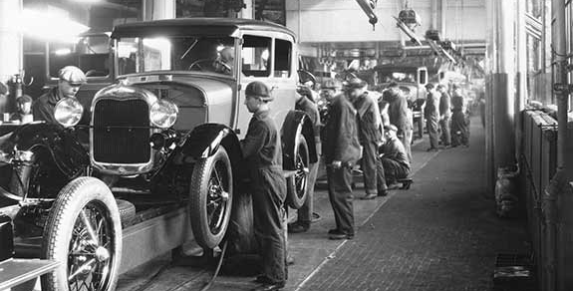
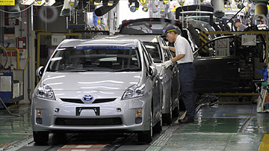
Industrial Revolution
@RBaptistaLeite

Slide 11
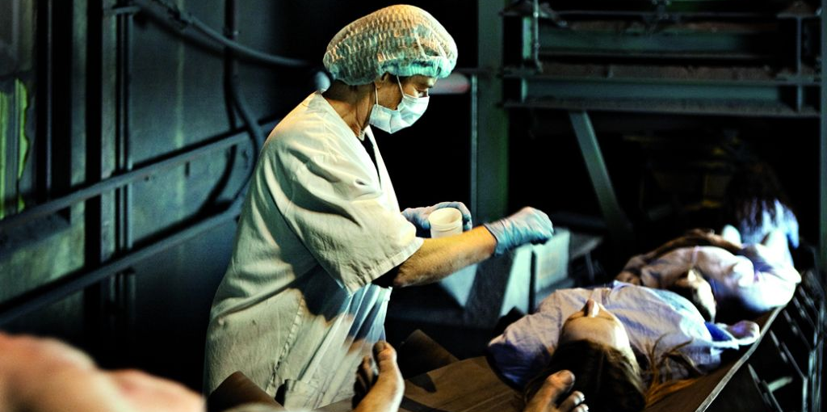
Industrialization of Healthcare
@RBaptistaLeite
Health Factory, Norway, 2010

Slide 12
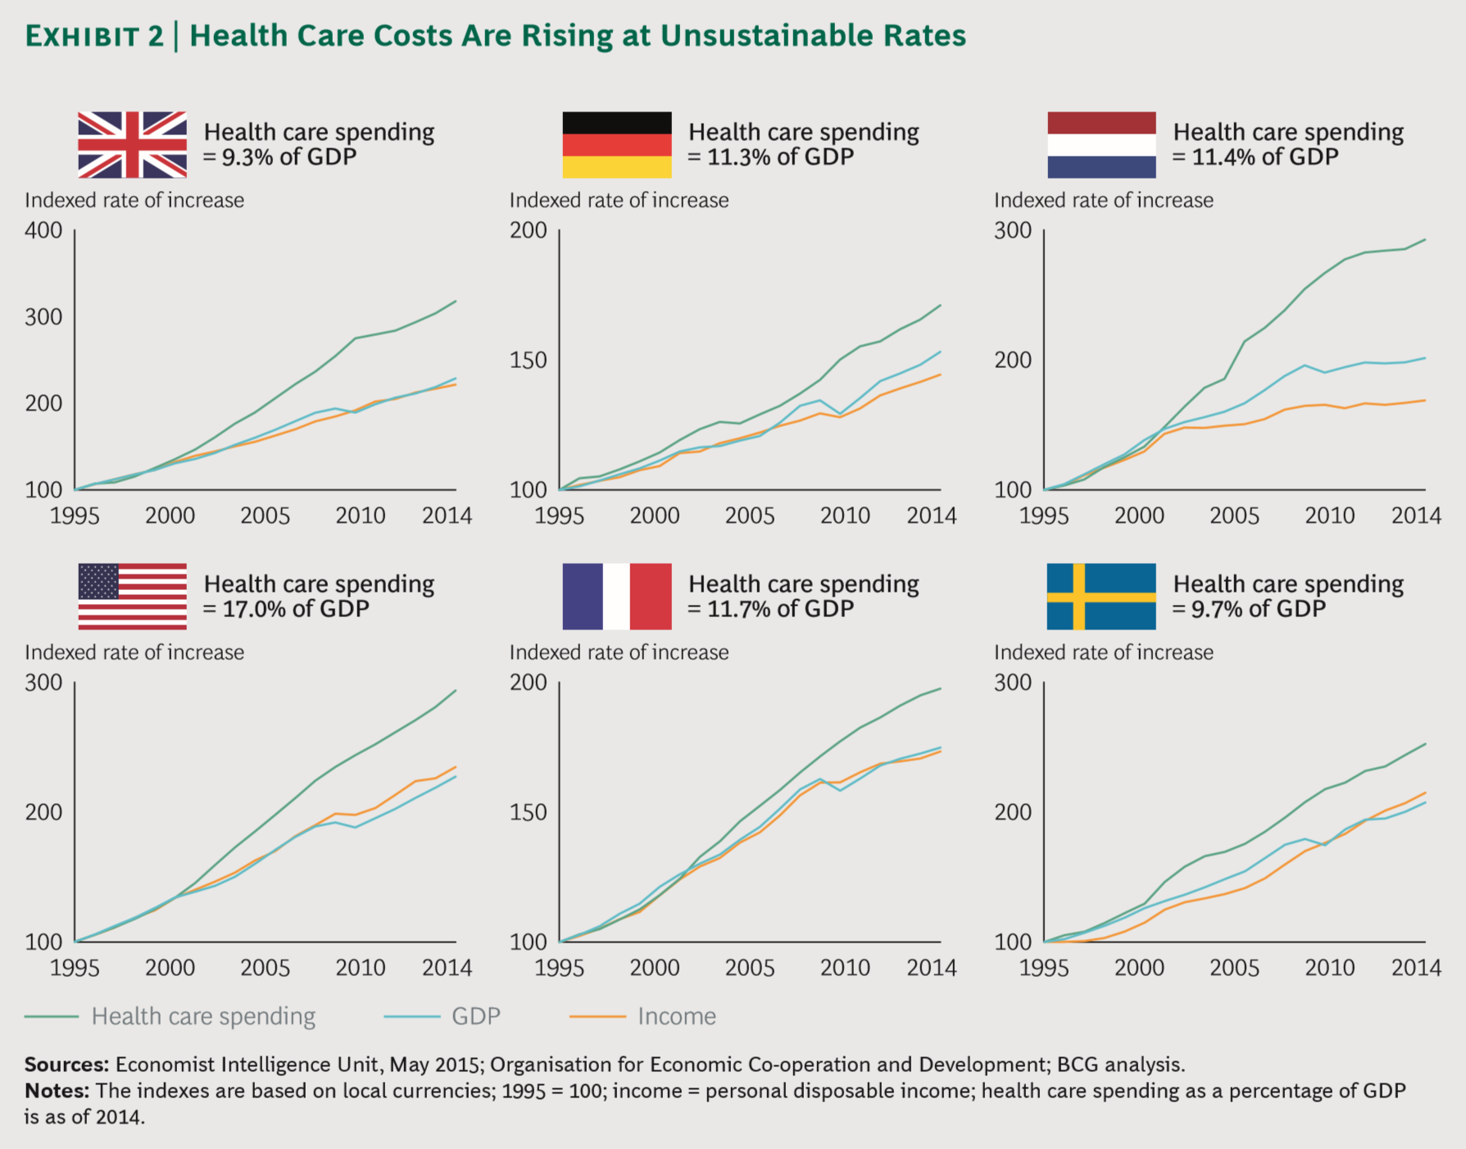

Rising Healthcare Costs
and
Rising Burden of Disease
Risks of Unsustainability
Universal Health Coverage
Worse health - mainly for most vulnerable populations
Rise of inequalities and poverty
@RBaptistaLeite

Slide 13
What is the future of healthcare?
Raising costs (innovation & tech)
Demographic pressure
Social inequities
“In health care, the days of business as usual are over” Michael Porter
Need for more qualified health care workers
Increasing burden of disease
Chronic diseases
@RBaptistaLeite
Porter ME, Lee TH, The Strategy That Will Fix Health Care, Harvard Business Review, October 2013
Notes:
As medidas de sustentabilidade financeira vão alterar profundamente o modo de funcionamento do SNS, mas não vão pôr em risco todos os benefícios nem os indicadores de saúde que o SNS proporcionou ao longo dos últimos 30 anos. O MS, através dos seus dirigentes, vai mostrar que é possível vencer os desafios difíceis de 2012, e conseguir, mesmo nesta conjuntura altamente desfavorável, …

Slide 14
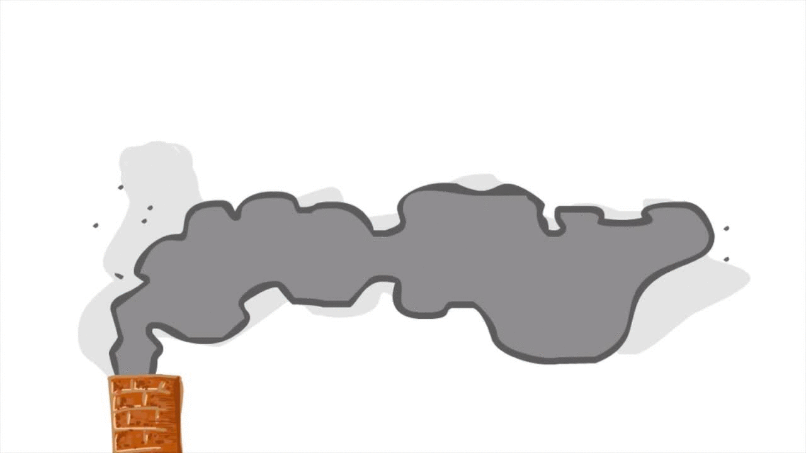



Future of healthcare | Agenda for Value
Health Outcomes
PREM’s
PROM’s
@RBaptistaLeite

Slide 15

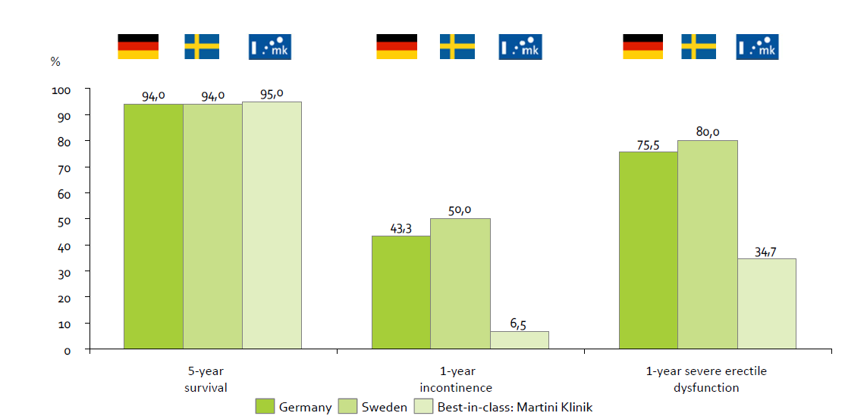
Outcomes matter
Prostate Cancer Surgery
@RBaptistaLeite

Slide 16
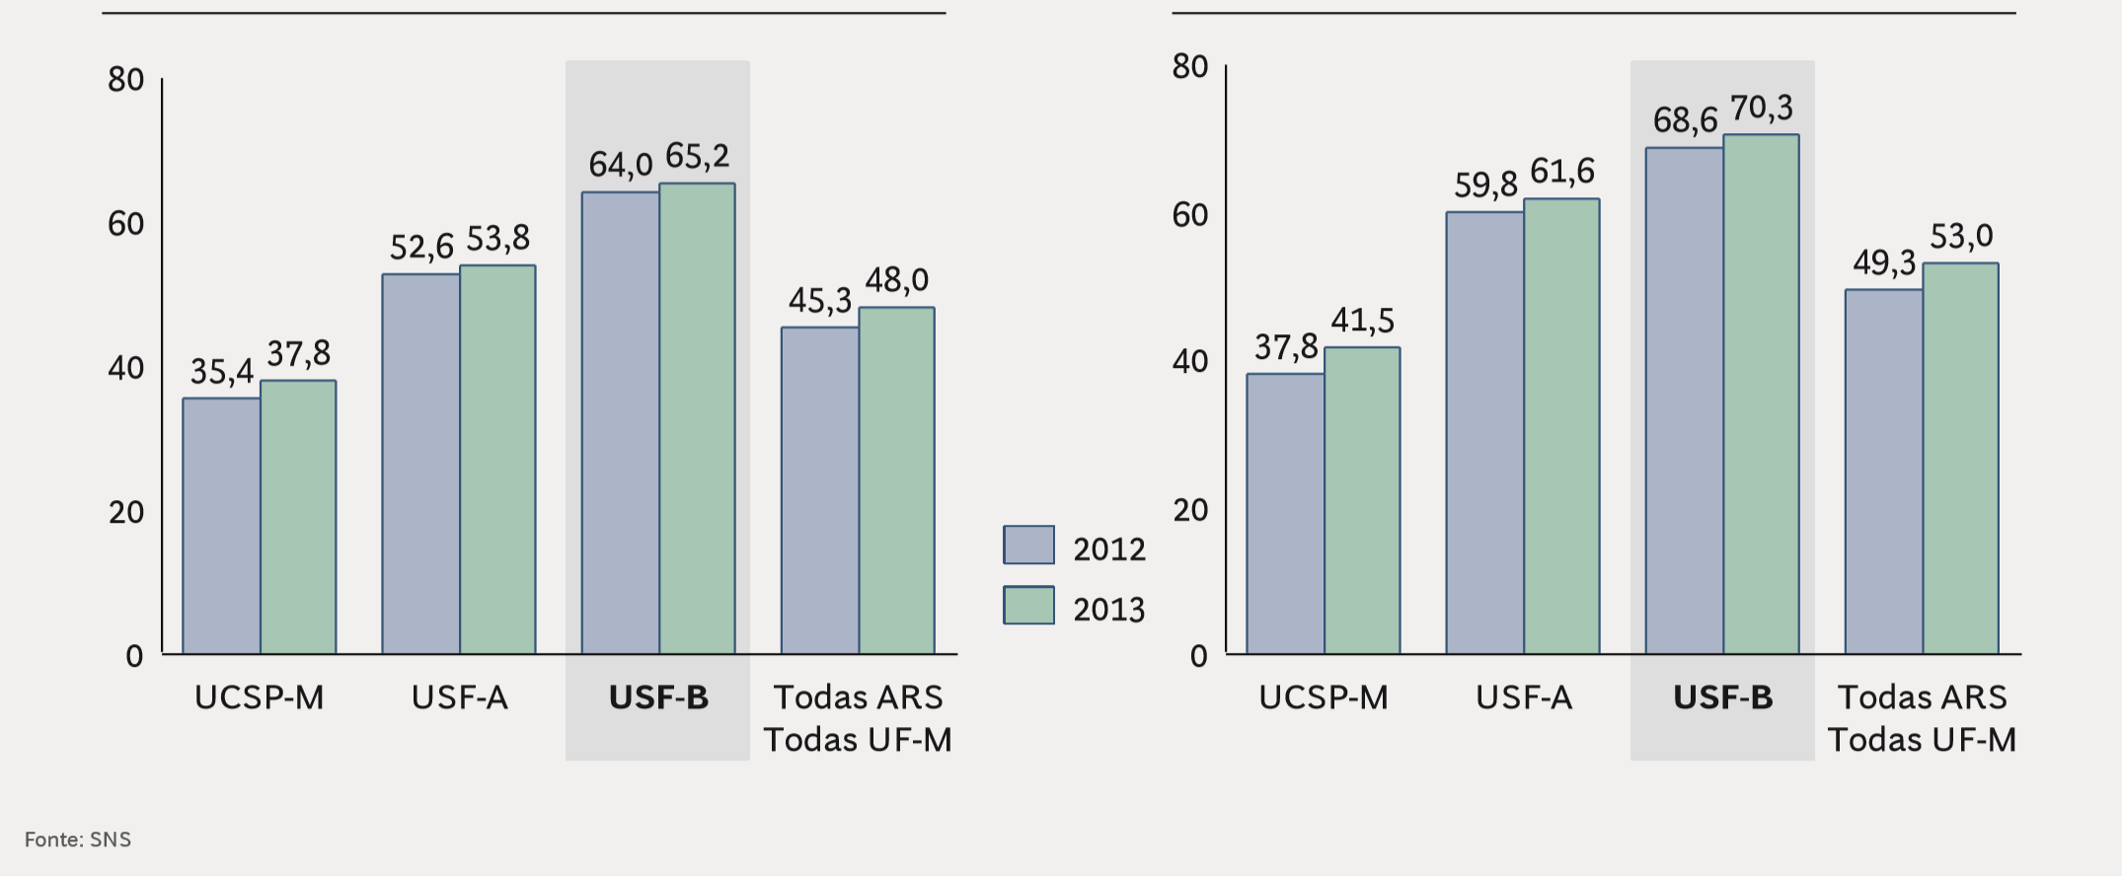

Outcomes matter
% of patients with controlled arterial hypertension
% of patients with controlled type-2 diabetes
Primary Healthcare
P4P vs. Classical
@RBaptistaLeite
Um Novo Modelo de Acesso à Inovação em Saúde Baseado em Resultados, Estudo BCG, 2016

Slide 17
Outcomes vs Spending
@RBaptistaLeite
Source: The EIU. Adapted by Ricardo Baptista Leite. Acknowledgment to slide owner Vivek Muthu

Slide 18
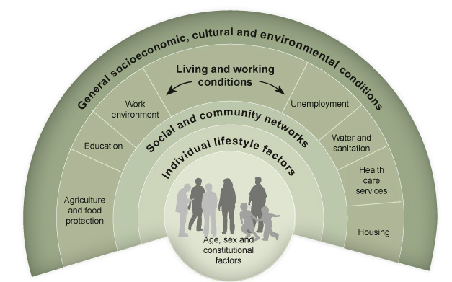
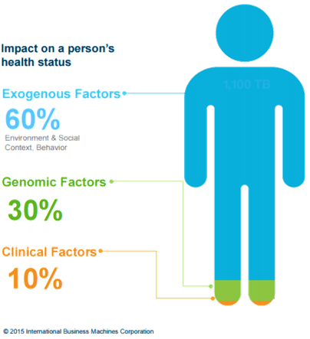
Determinants of Health
@RBaptistaLeite
Dahlgren and Whitehead, 1991

Slide 19
@RBaptistaLeite

Slide 20

Community
Value-based Health System
Public – Social - Private
C-BOM’s
Community Based Outcome Measurements
@RBaptistaLeite

Slide 21


Building a generation of
political leaders
in Global Health
Notes:
“Building a generation of political leaders on Global Health”

Slide 22

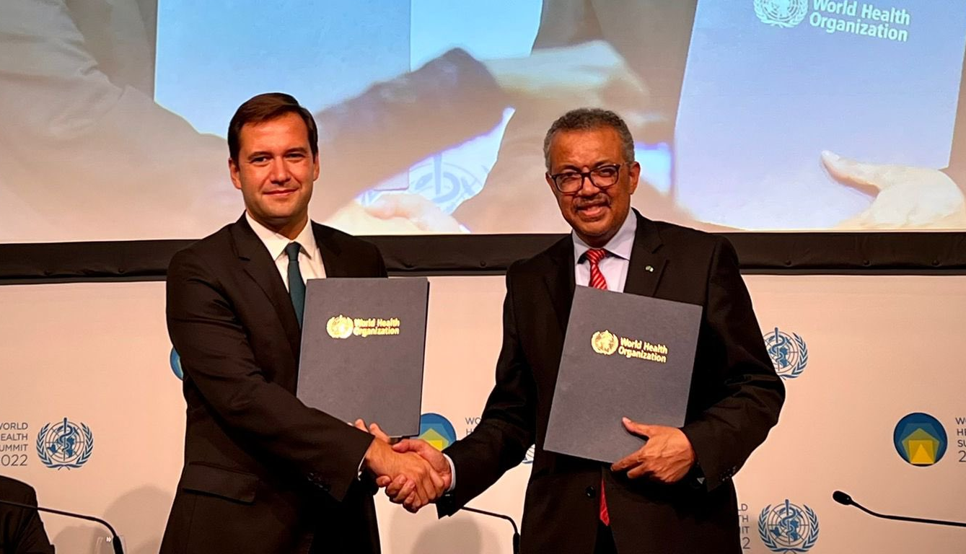






Priority areas of work
what we
do
human rights .and equitable .access to health.
UNITE focuses its activity in providing its members with technical and parliamentary engagement support
connecting.
them with.
providing them with the.
right advocacy tools.
strengthening.
of health.
.systems.
affected communities
international organizations
at the right moment
in the adequate format
academia
civil
society
to act accordingly in their Parliaments
governments
global health .architecture and security.
Notes:
2/ What we do
UNITE focuses its activity in providing technical and parliamentary engagement support to its members by connecting them together, connecting them with affected communities, civil society, academia, and governments, and by providing them with the right advocacy tools at the right moment, to act accordingly in their Parliaments.
UNITE’s work is guided by the objectives of the United Nations Sustainable Development Goals (SDG) and despite focusing its efforts on SDG 3 to reach good health and wellbeing for all, UNITE’s members strongly believe it will take a multisectoral approach contemplating the entirety of the UN SDGs to promote efficient and sustainable policies for improved global health systems worldwide.
UNITE held a Global Board Meeting in Rabat to discuss the UNITE Strategy for the upcoming years. In this event the UNITE Strategic Plan for 4 year was adopted and has been shaping the priorities of the organization in terms of content and events, around the 3 following pillars:
Human rights and equitable access to health;
Strengthening of health systems;
Global health architecture and security.

Slide 23
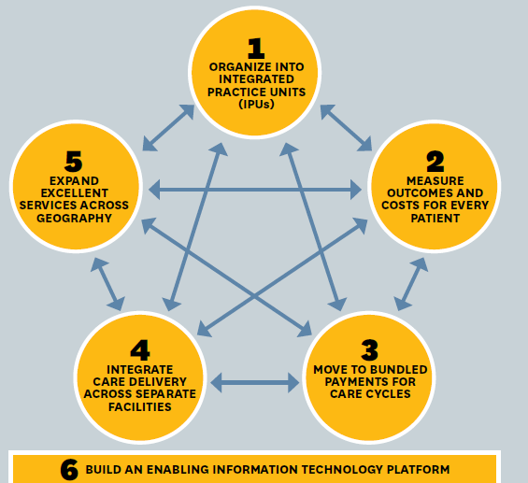

The role and importance of Health Information Technologies
@RBaptistaLeite
Porter ME, Lee TH, The Strategy That Will Fix Health Care, Harvard Business Review, October 2013

Slide 24
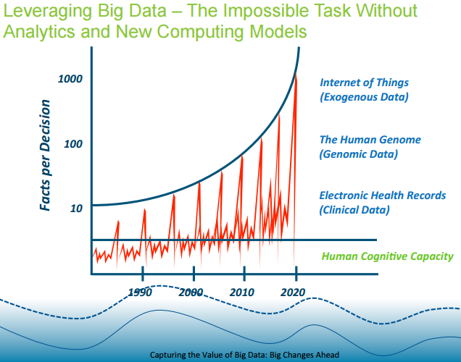
ICT Challenges in Healthcare
@RBaptistaLeite
William Sted, IOM Meeting, 8 October 2007. Growth in facts affecting Provider decisions versus human cognitive capacity.

Slide 25
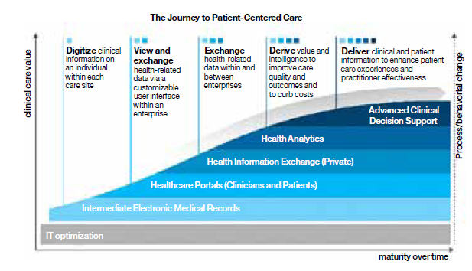
ICT Challenges in Healthcare
How to get here?
@RBaptistaLeite
Source : IBM Center for Applied Insights

Slide 26
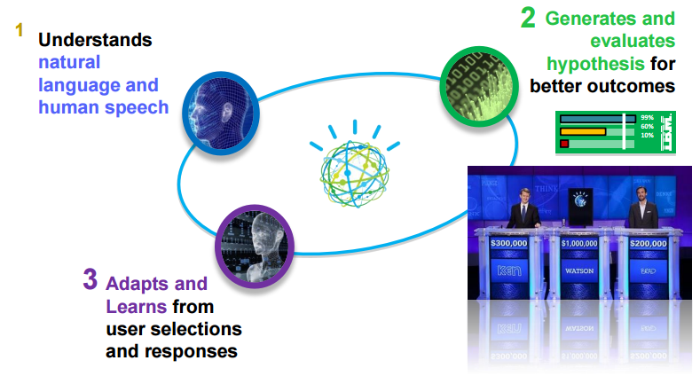
Trends for the Next Decade
Artificial Intelligence for Health
Integration of knowledge with data towards generating better decisions and outcomes
@RBaptistaLeite

Slide 27
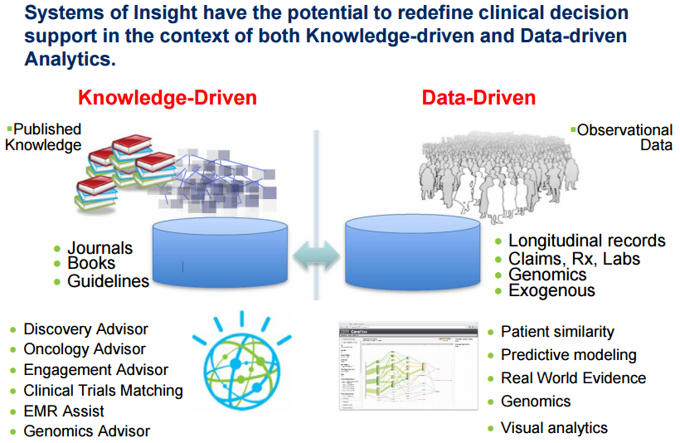
Trends for the Next Decade
@RBaptistaLeite

Slide 28
Trends for the Next Decade
“The Rise of Digital Health Care”
Disruptive Innovation and Evolution of a New Ecosystem for Sustainable Health
Sustainable Health:
Risk Reduction and Wellness
Mastery of Data-Intensive Biomedicine
Digital Medicine:
The infocosm of Healthcare
Molecular Medicine:
Precision Dx and Personalised Rx
@RBaptistaLeite
Dr. George Poste – Arizona State University, INFORMS Annual Meeting, Phoenix, USA, October 2012

Slide 29

Cloud-based Technology
Rise of Computational Capacity
Clinical Decision and Management Support tools (AI, QC, …)
Syndromic E-Screening
‘Nudging’ for better health
Patient Management NHS GPS
Remote Patient Monitoring and Interventions (autonomous)
Distance medicine 4.0
@RBaptistaLeite

Slide 30


‘Health Data’ as a Public Good
give blood
give data
‘DATA’ is ‘the electricity’ of the 21st Century
@RBaptistaLeite

Slide 31

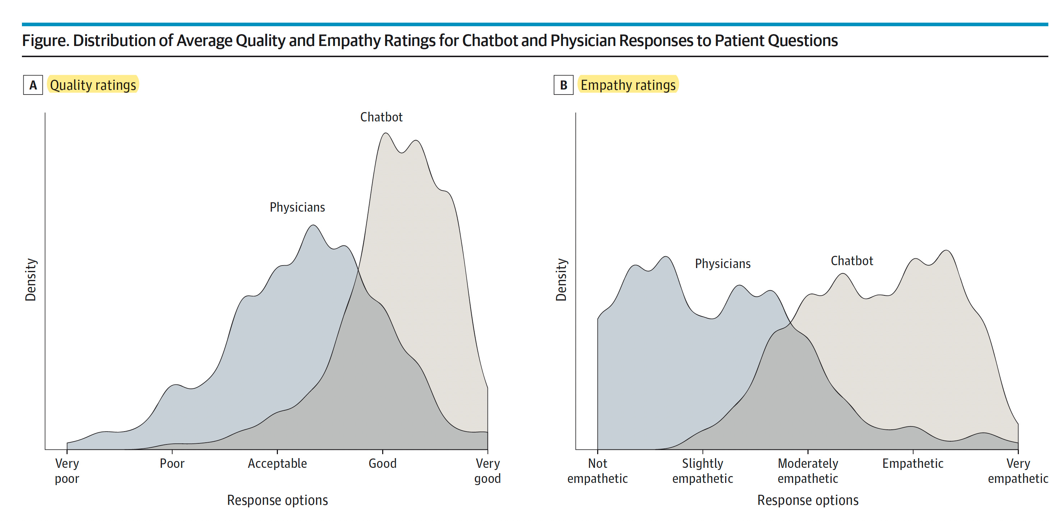
Respondents favoured the chatbot's responses over the physicians', giving them significantly higher ratings for quality and empathy.
JAMA, April 2023
The use of AI in US healthcare is evolving rapidly and lacks full regulation.
We must ensure that ChatGPT usage adheres to all pertinent laws and regulations.
Forbes, May 2023
28

Slide 32


38

Slide 33

When computers deal with your health…
Who deals with the computers?
39

Slide 34


Slide 35





I-DAIR’s New Strategic Direction
Responsible AI Solutions for Health
National/Regional validation of Responsible AI solutions for Health
Global Regulatory Responsible AI for Health Network
Global Public Registry of Responsible AI Solutions for Health
Advisory Support on Policies and Regulations
Notes:
Good morning, Honorable Ministers, distinguished colleagues and esteemed guests. It is a privilege to once again be with you all during this G20 Health Ministerial meeting under the leadership of the India G20 Presidency. Since we met in Hyderabad, and before then, in Kerala and Goa, much progress has been made on the Global Initiative on Digital Health, the GIDH – or as we call it the ‘Guide’ for short.

Slide 36
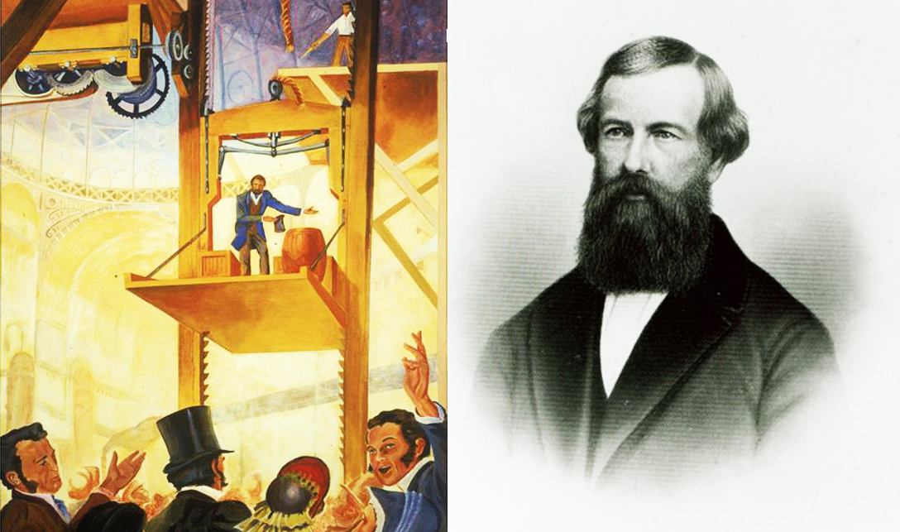

Slide 37





IMPROVED HEALTH
REDUCED COST AND WASTE
IMPROVED CARE
@RBaptistaLeite

Slide 38
Thank you!
ricardo.baptistaleite@gmail.com

