Slide 1


Climate Change Agreement for techUK
Note 15: Application Documentation
August 2021
Transfer of Ownership – Application Documents
As detailed in Note 02 - Transferring Ownership of a CCA, there are a number of documents that will need to be prepared for your application to the CCA register:
This note aims to provide guidance on how the Environment Agency will expect the documents to look, detailing aspects that they will check when making a decision on whether to approve the application.
Document | Format | File Type to submit
CCA Eligibility Application Form | Excel workbook | Excel
Process Description | Written document | pdf
Eligible Process Description | Written document | pdf
Description of Directly Associated Activities | Written document | pdf
Process Flow Map | Diagram | pdf
Annotated Site Plan | Diagram/CAD drawing/modified GPS image | pdf
70/30 evaluation | Excel spreadsheet with relevant calculations | Excel
Climate Change Agreement for techUK Page 1 of 14 Application Documentation

Slide 2
CCA Eligibility Application Form
This is an excel spreadsheet to gather information about the company and the site that is required to be entered onto the Environment Agency’s CCA register. Most of the form is self explanatory but some points to note are:
Target Unit Name:
This must be the name of the defined legal entity operating the facility. In the case of sites holding a permit, this would be the permit holder. The considerations below will help determine who is the operator:
Does the proposed operator have the authority and ability to:
Manage site operations through having day-to-day control of plant operations, including the manner and rate of operation
Ensure that permit conditions are effectively complied with
Decide who holds key staff positions and have incompetent staff removed
Make investment and/or other financial decisions affecting the performance of the facility
Ensure that regulated activities are suitably controlled in an emergency.
Responsible Person:
The Responsible Person must have sufficient authority to be able into an agreement on behalf of the company and have a UK address to which any notices may be served. They need to be able to receive notices on behalf of the company but this does not include personal liability, liability remains with the legal entity named in the agreement.
Administrative Contact:
This is the contact for day to day communications regarding the CCA, which will include requests for data submission, invoices, updates on changes, etc. This can be the same person as the Responsible Person and should be an employee of the operator but it is important that they are contactable as often communications will involve deadlines that need to be met to remain compliant with the terms of your agreement.
Variation on an Existing CCA:
If you already have one or more facilities in an existing Target Unit and are applying to transfer ownership of a facility into your company name, as long as the same legal entity is the operator for both old and new facilities, then you may choose for the new facility to join the existing target unit. This is known as ‘bubbling’. If you wish to bubble please enter the receiving target unit ID into this field.
Please complete all fields– frequently forms are returned due to ETS and other information being incomplete.
Climate Change Agreement for techUK Page 2 of 14 Application Documentation

Slide 3
Eligible Energy, Directly Associated Activities and Ineligible Energy
All energy consumed on site will fall into one of three categories:
Eligible:
This is energy used in the eligible process, i.e. activities that meet the sector definition – for techUK this is:
‘’The business activity is the leasing or licensing of a data facility which is being used as a data centre. “data facility” means a room, or rooms sharing the same electricity supply circuit, occupied mainly or exclusively by computer equipment which is enabled to transfer data electronically, and where in respect of the room or rooms—
the temperature and humidity is regulated in connection with the operation of the computer equipment;
the electricity supply is at least 200kW; and
electricity is supplied by a back-up electricity supply when the mains supply is interrupted.
This definition limits eligibility to contracting out white space and/or IT equipment to third parties, i.e. colocation. It does not currently extend to enterprise data centres. For further detail on eligibility please see Note 016 - Datacentre CCA eligibility
Directly Associated Activity (DAA):
This is energy used in activities that are integral to serving the eligible process, that could not take place away from site and without which the eligible process would cease. Activities include support services, and can also include those physically linked to the eligible process and such that disruption to these activities would disrupt the eligible process. For data centres, this can also include energy used in activities that are detailed in the contract with the third party such as security, without which the contract conditions would be breached.
Examples of DAAs could be:
HV Switchgear/transformers
HV Generators
UPS & Battery Rooms
Air Cooled Chillers
CRAC cooling
Ventilation Systems
Essential Stores (24 hour on site maintenance kit)
24 hour CCTV and Security Systems
Fire Suppression System
Loading Bay
Goods Lift
Climate Change Agreement for techUK Page 3 of 14 Application Documentation

Slide 4
Eligible Energy, Directly Associated Activities and Ineligible Energy (2)
Ineligible:
Energy which is unrelated to the eligible process is ineligible.
Examples include energy used in offices, canteens, non-essential stores, corridors, car parks
.
White space/racking for the operator’s own sole use and the proportion of directly associated activity energy needed to support this is also deemed ineligible.
Why is the classification of energy use important?
The supporting documents need to evidence that all energy has been accounted for correctly. The Environment Agency will expect to be able to cross refer an area or process across the documents, i.e. that the classification of a process or energy use in a written document matches the classification in the process flow map and likewise the site plan. They will need to satisfy themselves that the amount of energy included in the CCA is correct and therefore that the % of discount that can be claimed is correct.
It is important to note that although a DAA is not ‘eligible process’ energy, it is also not ‘ineligible’ in terms of completing the 70/30 evaluation. It is possible that only 20% of energy on site is used in eligible processes but the site still passes the 70/30 as 70% of energy is used in DAAs. This would mean the site is 90% ‘eligible’ in terms of the 70/30 evaluation.
Climate Change Agreement for techUK Page 4 of 14 Application Documentation

Slide 5
Process Description (Manufacturing Process Description or MPD)
This is a written document describing the manufacturing process conducted at the site from receipt of raw materials to dispatch of final product.
It should be of sufficient detail to allow an unambiguous interpretation of the extent of your process(es). The narrative should also describe the product or range of products being produced.
The MPD may include description of DAAs and ineligible processes to provide a comprehensive description of what happens on site.
Example MPD:
The business activity at the [site name] site in [site location] is the leasing or licensing of a data facility which is being used as a data centre; this is through the provision of serviced co-location facilities for our clients. The service provides secure, air conditioned data halls for the installation of client’s servers which can be provided at rack, cage or whole suite level.
The single storey site building comprises of several data halls with cooling provided by computer room air conditioning (CRAC) units. In addition there are some small office facilities for the organisation’s data centre and sales staff. There is also a loading bay and facilities for the clients to offload and assemble equipment prior to installation in the co-located space.
Heat rejection for the data halls is via externally located free cooling chillers. Humidity control and air handling is via additional separate systems to maintain the safe operation of client’s computer equipment.
The site is capable of delivering 4.8 MW of IT power to approximately 3,000m2 of net customer data centre space. The external supply to the whole site is rated at 10MVA.
The data halls are served via feeds from High Voltage transformers and are also on UPS combined with diesel generators in case of mains power loss. Mechanical loads are fed by a separate set of High Voltage transformers which are also connected to UPS and the site generators, the IT load and rest of site is extensively sub-metered.
Secure access to the site is provided combined with CCTV surveillance; in addition there is a fire detection and suppression system, required to support the secure operation of the co-located data halls.
For the avoidance of doubt, please note that any servers that are for own use have been classified as ineligible for the purposes of the 70:30 evaluation.
Climate Change Agreement for techUK Page 5 of 14 Application Documentation

Slide 6
Eligible Process Description (or EPD)
This is a written document describing just the eligible process. It should evidence how the process meets the sector definition to be eligible and should not include information about DAAs or ineligible activities/areas.
Example EPD:
The business activity at the [site name] site in [site location] is the leasing or licensing of a data facility which is being used as a data centre.
To maintain the safe operation of client’s computer equipment all of the data halls are atmospherically conditioned via; computer room air conditioning (CRAC) units, with heat rejection via externally located free cooling chillers & air handling to provide positive pressurisation to the data halls; humidity control in accordance with ASHRAE data hall design conditions.
The site is capable of delivering 4.8 MW of IT power to approximately 4,000m2 of net customer data centre space. The external supply to the whole site is rated at 10MVA. The electricity is supplied by a back-up electricity supply of UPS combined with diesel generators when the mains supply is interrupted.
Description of Directly Associated Activities (or DAA)
This is a written document describing all directly associates activities that you are claiming in support of the eligible process. An activity should be listed in this document if you can evidence that it is essential to the process and is not to be counted as ineligible in terms of the 70/30.
Example DAA:
HV Switchgear/transformers
Generators
UPS & Battery Rooms
CRAC cooling
Ventilation Systems
Essential Stores (24 hour on site maintenance kit)
24 hour CCTV and Security Systems
Fire Suppression System
Loading Bay
The terms of the service offering to the clients in the lease includes 24 hour on site security and fire protection. Therefore these are being claimed as Directly Associated Activities, as without them, the eligible business activity is unable to take place.
The loading bay has been included as the lease arrangements are such as that the clients are required to unload and install their own IT equipment.
Climate Change Agreement for techUK Page 6 of 14 Application Documentation

Slide 7
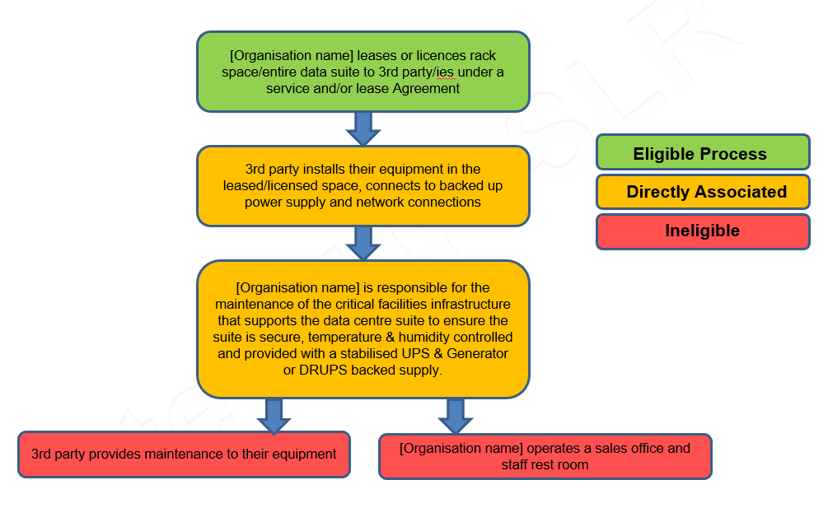
Process Flow Map (PFM)
This is a diagram showing the manufacturing process with activities under each relevant energy classification. The map should be colour coded with a map key.
Example PFM:
Climate Change Agreement for techUK Page 7 of 14 Application Documentation

Slide 8
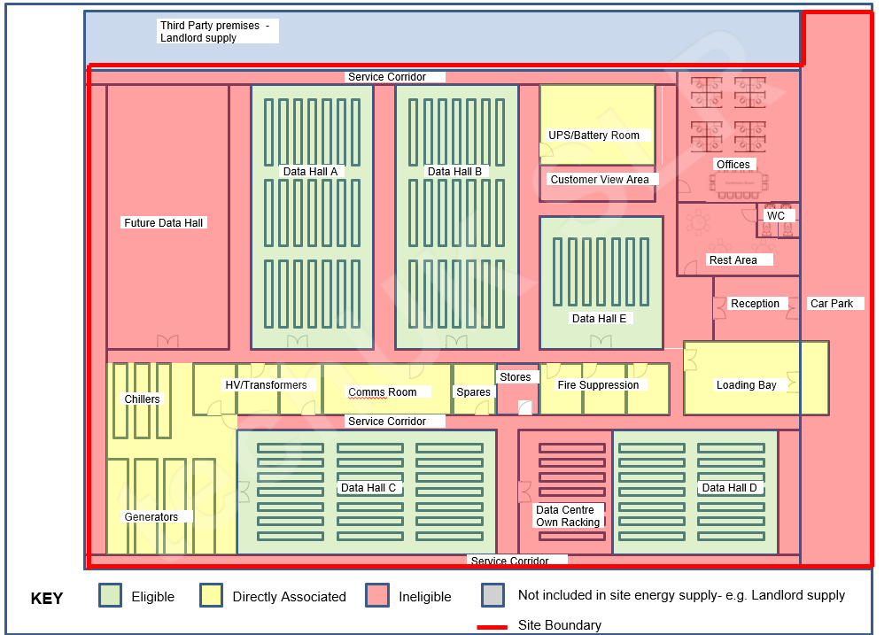
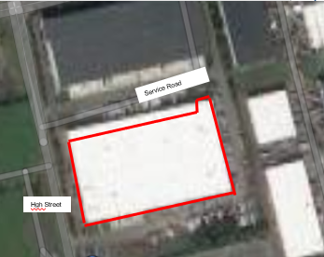
Annotated Site Plan (ASP) Example 1
This is a plan showing the whole site and colour coded and annotated to show where each process/area is on site. It should contain all the elements referred to in the other documents and requires a map key to show the colour coding and boundary line. The boundary line should include all areas consuming energy on site. A satellite image is often asked for to verify the extent of the site to be included in the CCA. Some items, such as security appliances would be difficult to depict so it is acceptable to exclude this detail from the plan.
Climate Change Agreement for techUK Page 8 of 14 Application Documentation

Slide 9
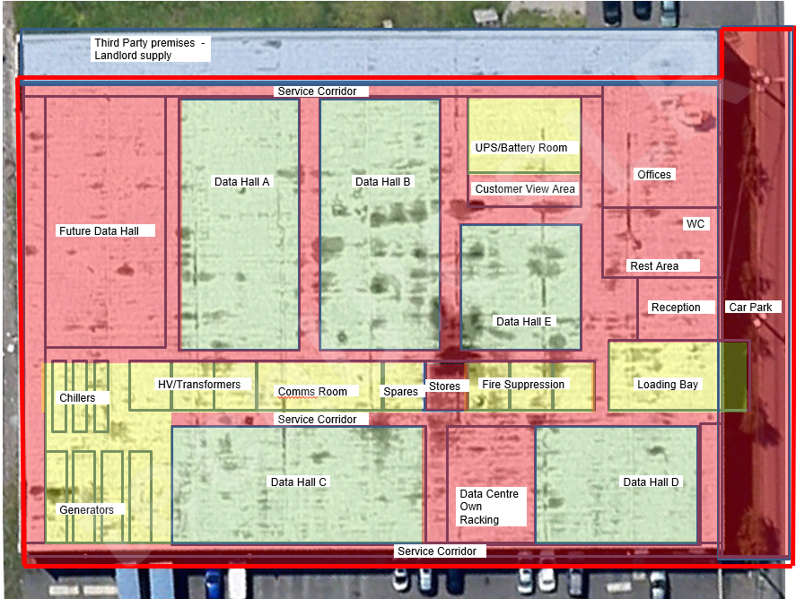
Annotated Site Plan (ASP) Example 2
Plan based on satellite image:
Climate Change Agreement for techUK Page 9 of 14 Application Documentation

Slide 10
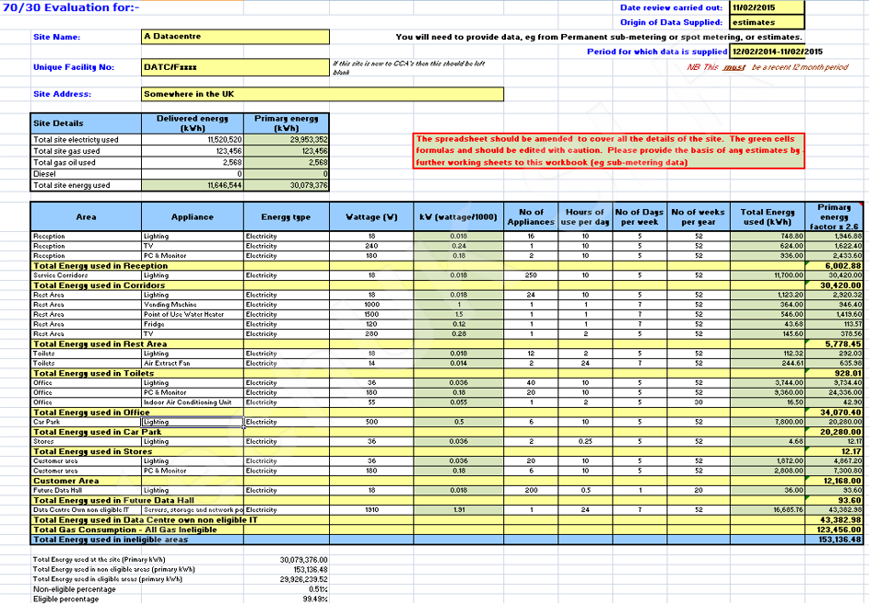
70/30 Evaluation
This establishes the percentage of energy for which CCL relief may be claimed. All ineligible energy use should be accounted for, either by use of submeter readings or by estimates of appliance energy usage.
Total Energy to Site (cells C10-C13) should be in kWh delivered for a recent 12 month period, with the end date being no more than 6 months old. Include fuels covered by UK/EU ETS.
The spreadsheet can be amended to add/delete rows however please check that sub-totals in column L calculate correctly. The eligible % will be shown in the final cell in column D.
If the eligible % is 70% or higher, then CCL relief can be claimed on 100% of energy consumed on site. If under 70% relief can only claimed for the % of energy that is eligible, plus up to 3/7ths additional sub-metered energy (please contact the helpdesk for further detail if this applies).
Example 70/30 using appliance estimates:
Climate Change Agreement for techUK Page 10 of 14 Application Documentation

Slide 11
Notes on 70/30 Evaluation for data centres:
Your site will consist of three categories of space/energy use – Eligible (co-lo IT), Directly Associated Activities and Ineligible (offices, rest rooms, car parks, IT racking purely for your own company’s use, etc). It is important to note that IT load that is for your company’s exclusive use is ineligible, this only applies to equipment that is for your sole use, for activities that are not required to support the data centre, e.g. general company accounting etc. If you use equipment that is jointly used by you and a customer (colo), then this should be treated as eligible.
Firstly you need to assess whether you pass the ‘70/30 Rule’. To pass the rule, at least 70% of the total primary* energy used on site needs to be used either by the CCA eligible process or in supporting the CCA eligible process (i.e. DAA).
The most common approach to assessing the 70/30 rule, is to assess the ineligible primary energy and deduct it from the total primary site energy to show it is less than 30%.
If all ineligible areas are sub metered, then this is straightforward – use the meter readings for the ineligible areas to calculate the total primary ineligible energy.
If the ineligible areas are not sub metered, then you should estimate the usage by counting appliances x wattage x average usage to determine the kWh ineligible use. Average occupancy methodology is not acceptable.
*Primary energy = (2.6 x consumed electricity in kWh) plus other fuels consumed in kWh
If the ineligible primary energy is less than 30% of the total primary energy then by calculation the remaining primary energy; that used by and to support the CCA eligible process (i.e. the eligible and DAA), is more than 70%. The site has therefore passed the 70/30 rule.
When a site passes the 70/30 rule, all of the energy used on site can be included in the CCA baseline and targets, hence it is all entitled to the maximum CCL discount
If the site is very close to the 70% value, this will be scrutinised closely by the Environment Agency (so needs to be robustly measured).
If you have passed the 70/30 rule, you do not need to extensively sub meter the site to prove the split between ineligible energy, eligible and DAAs. However you do still need to have sub meters installed to cumulatively measure the IT load. This is a requirement for all data centre CCAs – see ‘’Note 11 Submetering and base year’’ for further detail on this requirement.
To undertake the 70/30 assessment, a standard spreadsheet is available or you can use your own. The assessment must be submitted as an excel spread sheet so that any calculations can be checked.
Climate Change Agreement for techUK Page 11 of 14 Application Documentation

Slide 12
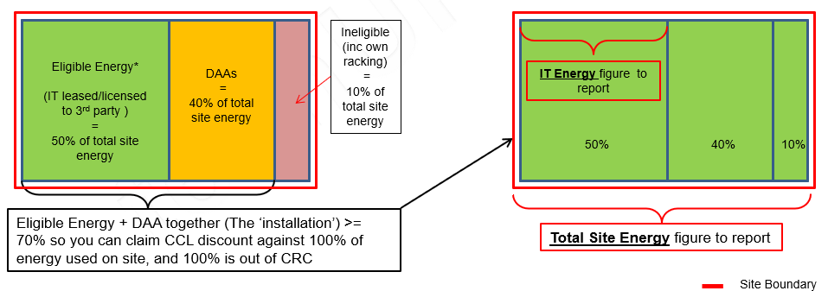
Notes on 70/30 Evaluation for data centres:
Supplying data for your CCA application and reporting if you have passed the 70/30 rule:
For your CCA application, you need to provide data for the 70/30 evaluation, but not for the base year as this will have been determined by the previous operator. You should, however, obtain the evidence pack from the outgoing operator as this would be required in the event of audit.
For data reporting, you will need to report:
Total Site Energy:
This should include all eligible, DAA and ineligible energy (electricity, gas oil, etc) used on site. However, if a site is in ETS, then fuels combusted on site should not be reported as will be reported under ETS. These fuels, however, will still be eligible for CCL discount where levied as are covered by the CCA.
IT Energy:
This is the IT electricity load only as sub metered (can be before the UPS, between the UPS and PDU or after the PDU). Do not include DAAs but do include your own racking (although this is counted as ineligible for purposes of the 70/30, it is included in the IT Energy figure but only if you pass the 70/30 rule).
*The EA also refers to the ‘eligible energy’ as the STU = Stationary Technical Unit
Climate Change Agreement for techUK Page 12 of 14 Application Documentation

Slide 13
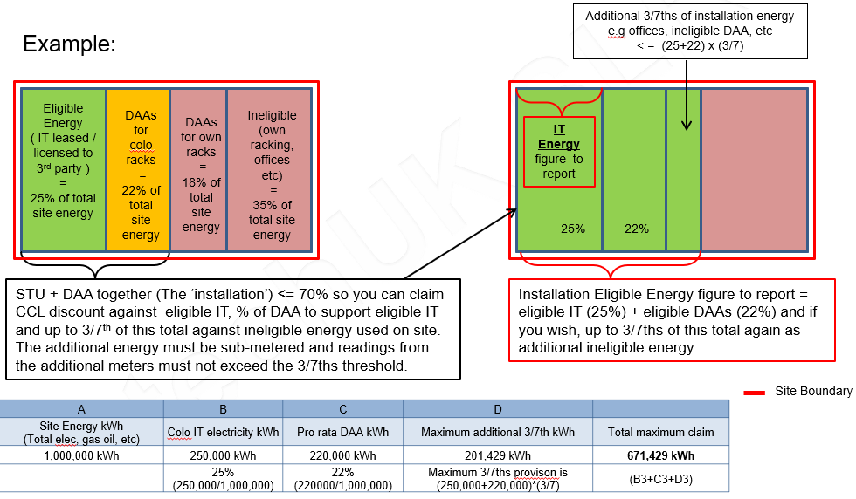
Notes on 70/30 Evaluation for data centres:
Supplying data for your CCA application and reporting if you have failed the 70/30 rule:
Sites failing the rule must separately sub meter the energy used for the eligible process and supporting DAAs, plus any additional 3/7ths of ineligible energy that you wish to claim. Energy for shared DAA such as crack units in halls occupied by both colo and non-eligible racks should be pro-rated to the same ratio.
Because a site that passes the 70/30 rule gets up to an extra 3/7th of their site energy included in their CCA baseline and targets, a failing site is also allowed to claim an extra ‘3/7ths’ of ineligible energy in the CCA baseline and targets (but it must be sub-metered).
For data reporting, you will need to report:
CCA Site Energy:
This is energy that is included in the CCA, i.e. that which is used in the colo IT, DAAs to support this and the extra 3/7ths allowed, if sub-metered.
IT Energy:
This is the colo IT electricity load only as sub metered before the UPS, between the UPS and PDU or after the PDU. Do not include DAAs or your own IT racking/usage.
Climate Change Agreement for techUK Page 13 of 14 Application Documentation

Slide 14
For further information please contact SLR’s techUK CCA helpdesk:
+44 (0)844 800 1880
techUK@slrconsulting.com
or visit www.techuk.org/developing-markets/data-centres.html
The full suite of techUK CCA Guidance Notes are listed below and can be accessed via contacting the helpdesk or visiting the website.
Guidance Note | Title
1 | What is a CCA
2 | Transferring Ownership of a CCA
3 | techUK CCA Administration Charges
4 | Completing HMRC PP10 and PP11 Forms
5 | Timetable of techUK CCA Activities
6 | Obligations under your CCA including audits
7 | Reporting data at each Target Period
8 | How CCAs interact with other schemes
9 | Glossary and Abbreviations
10 | What happens if...
11 | Submetering and base year
12 | Measuring Generator Fuel
13 | State Aid Transparency reporting
14 | Penalties for non compliance
15 | Application Documentation
16 | Datacentre CCA eligibility
Climate Change Agreement for techUK Page 14 of 14 Application Documentation

