Slide 1
Fire Innovation Forum - Digital and Data Skills
Kirsty James
West Yorkshire Fire and Rescue Service
Notes:
Intro
Fundamental to the future of our sector: digital and data literacy
why it matters, what we’ve learned, and what we need from industry partners to accelerate progress.

Slide 2


Why Digital & Data Skills Matter
Beyond Fire and Rescue Services
Within Fire and Rescue Services
Notes:
Digital and data skills are no longer “nice to haves.”
They are life skills.
For our staff — firefighters, control, support staff — these skills matter because:
They improve safety
They support better decisions
They reduce risk
They make systems easier, not harder
They protect our people personally as well as professionally
For example, understanding cyber security basics helps them protect their station login and helps them protect their children from online scams at home.
When we make this connection clear, motivation skyrockets.
In the fire service, digital and data literacy underpin:
Smarter operational decision-making
Risk reduction work
Performance management
Data entry accuracy
Prevention insights
Community safety work
Efficient use of limited resources
Our ability to evidence value
We also work in high-pressure contexts.
People need systems that don’t slow them down or confuse them.

Slide 3


Why Digital & Data Skills Matter
Beyond Fire and Rescue Services
Within FIRE AND RESCUE SERVICES
Notes:
Digital and data skills are no longer “nice to haves.”
They are life skills.
For our staff — firefighters, control, support staff — these skills matter because:
They improve safety
They support better decisions
They reduce risk
They make systems easier, not harder
They protect our people personally as well as professionally
For example, understanding cyber security basics helps them protect their station login and helps them protect their children from online scams at home.
When we make this connection clear, motivation skyrockets.
In the fire service, digital and data literacy underpin:
Smarter operational decision-making
Risk reduction work
Performance management
Data entry accuracy
Prevention insights
Community safety work
Efficient use of limited resources
Our ability to evidence value
We also work in high-pressure contexts.
People need systems that don’t slow them down or confuse them.

Slide 4
Explaining the “Why” to End Users
Makes it relevant
Builds a desire to learn
Saves them time
Notes:
We learned early on that people don’t resist digital tools —
They resist not understanding why they matter.
So we changed our approach:
We start every rollout with the why
We explain the personal benefit
We show how simple changes prevent rework, reduce errors, and save time
We show how using data helps them succeed in their role
We make the work relevant to their world — not ours
When we talk about digital and data literacy this way, people lean in.

Slide 5



Explaining the “Why” to End Users
Makes it relevant
Builds a desire to learn
Saves them time
Notes:
We learned early on that people don’t resist digital tools —
They resist not understanding why they matter.
So we changed our approach:
We start every rollout with the why
We explain the personal benefit
We show how simple changes prevent rework, reduce errors, and save time
We show how using data helps them succeed in their role
We make the work relevant to their world — not ours
When we talk about digital and data literacy this way, people lean in.

Slide 6
What We’ve Done So Far
Digital Literacy
Advanced Data Literacy
Personas & Targeted Upskilling
Five‑Week Data Series with Stephanie Posavec
OneView: Our Single Source of Truth
Embedding Digital Inclusion
Notes:
At WYFRS, we’ve invested heavily in building digital fluency:
1. Digital Literacy eLearning
Over 1,100 staff completed our in‑house course
National interest from NFCC
Being considered as a sector standard
2. Advanced Data Literacy Workshops
90+ staff trained so far
Practical, scenario-based
Focus on confidence and curiosity
3. Five‑Week Data Series with Stephanie Posavec
Making data approachable, visual, engaging
4. OneView: Our Single Source of Truth
A platform that simplifies data, improves decisions
Staff can drill down to risk, trends, and insights
Real examples like identifying hotspots for secondary fires
5. Personas & Targeted Upskilling
DDaT personas help us tailor training
Execs need short, sharp 1:1 learning
Operational staff need hands-on, scenario-based sessions
Half a day with all new recruits
6. Embedding Digital Inclusion
Accessibility as a core requirement
No one left behind

Slide 7




Where Our Gaps Are Now
UX and Design
Unintuitive Systems
Accessibility Varies
Limited Influence
Notes:
Despite our progress, we still face significant gaps:
Systems are not consistently intuitive
Accessibility is still variable across vendors
UX and design capability in-house is limited
We need developer education on accessibility, UI design, and usability
Skill levels still vary dramatically
Legacy systems slow down adoption
People lack trust when systems "look different" or feel unfamiliar
And we have limited influence over external product design (Fire sector is small)
This is where we want to partner with industry.

Slide 8
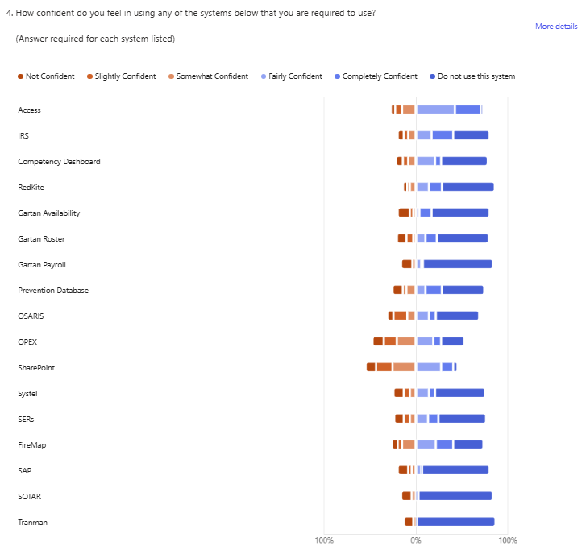
Survey Insights
System Competency
How confident are they when using the systems required of their role?
Notes:
Our Digital & Data Survey revealed something important.
Confidence levels vary hugely — and this shapes adoption.
Many of the gaps we see have nothing to do with capability…
and everything to do with fear of getting something wrong.
This is a solvable problem — with good design, consistent interfaces, and accessible training.
Digital Literacy has a direct link into into data quality and data literacy
23 of the people who responded were system owners or Admins for a system.
41% of the responders said that there was issues around the data.
35% of system owners said there was no guidance for key processes.
They also told us where they felt our different staff groups competencies were at the time.
This showed a large group of staff as being not competent.
14 systems have no training registered. The others are very infrequent

Slide 9
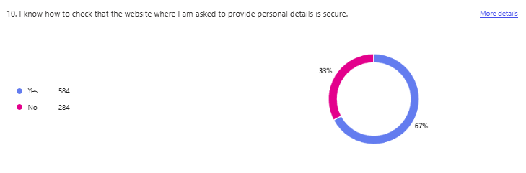
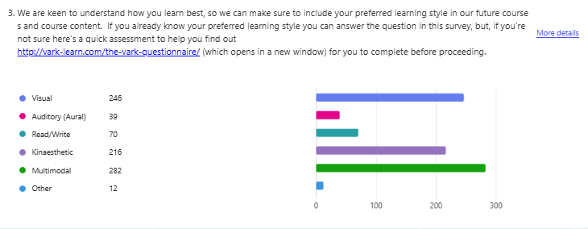
Survey Insights
Security
Do they know how to check websites to ensure personal data is secure?
Preferred Learning Style
How do they learn best?
Notes:
Majority of learning styles are Kinaesthetic or Visual
We cant just learn on eLeaning
It needs to meet all learning style needs and be accessible to all
3 hour CPD face to face for all crews and support at all levels
TikTok style short videos

Slide 10
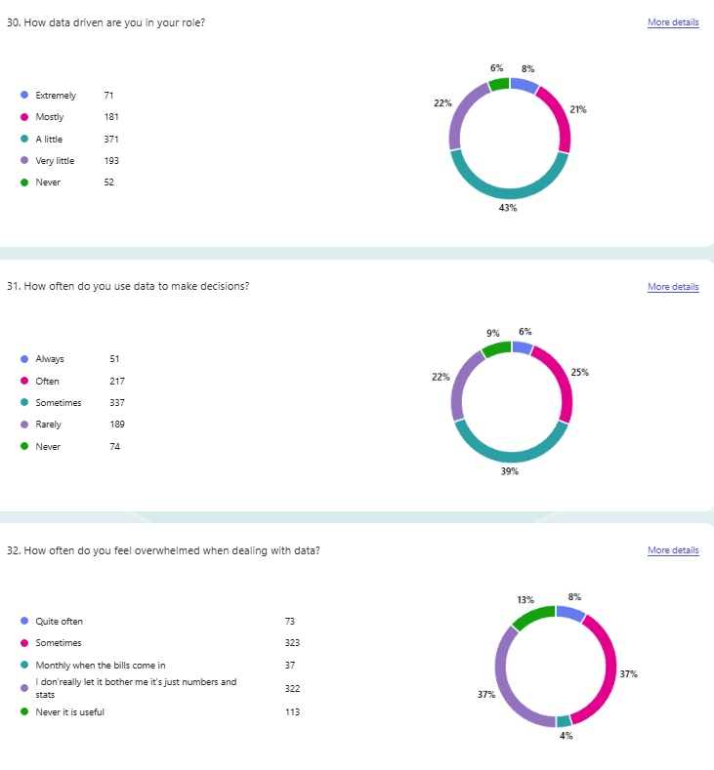
Survey Insights
Data Drivers
How data driven are their roles?
Decision Making
How often do they use data to make decisions?
Data Confidence
How often do they feel overwhelmed when dealing with data?

Slide 11
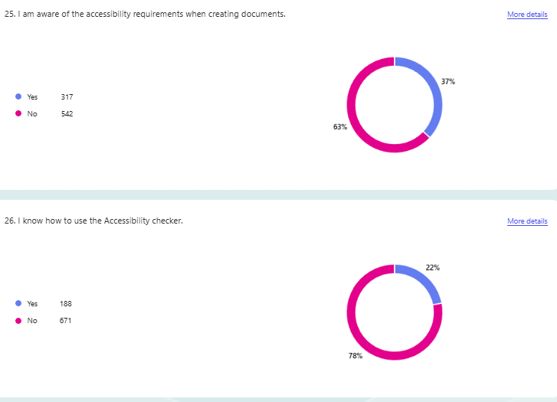
Survey Insights
Accessibility
Are they aware of accessibility requirements when creating documents?
Do they know how to use the accessibility tracker?

Slide 12
What We Need from Tech Industry
Accessibility
Familiarity and Trust
UX Training for Developers
Notes:
This is my key message to the tech sector:
Accessibility cannot be an afterthought.
It must be foundational.
We need:
Clear fonts
Strong colour contrast
Scalable interfaces
Simple navigation
Consistent components
Predictable layouts
If it isn’t usable, it won’t be used — especially in fire and rescue.
Familiarity is a safety feature.
When every system looks different:
People assume it’s not secure
They think it's from another organisation
They believe they must relearn everything
The cognitive load is huge.
We already use a PowerApps design template to standardise:
Fonts
Colours
Data validation
Navigation
Buttons
Terminology
We need big tech companies to support similar templating and design guardrails across their products.
Many developers know how to build.
Fewer know how people actually use what they build.
We’re asking for:
UX training to be an expected part of developer programmes
Accessibility certification pathways
Co-designed fire-specific UI patterns
Tools that encourage simplicity, not complexity
If developers don’t understand users, the product will never succeed — no matter how clever the code is.
We don’t just want vendors.
We want collaborators.
Here’s what partnership could look like:
Co-designing accessible templates and UI patterns
Fire‑service‑specific prompt libraries for Copilot and AI tools
Joint digital literacy programmes
Shared data literacy curricula for emergency services
Affordable licensing models for shift and part-time staff
Transparent AI documentation
Training that is shorter, simpler, and easier to embed
Together, we can dramatically accelerate capability in this sector.

Slide 13
Vision
A Digitally Confident Fire Sector
Digital and data literacy are about people, culture, and confidence
Notes:
Imagine a fire service where:
Every firefighter can access and understand the data they need
Every system is intuitive, accessible, and familiar
Every member of staff feels confident using technology
Digital inclusion is automatic
AI tools support, not overwhelm, end users
The entire workforce has the digital resilience to thrive at work and at home
That’s where we’re heading — but we need strong industry partnership to get there.
Digital and data literacy are about people, culture, and confidence.
Technology is only as good as the hands it’s placed in.
If we design systems people trust, teach skills people understand, and explain why it matters —
we unlock enormous potential across the fire and rescue sector.
I’m excited to work with many of you to make that a reality.

