Slide 2

techUK workshop
Future demand for unlicensed spectrum

Slide 3

DECT Forum
What is the DECT Forum:
Global organization representing the DECT industry
Around 40 members active with consumer and/or
professional DECT solutions
Activities:
  Marketing the DECT technologies
  Defending and expanding spectrum access
  Certifying DECT products (interoperability and quality)
Working closely together with ETSI TC DECT who
develop the technical standards
Representing both the classic DECT as well as the
new DECT NR+ worlds
Roel Ottink
DECT Forum

Slide 4
History of DECT regulation
1991 – EC legislates to harmonise the 1880-1900 MHz band for DECT (cordless telephony) (Council Directive 91/287/EEC and Recommendation 91/288/EEC)
1994 – ERC Decision (94)03 to introduce DECT to the 1880-1900 MHz band in CEPT, followed in 1998 by ERC Decision (98)22 to make DECT licence exempt
1996 – UK already exempted DECT: The Wireless Telegraphy (Cordless Telephone Apparatus) (Exemption) Regulations
1999 – DECT added to the Wireless Telegraphy (Exemption) Regulations and the 1996 Regulations revoked
2000 – Regulations amended to reference IR2011. For DECT equipment to be licence exempt it must comply with the “minimum requirements set out in the IR”
Since 2000 – minor amendments to the Regulations but essentially the same as in 1996

Slide 5
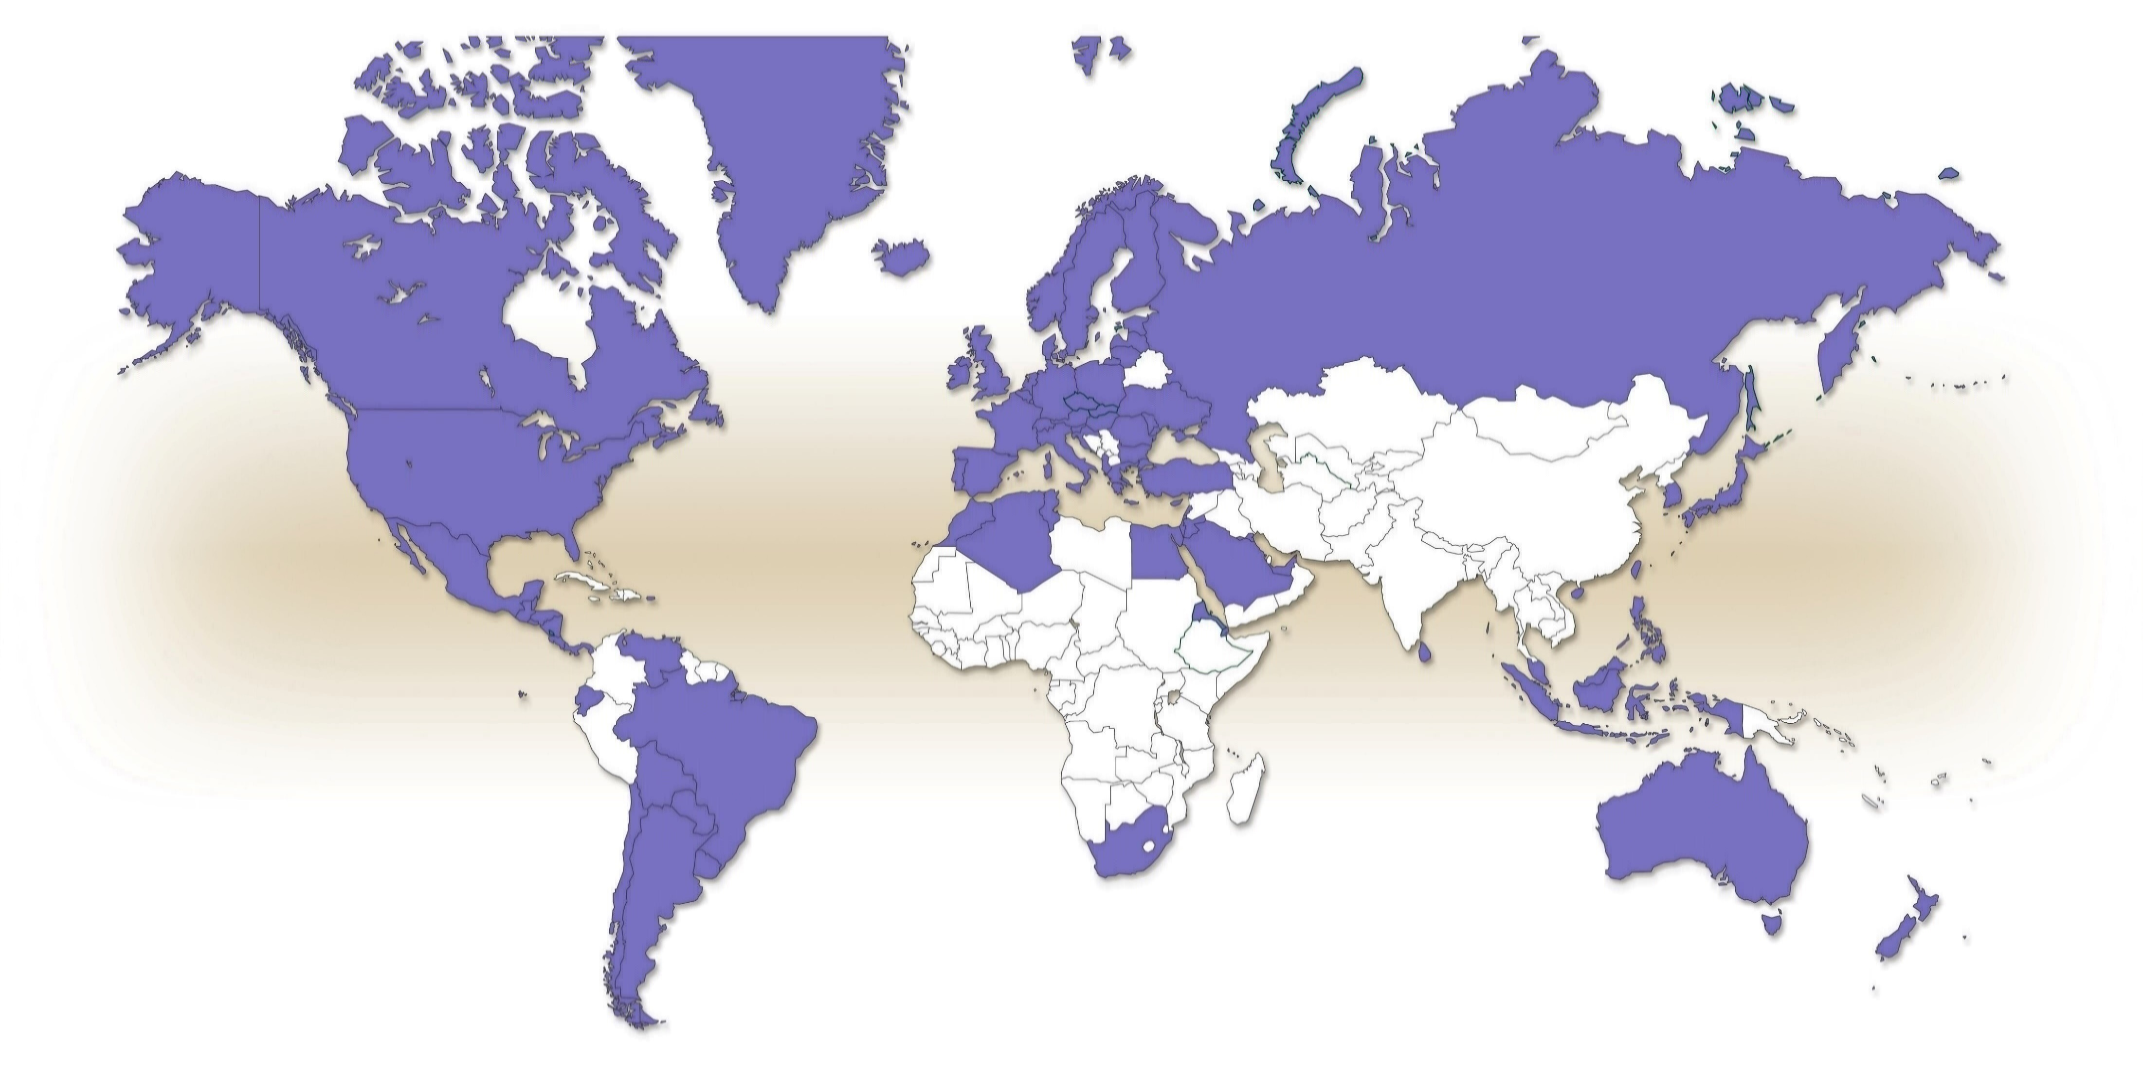
DECT World Map

Slide 6
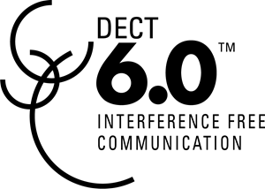






DECT technology evolution
1990
2000
2010
2020
DECT
GAP
DECT Evolution

Slide 7
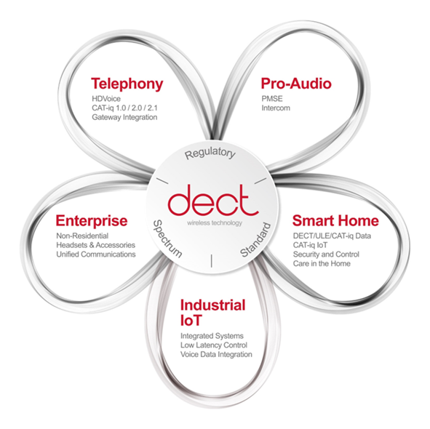
DECT application areas
Market development

Slide 8
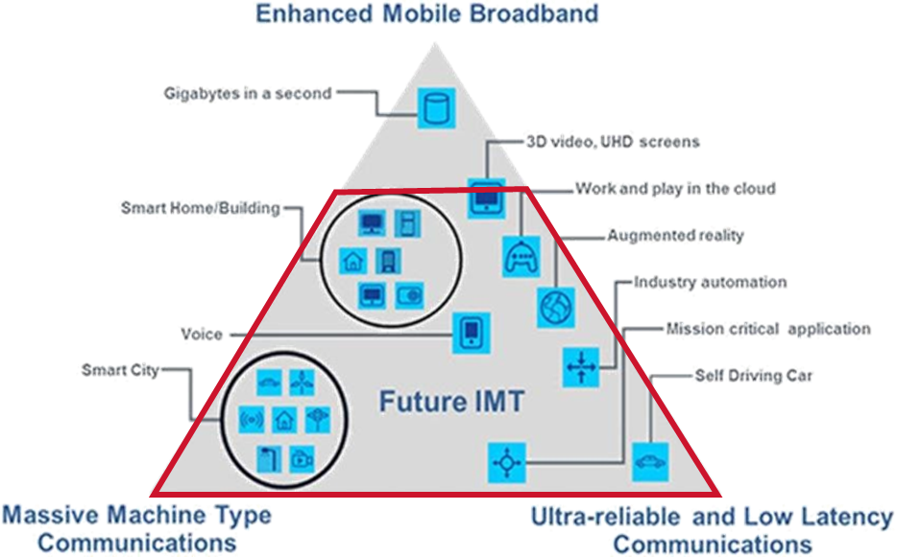
DECT NR+ overview
DECT NR+ is the marketing name for the standard DECT-2020 NR
DECT-2020 NR is developed by ETSI
Designed to meet the IMT-2020 (5G) framework
requirements for:
  massive Machine Type Communications (mMTC)
  Ultra-Reliable and Low Latency Communications (URLLC)
Formally recognized by the ITU-R as an
IMT-2020 (5G) standard
Initial deployment in the DECT band (1.9 GHz)
Possible deployment in bands up to 6 GHz

Slide 9

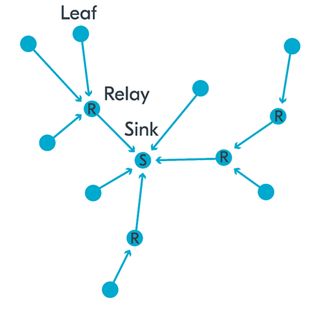

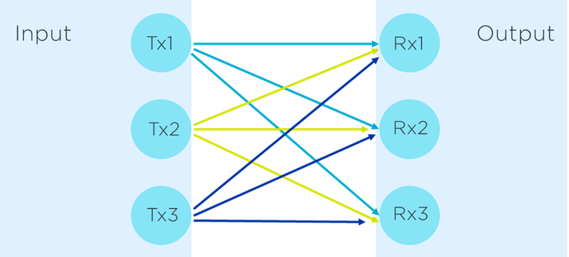
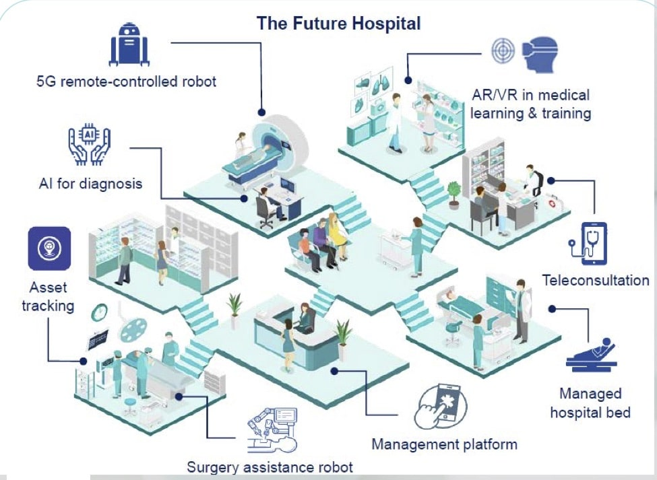
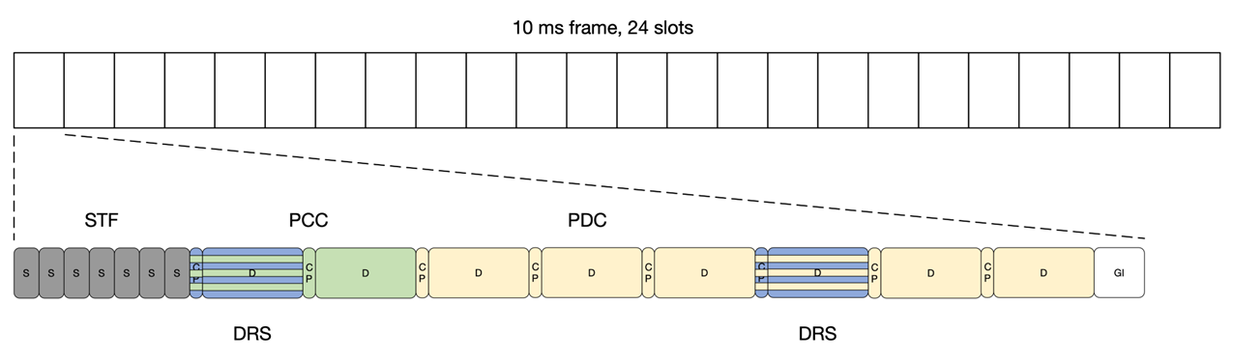
DECT NR+ use cases
Applications and use cases
Features and benefits
Technology foundation
Mesh networking
High density (mMTC)
Ultra Low Latency and reliability (URLLC)
Licensed & licence free operation
Dedicated frequency band
Private networking
Self healing and robust
Range

Slide 10

DECT NR+ for private networks
  DECT NR+ is a wireless communication technology that can be deployed by anyone, operated by anybody and used anywhere.
  DECT NR+ devices support autonomous operation which is a key character enabling to co-exist with other local networks in the same area sharing the spectrum
  Technology is easy to introduce into new frequency bands
  DECT NR+ is an application agnostic technology supporting both IP and non-IP applications. It can be adapted to different use cases fostering digitalization.
  DECT NR+ supports ultra-reliable low latency communication and massive-scale machine communication networks exploiting mesh communication by supporting different network topologies.

Slide 11
Future spectrum demand
  Growth of wireless IoT, PMSE and applications for vertical markets will drive demand for more spectrum
  The need to licence may limit the development of a mass market
  Easy access to spectrum, such as under a licence exemption will attract many companies to develop new products and solutions, thereby maximizing innovation
  Sharing spectrum between different technologies will ensure efficient use of available bandwidth

