Slide 1


Transformation Through Innovation
MHRA’s Journey to Becoming an AI-Enabled Health Regulator
Claire Harrison
Chief Digital and Technology Officer

Slide 2
Why Transformation Was Essential
Political pressure for faster clinical trial assessments
Align with national technology and growth strategies, and global best practices
Increasing threat of counterfeit medical products
Outdated legacy systems
Demand for smarter, faster, safer regulatory tools
Cyber vulnerabilities
Partnerships to replace supplier-driven digital delivery
Support UK science & technology superpower ambitions
* AI concerns … ethics … safety (risk proportionate)
… a moment to lead, not lag
Digital By Default. Secure By Design. Prove By Doing.

Slide 3
Technology Roadmap - Strategic Themes
Supported by 3 principles DIGITAL BY DEFAULT. SECURE BY DESIGN. PROVE BY DOING
Leveraging the spectrum of innovation with technology. From cutting-edge technologies for productivity and efficiencies, through to decision support and decision-making AI, on a sliding scale with risk and benefits
Innovation
Legacy technologies and processes are inefficient and often unsafe. We need solid foundations to support innovation and optimised digital solutions
Tech Modernisation
Cyber Resilience
Cyber security is a critical enabler in technology. We defend against new technologies but we also utilise cutting-edge technologies to defend and keep MHRA secure
Digital & Technology Group
Digital By Default. Secure By Design. Prove By Doing.

Slide 4
Innovation Readiness … Transforming The Foundations
Talent: recruit, retain, retrain
- ‘Spend to Save’ business case’ – balancing in-house with partnerships
- apprenticeships & internships, career changes
- upskilling, shadowing, promotions
Cyber: collaboration, principles, taskforce
- ‘secure by design’ - baked into everything, not just ‘pen-testing’ <ggrrr!>
USA, NHSE, NCSC
prioritisation supply chain, user behaviours, technologies – new and old
Technology: maintenance, modernisation, sustainability
infrastructure first - expensive to maintain and interoperability issues
‘lift and shift’, strangler pattern for applications (including spreadsheets?!)
new tech criteria …TCO, in-house skills/externally, trial evaluations with users
Digital By Default. Secure By Design. Prove By Doing.

Slide 5

Artificial Intelligence in MHRA
AI has been identified as one of the five critical technologies in the UK Science and Technology Framework. As a science-led organisation, the MHRA has a key role to play in enabling the UK to be a science and technology superpower by 2030. The agency is considering the opportunities and risks of AI from three different perspectives.
As a regulator of AI products that impact on public and patient safety.
As a public service organisation delivering time critical decisions.
As an organisation that makes evidence-based decisions where that evidence is supplied by third parties.
Digital By Default. Secure By Design. Prove By Doing.

Slide 6
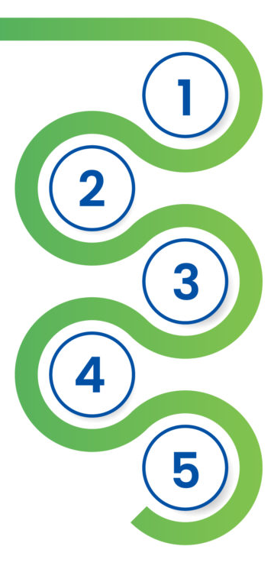
Product Lifecycle – AI Solutions (batch 1)
British Pharmacopoeia Enquiry handling
Medicines standards are used as reference materials to ensure consistency
Discovery & Development
Research for a new medicine begins in the laboratory
Preclinical Research
Medicines undergo laboratory and animal testing to answer basic questions about safety
AI for Clinical Trials
Tools to support the validation and assessment of clinical trial applications
Clinical Research
Medicines are tested on people to make sure they are safe and effective
Identification of ‘rogue’ on-line sellers
Enforcement teams actively investigate and take down websites selling illegal / counterfeit medicines and devices
MHRA Review
MHRA assessors thoroughly examine all of the submitted data related to the medical product in order to make a decision
Automated submission reviews
Tools to support the validation and assessment of Product Licences
Post-Market Surveillance
The MHRA monitors medicines safety once products are available for use by the public.
Literature monitoring
Continuous scanning scientific literature for safety signals
Prioritisation algorithms
Help allocate limited regulatory resource to highest risk products
Decision consistency
Ensure similar products receive consistent treatment
Digital By Default. Secure By Design. Prove By Doing.

Slide 7
Challenges and Opportunities
We identified ~20 use cases for prototyping with different technologies with different AI paradigms. Use-cases range from productivity, through to decision making across all areas of the business, including communications, customer service and Helpdesk; as well as across the regulatory activities for the whole product lifecycle, including post-market surveillance. We take a risk-proportionate approach tailored to each use-case rather than a ‘one size fits all’ risk-averse approach.
Productivity
Decision Support
Decision Making
Low Risk
High Risk
We have updated our 12-month technology roadmap with emphasis on three strategic themes: innovation, technology modernisation, and cybersecurity which are fundamental to the successful deployment of AI. We also have a refreshed plan for information governance and data protection policies as well as for new ways of working.
Digital By Default. Secure By Design. Prove By Doing.

Slide 8
Fighting illicit websites with AI

Slide 9
Focus On Illicit Websites
Problem
TRI partnered with the MHRA to combat the issue of websites selling medicines to the UK public illegally (without the required prescription, for example) - work that until now had been manual and time-consuming.
Solution + Impact
We developed an AI-powered tool that detects and analyses fraudulent online platforms. The tool uses web scraping to collect potentially suspicious URLs and leverages machine learning and Natural Language Processing (NLP) models for classification, identifying websites as red (high risk), amber (moderate risk), or green (low risk)
Identify suspicious sites
10x faster
turning a
30-hour
task into a
3-hour
task
Digital By Default. Secure By Design. Prove By Doing.

Slide 10


Key Benefits and Impact
DATE OF RUN
TOTAL URL COUNT
RAG RATING
12.12.2024
266
12 Red
178 (114 forbids scrapping + 64 analysis performed) Amber
75 Green
Benefits
✓ Customisable & Scalable
Adaptable for various regulatory needs, with modular design for future enhancements.
✓ Proactive Fraud Detection
Identifies emerging threats before they escalate.
✓ Efficiency & Automation
Reduces manual workload for enforcement teams
✓ Data-Driven Decision Making
Provides detailed insights into fraudulent trends and compliance issues.
Digital By Default. Secure By Design. Prove By Doing.

Slide 11
British Pharmacopoeia
Enquiry Handling

Slide 12








Manual Process
Reviews BP
Sends Query
External User
MHRA Team
Sends Response
Reviews Historic Queries
Digital By Default. Secure By Design. Prove By Doing.

Slide 13

AI Enabled Process
AI Assistant
Access AI Assistant
Sends Query
External User
MHRA Team
Sends Response
Digital By Default. Secure By Design. Prove By Doing.

Slide 14
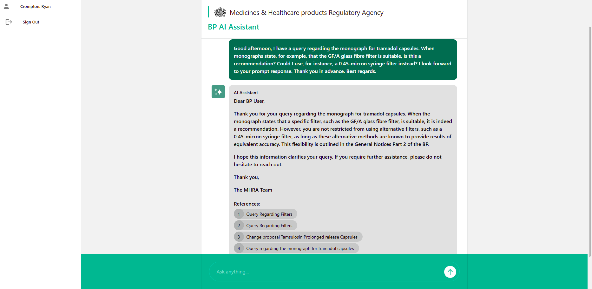
BP Enquiry Automation
Digital By Default. Secure By Design. Prove By Doing.

Slide 15
AI for Clinical Trials

Slide 16
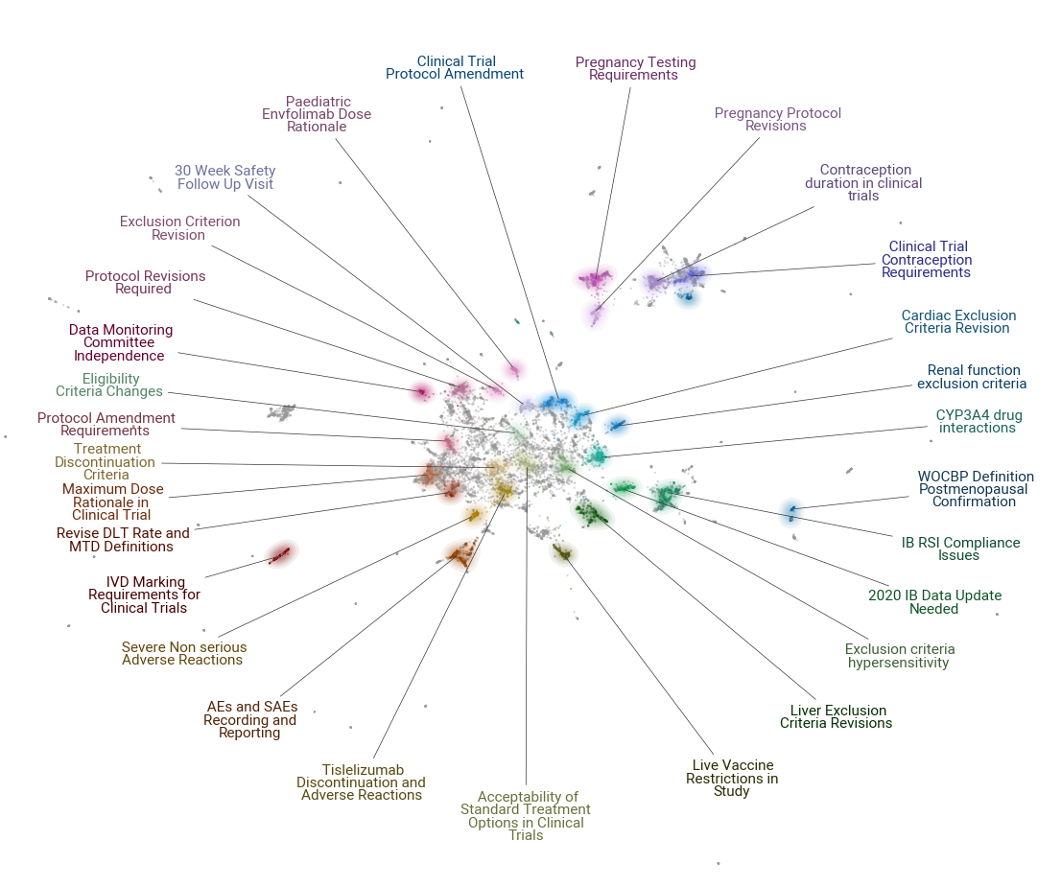

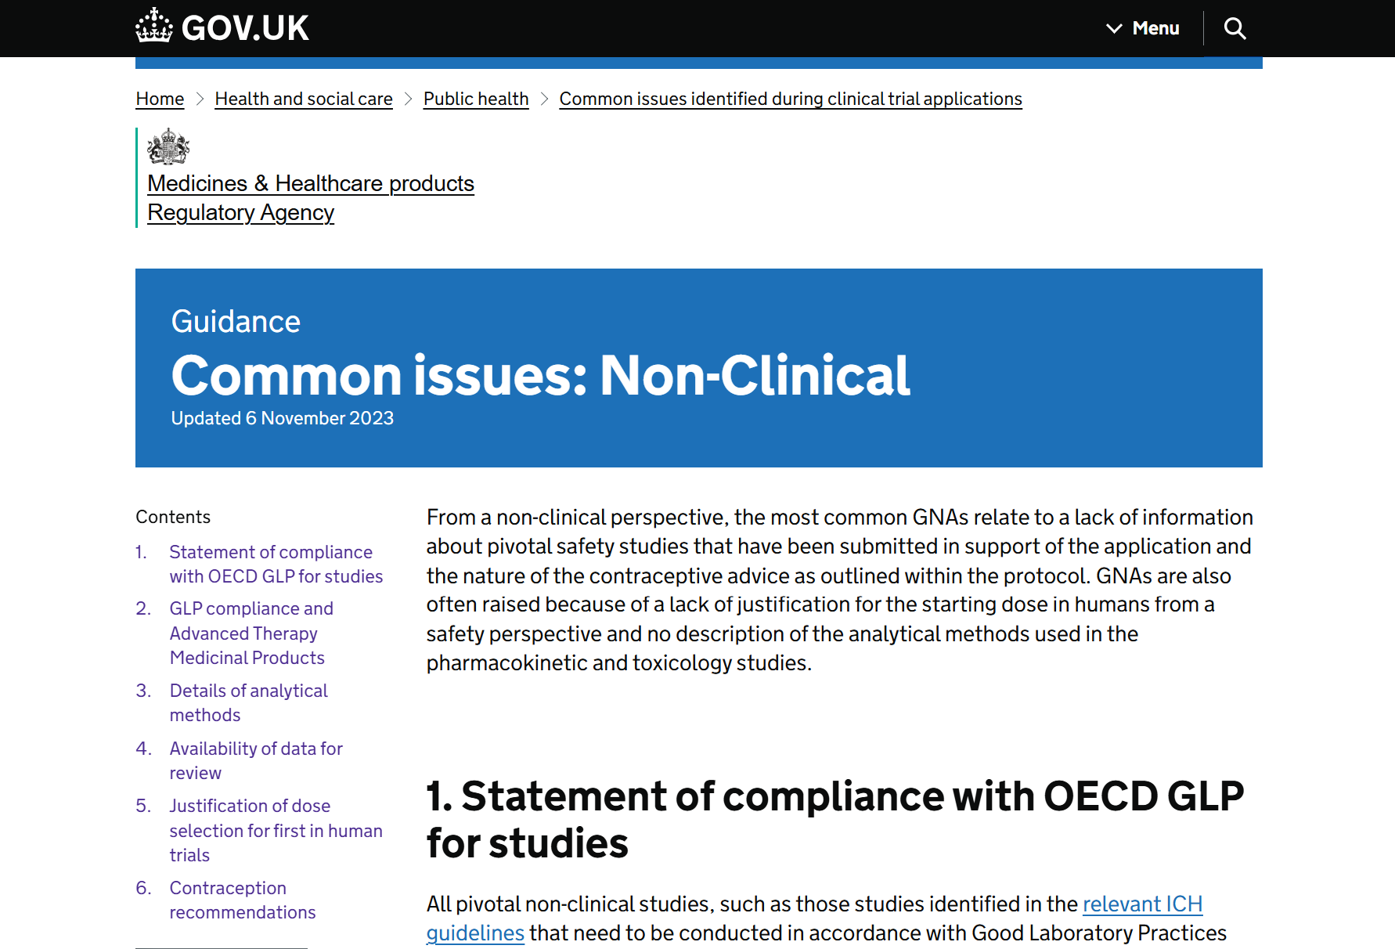
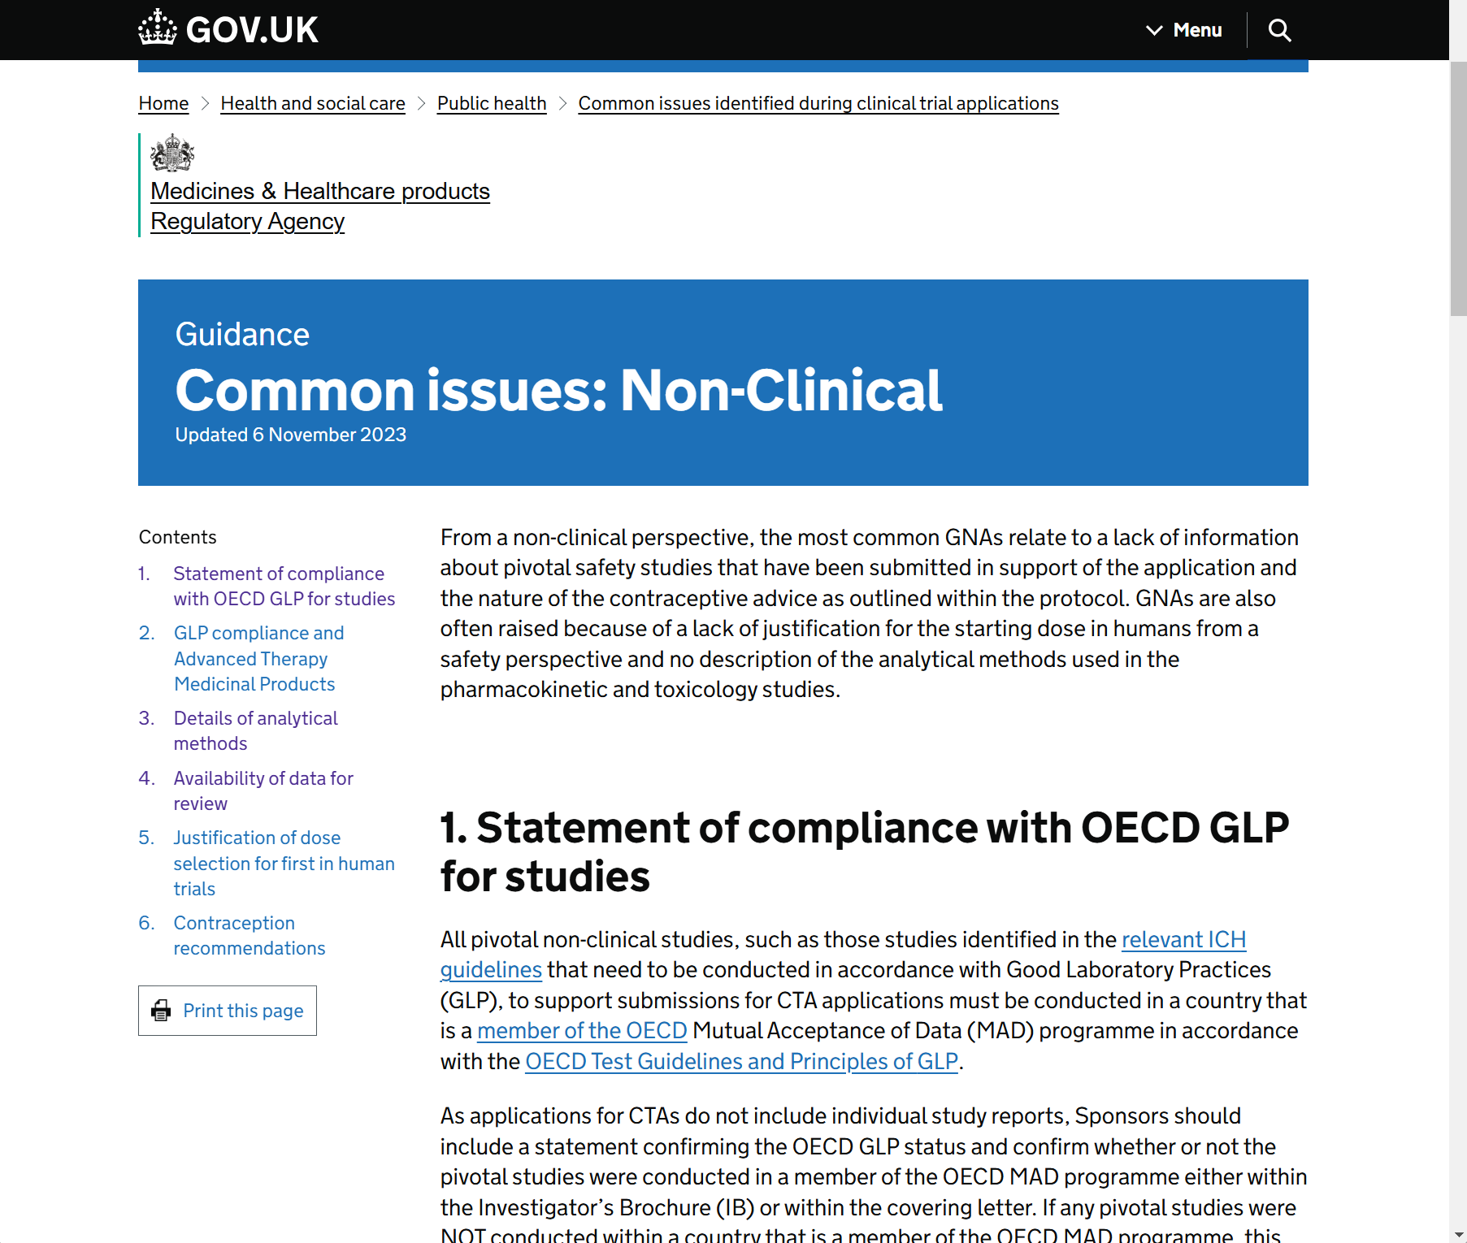
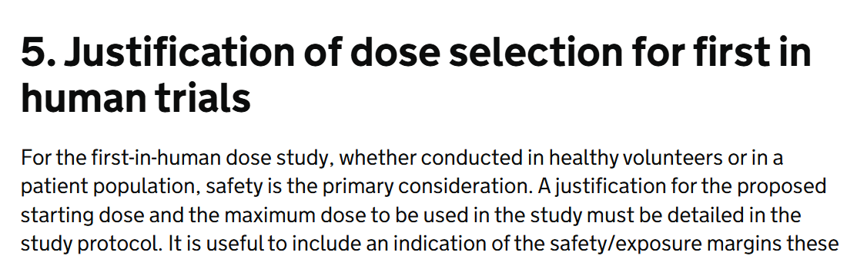
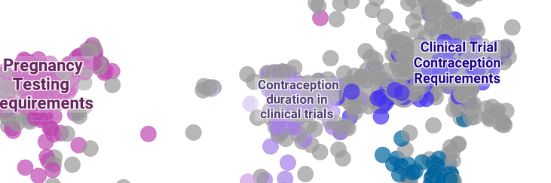
Solution 1: Data Driven Guidance for Applicants
Digital By Default. Secure By Design. Prove By Doing.

Slide 17
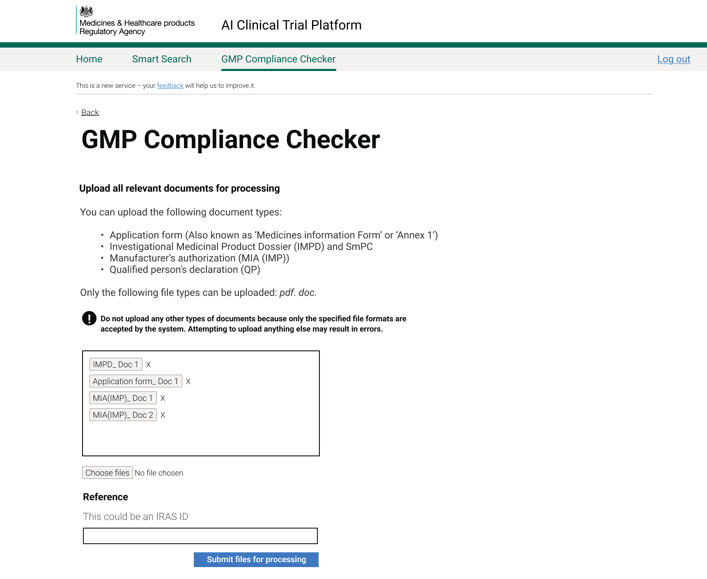
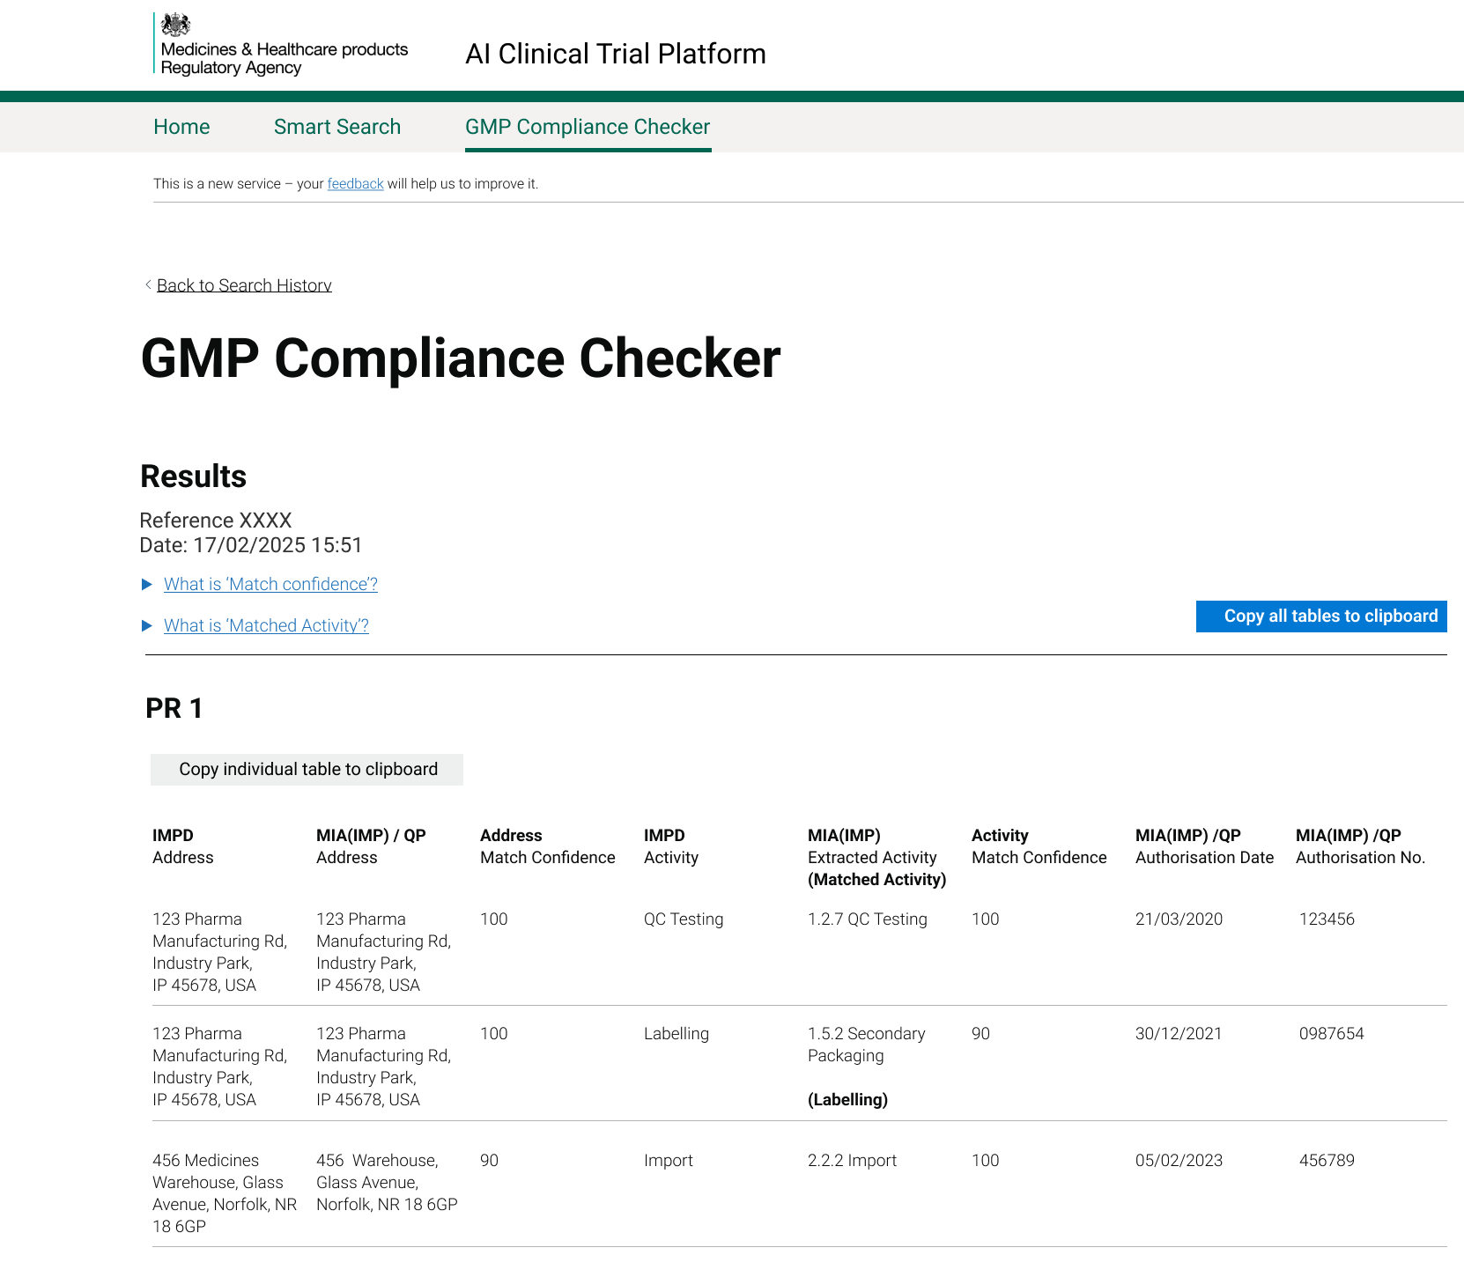
Solution 2: Good Manufacturing Practice – Interface
Digital By Default. Secure By Design. Prove By Doing.

Slide 18
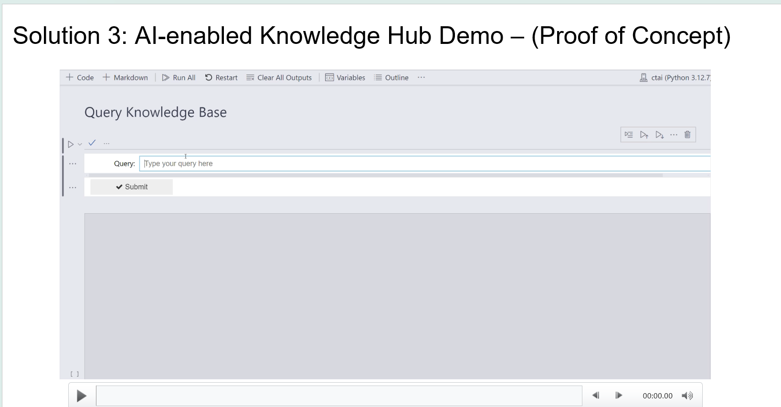
Digital By Default. Secure By Design. Prove By Doing.

Slide 19
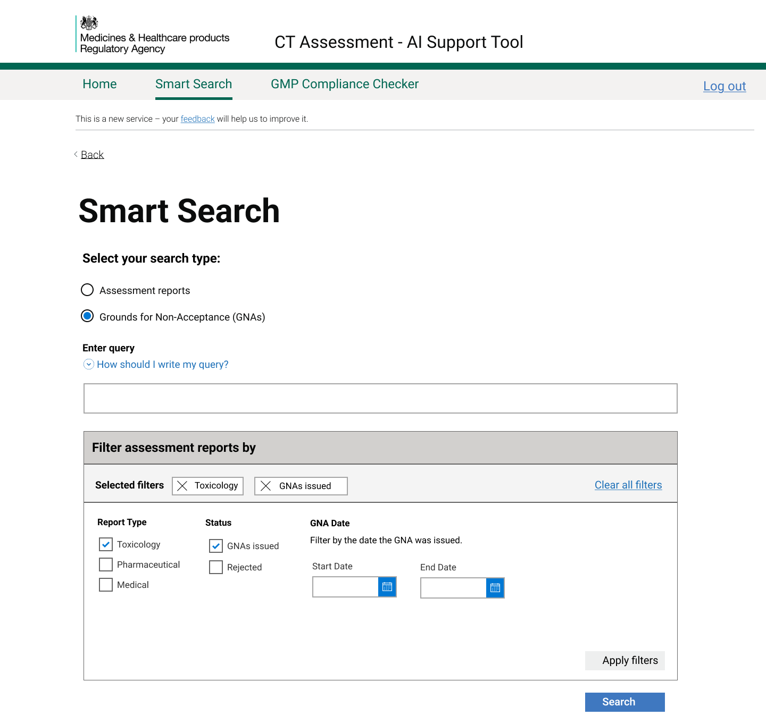
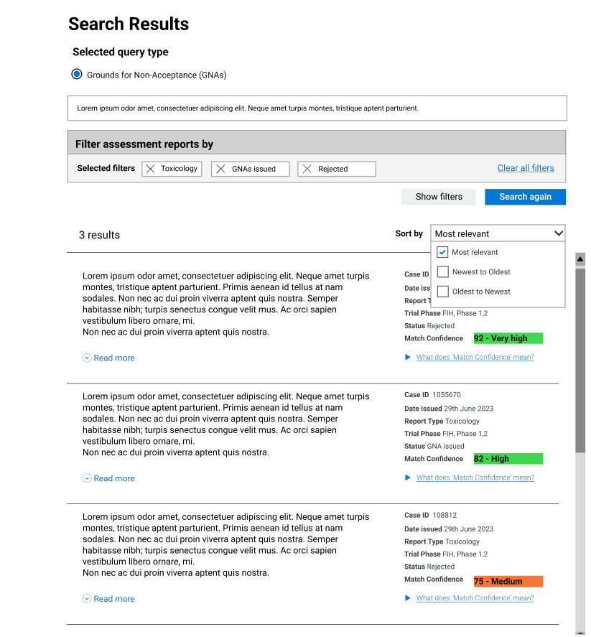
Solution 3: AI-enabled Knowledge Hub Interface
Digital By Default. Secure By Design. Prove By Doing.

Slide 20
Corporate Chatbot

Slide 21
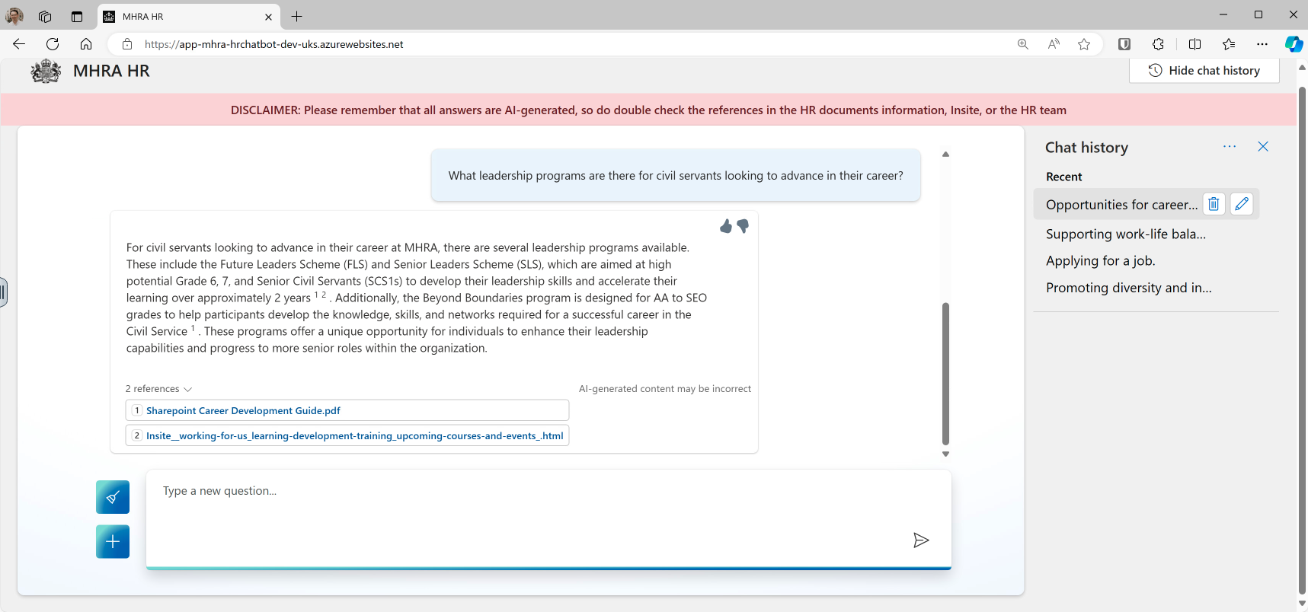
MHRA HR Chatbot
Digital By Default. Secure By Design. Prove By Doing.
Notes:
- Answer Employee Queries
- Provide Accurate Information
- Automate Routine Tasks

Slide 22
Turning Vision Into Reality
Time Savings for Initial Assessments
Medical assessors currently spend 3-4 hours on initial assessments …
…Improved application quality and internal efficiencies save approximately 32 hours per week
Other processes reduced from 3 hours to 34 seconds
Reduction in Manual Review of IMPDs
Assessors spend 30 minutes on Good Manufacturing Practices for initial assessments…
…Reducing this to 5 minutes saves approximately 425 minutes per week
Statistics Based on Anecdotal Estimates
Average case statistics
Range can vary depending on the case
In some cases, processing times are 99.8% faster
Reuse & Scaling
Replication across other UK regulators (RIO)
Reuse across UK Government & NHS etc
Vietnam, Switzerland, Australia, South Africa
Technology Improvements
60% cloud migration
45% legacy tech reduction
60% cyber resilience improvement
£2.4M annual savings
100+ digital hires
Digital By Default. Secure By Design. Prove By Doing.

Slide 23
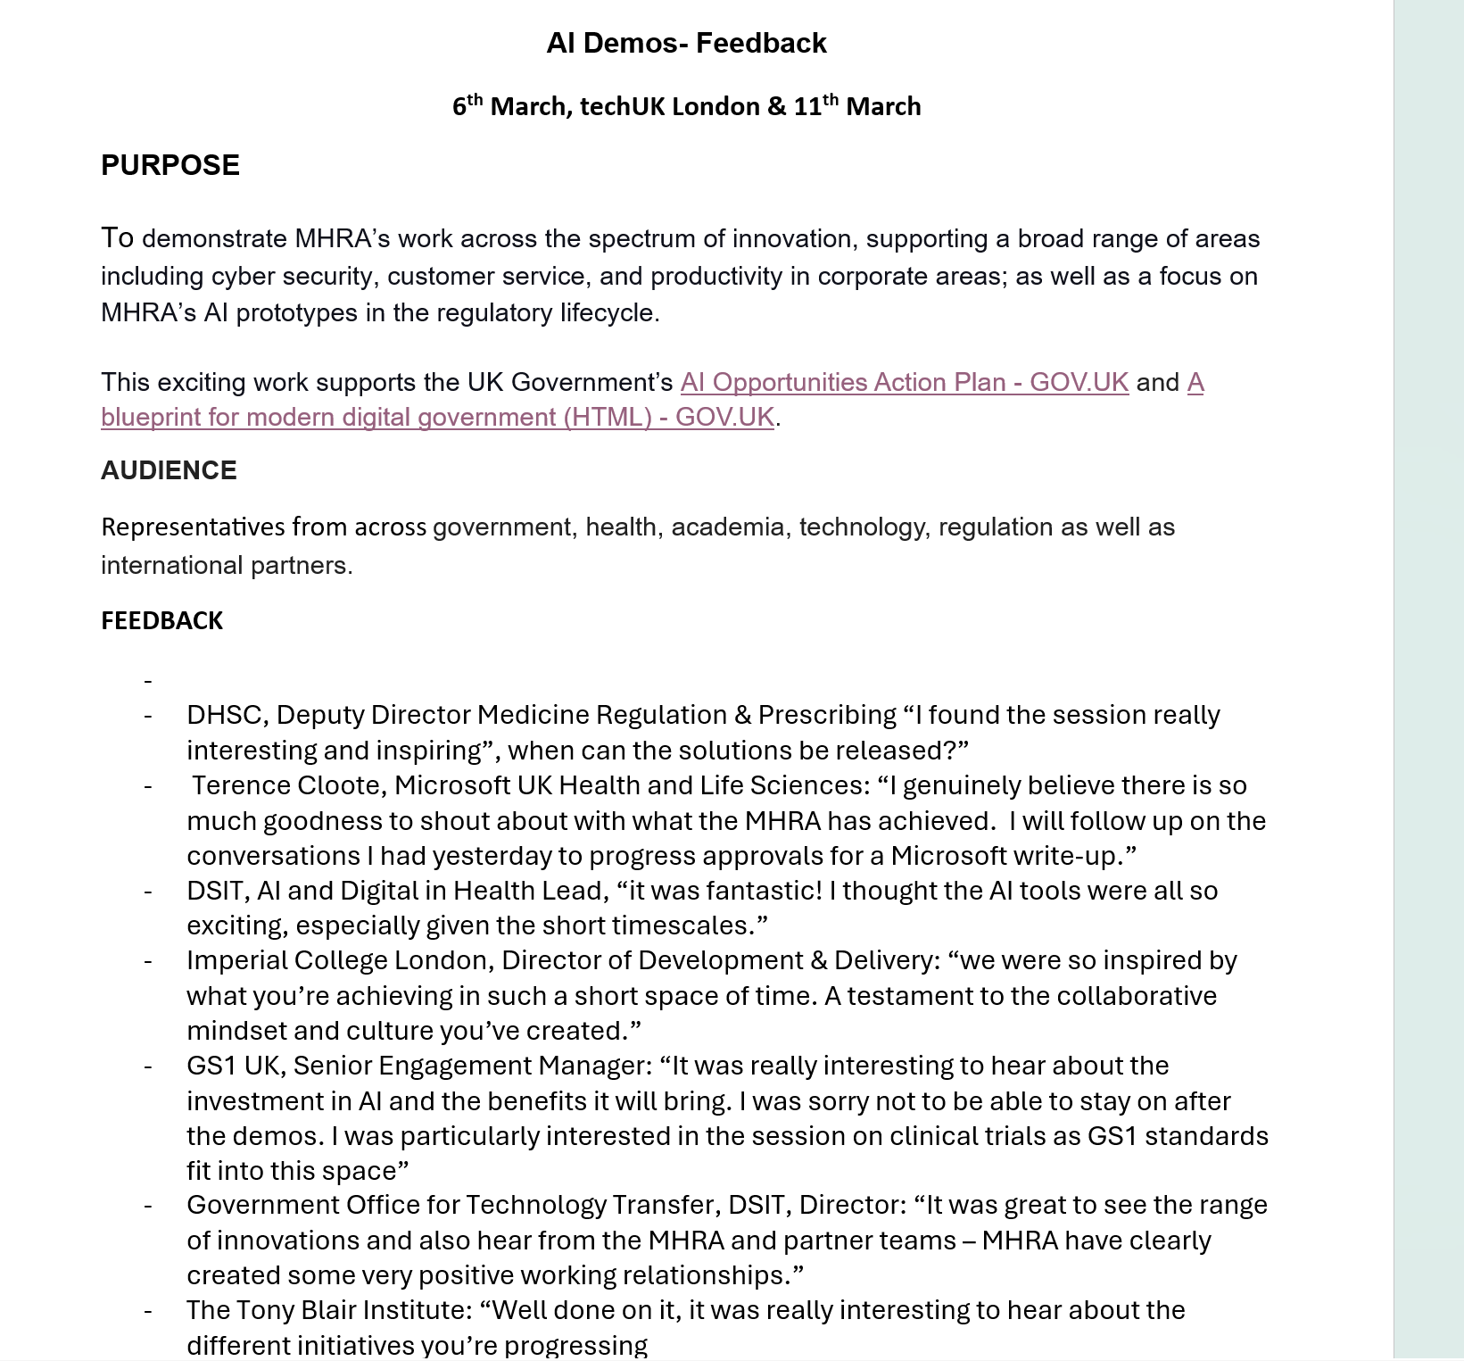
Innovation Showcase - Feedback
Andrea Manfrin
Deputy Director, Clinical Investigations and Trials :
It’s just an absolute privilege for me to be involved in this project - it's difficult for me to understand all the mechanics, but I can understand helicopter view of it and it's just amazing what you can do and what you are doing.
Creating from nothing because pretty much we started with a few ideas and now we are going at the speed of light and what you're proposing to me is an absolute game changer, not only for the UK but for the regulatory environment because we are creating in some way something that doesn't exist.
Kingyin Lee
Head of Clinical Trials, Clinical Investigations and Trials :
A big thank you to all of you in in the team, before this were wondering whether we would ever see it in a lifetime. That was last year. You've been a great team and glad that we're working with you and you're on the ball with it and I love the fact that you can see what we're thinking every time we interact and this really helps to make it a success!
:
Digital By Default. Secure By Design. Prove By Doing.

Slide 24
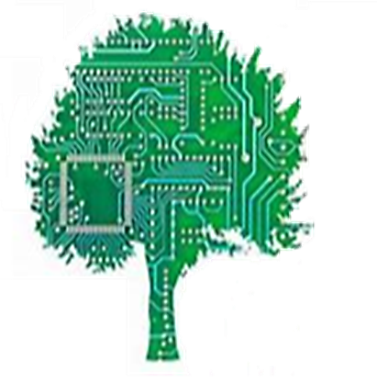
Code Green!
Generating one AI image takes as much energy as fully charging a smartphone
Along with the responsibility to keep our digital solutions safe, agile and modern, technology innovation brings an additional responsibility – sustainable computing or Green IT.
Green IT refers to designing, using, and managing digital solutions and technologies in an environmentally responsible manner.
MHRA is committed to doing what we can to create a more sustainable technology ecosystem that benefits users and the planet. Code Green!
Assess the location of agency servers
AI’s carbon footprint is approaching 1% of global emissions
Reduce our power consumption
What we must address
Things we can do to improve
‘The Cloud’ now has a larger carbon footprint than the entire aviation industry
Best practice engineering
Code Green!
Notes:
**Possibly create a second slide called Code Green??
Along with the responsibility to keep our digital solutions safe, agile and modern, technology innovation brings an additional responsibility – sustainable computing. Green IT refers to designing, using, and managing digital solutions and technologies in an environmentally responsible manner. After all, generating one AI image takes as much energy as fully charging a smartphone, AI's carbon footprint is approaching 1% of global emissions while 'The cloud' now has a larger carbon footprint than the entire aviation industry,
There are Green IT things we can do to mitigate e.g. the location of servers, power consumption, the energy that fuels data-centres good coding and best practice engineering can make a huge difference – code green!
DTG is committed to doing what we can to create a more sustainable technology ecosystem that benefits users and the planet. Code green!
Maybe do bullets of some stats:
generating one AI image takes as much energy as fully charging a smartphone,
AI's carbon footprint is approaching 1% of global emissions
'The cloud' now has a larger carbon footprint than the entire aviation industry,
There are Green IT things we can do to mitigate e.g. the location of servers, power consumption, the energy that fuels data-centres good coding and best practice engineering can make a huge difference – code green!
DTG is committed to doing what we can to create a more sustainable technology ecosystem that benefits users and the planet. Code green!

Slide 25
Thank you.
Questions?

