Slide 1
UK SPF Cluster 1 workshop: Connectivity from the Sky – 15 December 2022
Emergency SOS via Satellite

Slide 2
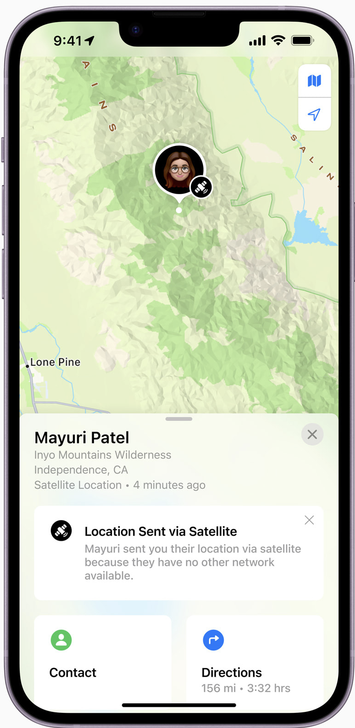
Emergency SOS via Satellite
  iPhone 14 Announcement
7 September 2022 Apple Event announced new Emergency SOS via Satellite feature in iPhone 14
Allows iPhone 14 to connect directly to a satellite, enabling messaging with emergency services when outside of cellular or Wi-Fi coverage.
Also allows users to manually share their location over satellite with Find My when there is no cellular or Wi-Fi connection, providing a sense of security when hiking or camping off the grid.
Service will run over Globalstar NGSO MSS network

Slide 3
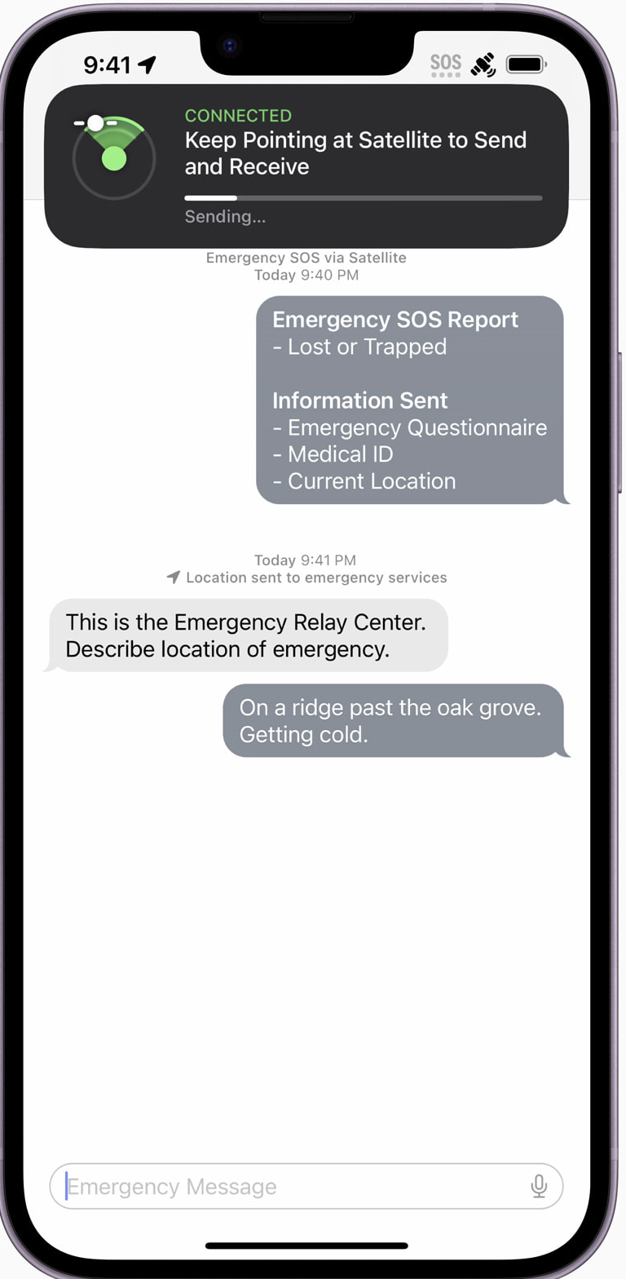
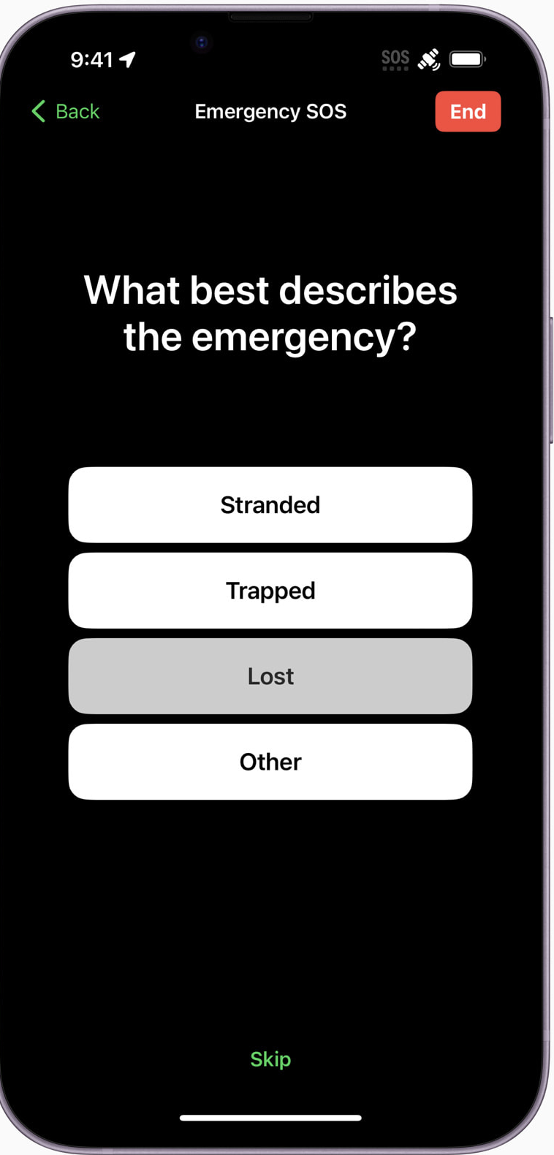
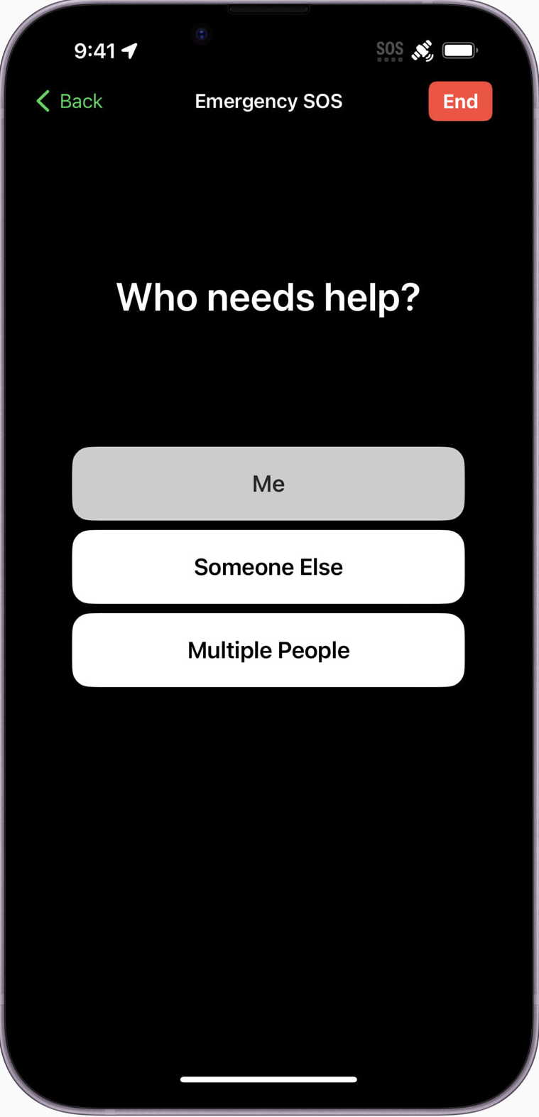
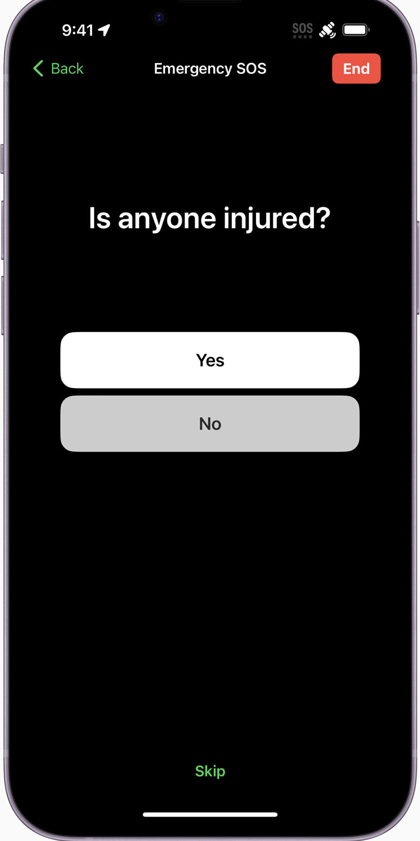
Emergency SOS via Satellite
User Interface
Emergency SOS via satellite includes a simple questionnaire to help quickly assess a user’s situation and relay vital information directly to the PSAP where Text to emergency services is supported, or to ground stations staffed by Apple-trained specialists when it is not.
Since every second counts, iPhone will show the user where to point their phone to connect to — and stay connected with — a satellite while they message with emergency services.

Slide 4
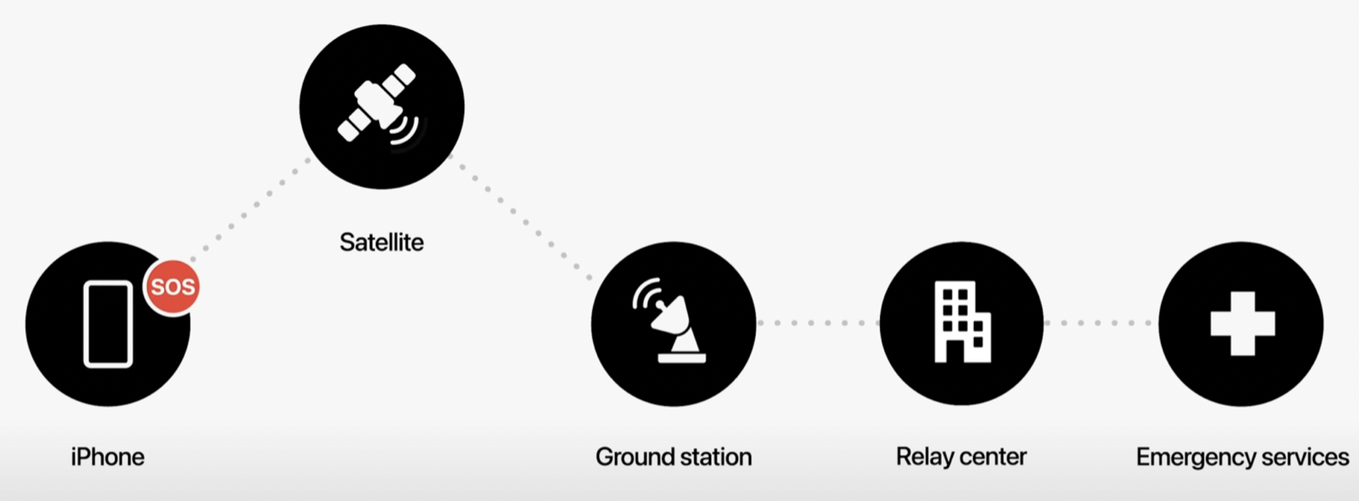
Network diagram
Globalstar

Slide 5
Emergency SOS via Satellite
  Regulatory Status
Emergency SOS via Satellite service fully compliant with existing allocations and MSS licensing rules
iPhone 14 will be tested to all relevant MS and MSS standards
Service will operate in compliance with ECC/DEC(09)02 covering 1.6/2.4 GHz MSS terminals
Feature will be disabled in countries where Globalstar service is not authorized
Live in the US and Canada as of 15 November 2022.
Live in France, Germany, UK and Ireland as of 13 December 2022

Slide 6
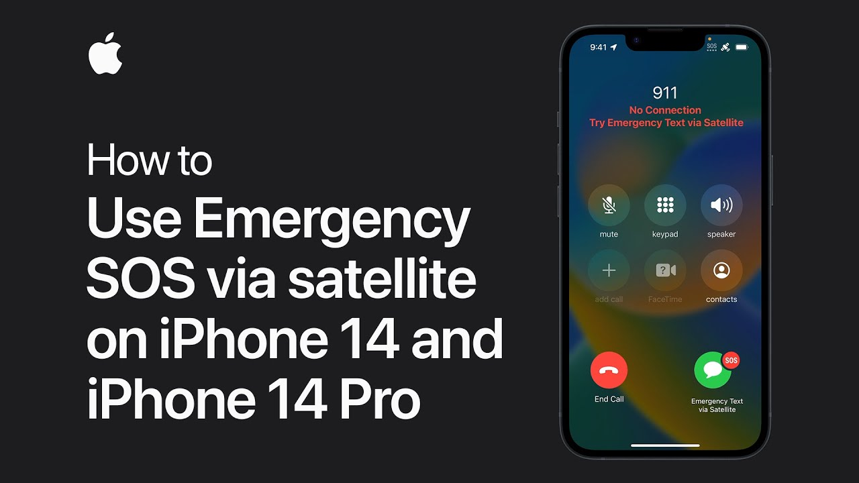
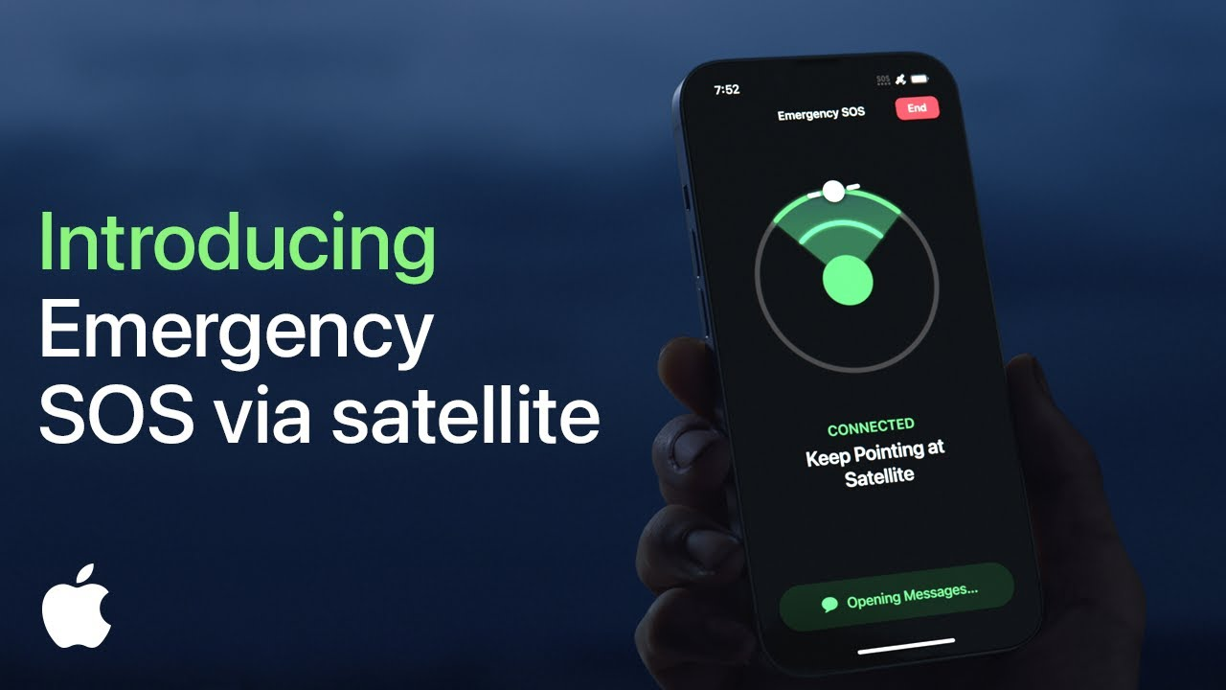
Emergency SOS via Satellite
  iPhone 14 videos

