Slide 1
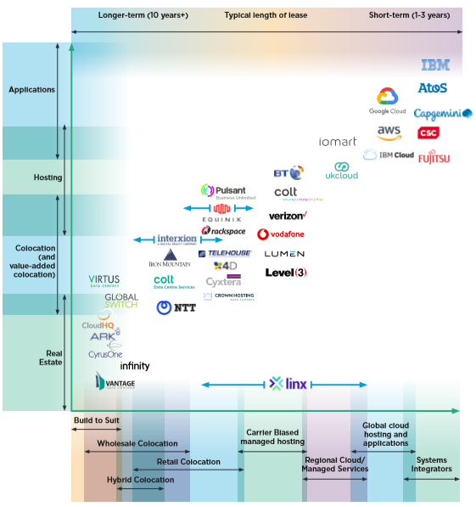
Data Centre Services: Who does what?
Mapping UK Data Centre Offerings
October 2020
This diagram identifies some of the operators active in the UK at present, and where they fit – very approximately- within the spectrum of data centre services. This is only indicative: the intention is just to present the range of activity and demonstrate that data centres don’t all do the same thing. Many of the operators shown below provide a range of services across multiple columns, but for simplicity we have limited them to one type of offering here: their position in the market is therefore under-represented. Please ensure you read the notes overleaf.

Slide 2
Notes: UK data centre services landscape
Many data centre operators, for example Pulsant, Iomart and Crown Hosting, offer a broader range of services than implied here. Pulsant for example has a cloud offering as well as providing colocation services. There is a strong trend for operators to broaden their service offerings. In reality, therefore, the boundaries between data centre services are already blurred and likely to become less easy to define over time. Some operators, like Equinix, are actively expanding their service offerings across the board and others, like Interxion: A Digital Realty Company (the product of a merger between (predictably) Interxion and Digital Realty) are doing this by acquisition and merger.
Large (global) cloud service providers (CSPs) may operate their own data centres or take space in third parties, particularly within wholesale colocation. CSPs will often use colo facilities to scale initial operations and then look to build their own facilities over time or utilise a third party operator to enable a built to suit solution.
Broadly speaking many of the cloud, hosting and application service providers on the right hand side of the chart will be customers of the colocation providers on the left hand side.
The importance of the global CSPs in our market is understated within this diagram. They are driving much of the growth we are seeing in the UK market at the moment and this is happening predominantly in wholesale colocation (the left hand side).
This landscape tends to change rapidly so must only be regarded as a snapshot in time.
This chart is not comprehensive and only represents a sample of operators. There are many providers who are not represented here.
LINX (London Internet Exchange) provides interconnection services across multiple business models, hence is not allocated to a particular service.
What is this telling us about the UK market?
This mapping exercise, although not comprehensive, reveals some interesting market characteristics:
Competition and choice: The most important thing this map tells us is that there are multiple providers in the UK for every type of data centre related service or combination of services. From a customer perspective that is a good thing because it demonstrates that a competitive market exists with plenty of choice. The structure of the UK market is such that the pricing power of individual providers is checked.
Dynamic change: The UK data centre market is self-disruptive and constantly changing to meet new types of customer and new forms of demand. We conducted a similar exercise several years ago and it is clear that the market is changing rapidly. There is strong M&A activity – some operators have merged, others have been acquired. This has not, however, consolidated the market into an oligarchy. Although names once prominent in this landscape like Telecity have disappeared, at the same time new entrants like CloudHQ, CyrusOne and other smaller players have emerged on the scene, disrupting the type of services being offered e.g. build to suit for CSPs requiring scale operations, in a short timeframe.
Emma Fryer, 2021

