Slide 1
Preparing for a Changing Climate in the Tech Sector Thursday 26 March

Slide 2
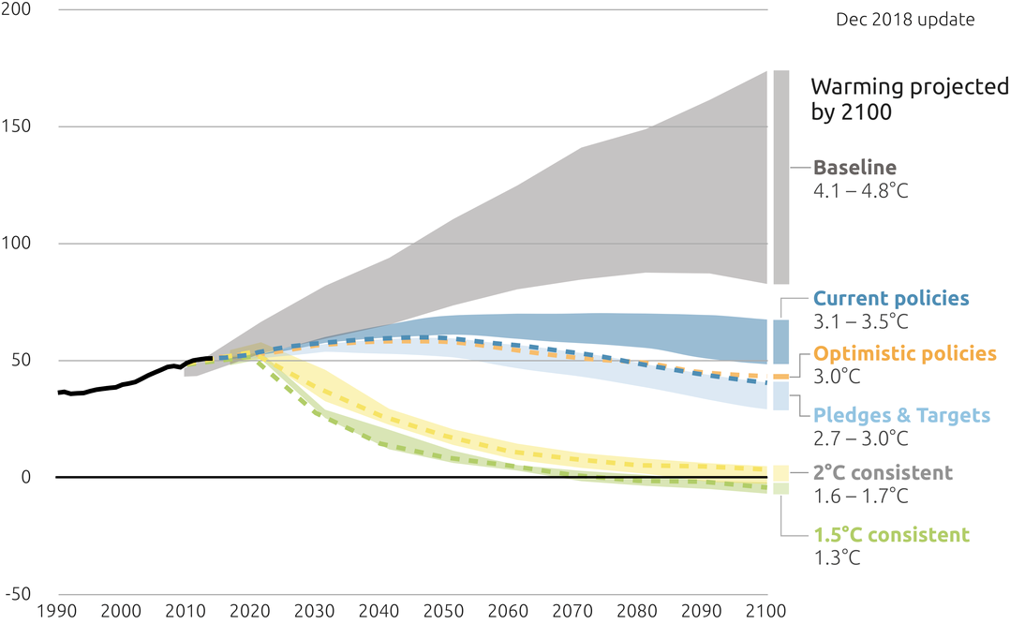
Based on current global policies, we’re heading for a 3.1-3.5°C rise by 2100. Limiting warming to 1.5°C requires CO₂ cuts of around 45% between 2010-30
2100 Warming Projections
Emissions and expected warming based on NDC pledges and current policies
Global greenhouse gas emissions
Source: Climate Action Tracker, December 2018
4
Notes:
The IPCC found last year that the world is completely off track when it comes to keeping the term rise under 1.5 degrees C, heading instead towards 3C.
We only have a few years to dramatically accelerate action before keeping global warming to a maximum of 1.5C becomes impossible – beyond this limit even half a degree will significantly worsen the risks of drought, floods, extreme heat and poverty for hundreds of millions of people.
The IPCC Special report on 1.5 degrees also says that CO2 emissions are net zero around 2050 for 1.5°C, and major cuts are needed in non-CO2 emissions. ed warming to 1.5°C above pre-industrial levels will mean rapid, far-reaching and unprecedented changes in all aspects of society
According to the World Economic Forum’s 2019 Global Risks Report, half of the top risks are related to the environment and climate-change: including environmental disasters, biodiversity loss and ecosystem collapse, the failure of climate-change mitigation and adaptation efforts, and water crises – all of which have material impacts on a company’s operational costs, reputation, risk and profitability. At the same time, financial institutions are increasingly looking for new instruments and solutions to battle complex risk, particularly from climate change.

Slide 3
The UK’s climate is changing ...
The UK could experience temperature increases up to 7 degrees by 2061-2080, in a 4 degree warmer world.
UK climate projections show an increased chance of hotter, drier summers and warmer, wetter winters with an increase in frequency of extreme events.
By mid-century, hot Summers, such as in 2018,
could become common.
By the 2050s, water demand could exceed supply in many parts of the UK.
Temperature °C
Winter rainfall
Summer rainfall
UK projected rainfall in Winter and Summer.
The red line denotes projected rainfall and the black line shows observed rainfall
Sources: Met Office, UKCP18: National Climate Projections (2018)
5
Notes:
By the end of the 21st century, all areas of the UK are projected to be warmer, more so in summer than in winter.
Hot summers are expected to become more common in the UK. In the recent past (1981-2000) the probability of seeing a summer as hot as 2018 was low (<10%). The probability has increased due to climate change and is now estimated to be between 10-20%. With continued warming, hot summers by the mid-century could become even more common (with probabilities of the order of 50% depending on the emissions scenario followed).
Currently 2,000 people die prematurely each year in the UK from heat-related conditions. The growing, ageing population means the number of vulnerable people at risk is increasing. In combination this means the number of premature heat-related deaths is expected to more than triple by the 2050s.
Recent analysis shows that an extended period of extreme UK winter rainfall is now 7 times more likely than in a world without human emissions of greenhouse gases.​
Record-breaking UK temperatures, such as 2014, have become at least ten times more likely as a result of human influence on the climate.​
Extremely warm summers, such as the European heatwave of 2003 which led to 35,000 excess deaths, are now expected to happen twice a decade compared to twice a century in the early 2000s.
Also consistent with the global projections, variability in rainfall is increasing: wet winters will get wetter, but we can still expect to see dry winters. This means that we will need to be resilient to wider range of conditions than we currently are.
UK ​Impacts in 2100​
Water availability​
[Limiting to 2°C by 2100​] 1.5 billion people exposed to increased water resources stress​
Flooding and coastal change​
[Limiting to 2°C by 2100​] 2.6 million people at significant risk of river, surface water or coastal flooding in the UK by 2050*​
[Limiting to 4°C by 2100​] 3.3 million people at significant risk of river, surface water or coastal flooding in the UK by 2050* ​
Risks to health, well-being and productivity from heat​
[Limiting to 2°C by 2100​] 700-1000 more heat-related deaths per year in southeast England​
[Limiting to 4°C by 2100​] Three-fold increase in heat-related deaths in the UK by 2050
Water shortages​
[Limiting to 2°C by 2100​] 15% of water resource zones in deficit, with water demand exceeding supply in 5% of catchments​
[Limiting to 4°C by 2100​] 25% of water resource zones in deficit, with water demand exceeding supply in 20% of catchments​
Risk to natural capital ​
[Limiting to 2°C by 2100​] Up to 25% of blanket bog habitat at risk of loss​
[Limiting to 4°C by 2100​] Up to 85% of blanket bog habitat at risk of loss​
Risk to food production and trade​
[Limiting to 2°C by 2100​] Production and supply chains affected by increased risk of extreme weather events​
[Limiting to 4°C by 2100​] 70% of UK agricultural land classed as ‘poor’​
New and emerging pests and diseases​
[Limiting to 2°C by 2100​] Increased number and range of pests, and more prevalent pathogens​
[Limiting to 4°C by 2100​] Increased risk of dengue and the Chikungunya virus

Slide 4
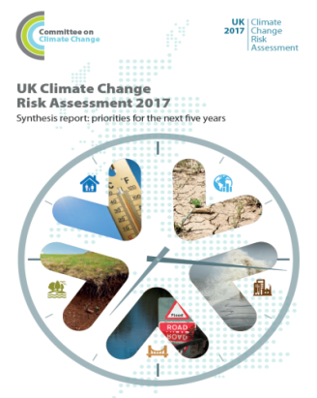
…. posing considerable risks
Water shortages for public water supply, for agriculture, energy generation and industry
Flooding and coastal change risks to communities, businesses and infrastructure
Risks to natural capital
Priority risks for the UK are identified under the Climate Change Risk Assessment (CCRA) Evidence Report which is updated every 5 years.
The second CCRA was published in 2017 and work is already underway for the third CCRA due in 2022.
UK Top Climate Risks
Risk to health and productivity from high temperatures
Climate Change Risk Assessment 2017
Risks to food production and trade
Pest, diseases and invasive species

Slide 5
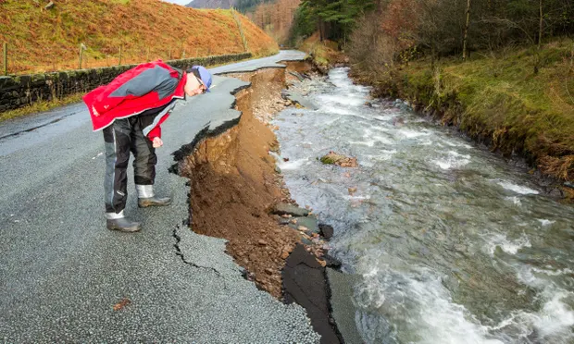
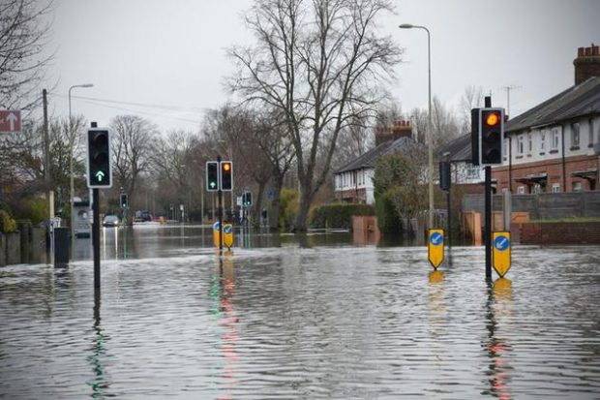
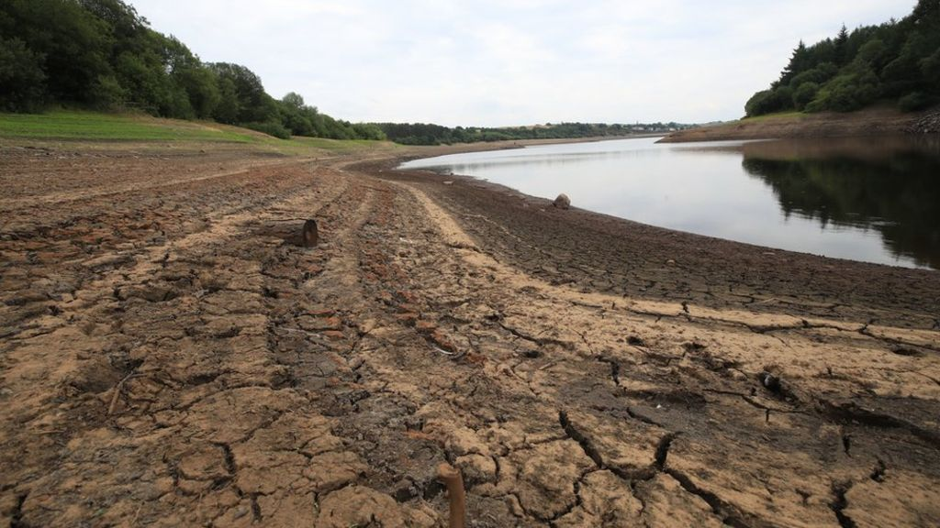
We are already experiencing human and economic loss in the UK
Climate change made the record-breaking 2018 heat wave 30x more likely than before the pre-industrial period – and by 2050 these heatwaves are likely to be the new norm*
The heatwave across Europe in 2003 was estimated to have contributed to the causes of 2,000 deaths in the UK and over 70,000 deaths across Europe**
Approximately 1.8 million people already live in properties exposed to an unacceptable flooding risk. With 2°C of warming this increases to 2.6 million ***
Drought is already impacting agriculture and forestry, and was a factor in missing Government’s tree planting target this year.
Changing conditions are driving an increase in exposure to food and water-borne diseases as well as transmission of new pests.

Slide 6
The impacts of a 2°C and 4°C warmer world by 2100 without adaptation are significant
As global average temperature rises approach 4°C, impacts become increasingly severe and the worst impacts may not be avoidable through adaptation. Early action is therefore critical.
Projections indicate 2.6 million people are at risk of flooding in the UK under 2 degrees of warming by 2080. This increases to 3.7 million under 4 degrees of warming without adaptation action.
The supply demand deficit for water availability in UK is projected to be 1.8 billion litres per day by 2080 with 2 degrees of warming and up to 5.8 litres per day with global temperature increases of 4 degrees without adaptation action.

Slide 7
We have a good framework to address climate risks [ Defra is the co-ordinating department and government lead on climate change adaptation in England and reserved matters but – like emissions reduction - responsibility sits across government, public sector, business and wider society.
A UK Climate Change Risk Assessment (CCRA) is required every 5 years: the second report was published in 2017.
A National Adaptation Programme (NAP) which aims to address the priority risks highlighted by the CCRA is also published every 5 years: the second NAP was published in 2018.
Currently over 90 organisations are voluntarily reporting their plan to manage climate risks under the UK’s Adaptation Reporting Power (ARP), due 2021.
Nevertheless further action is required across the UK.
Notes:
Organisations reporting under UK Adaptations Reporting Power includes utility/infrastructure providers, regulators and public bodies responsible for water, energy, transport, environment, heritage, health and finance, with the all four financial regulators reporting for the first time.

Slide 8
However further adaptation progress is required across all risk areas
Progress in managing risk
More progress
Less progress
The Committee on Climate Change’s 2019 progress report, awarded no top scores for adaptation action in key risk areas, in their biennial assessment.
Further progress is required to manage risk in all risk areas.
Telecoms, digital and ICT were given the lowest score for quality of planning
Lower
4 | 2 Telecoms, digital and ICT Human health impacts to heat and cold Supply chain disruptions and business opportunities | 1 Infrastructure interdependencies Agriculture and farmland species loss
7 | 5 Ports and airports Water demand by Industry Emergency planning system | 3 Property-level flooding and coastal erosion
9 | 8 Water and energy networks Major road and Rail networks | 6 Design/planning of new infrastructure
Overall quality of planning
Higher

Slide 9
Next year there are important adaptation milestones and we need to demonstrate what progress we have made
In 2021 we will need to respond to the CCC’s adaptation progress report as well as consider how to respond to critical information in the evidence report of the Climate Change Risk Assessment.
Monitoring trends in climate risks and adaptation actions
ASC activities
CCC Adaptation progress report
CCRA2 Evidence report
CCC Adaptation progress report
CCRA3 Evidence report
2016
2017
2018
2019
2020
2021
2022
2023
CCRA2 2017
2nd NAP
CCRA3 2022
3nd NAP
3rd ARP Strategy
NAP2 Delivery of actions 2018-2023
UK Climate Projections 2018 launch
(UKCP18)
ARP III reporting (2019-21)
HMG activities

Slide 10
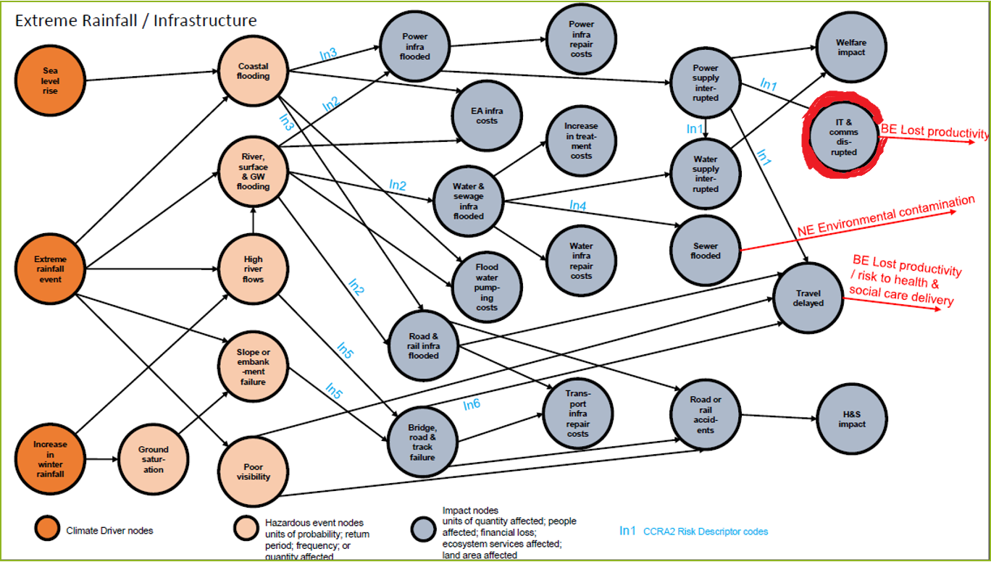
Priority climate risks to Data Centres and Telecommunications
Key Climate risks
Cascading failures due to interdependencies; risks from flooding; risks from high winds and lightning; risks to productivity due to infrastructure disruption

Slide 11
What should I include in my report in the third adaptation round?
Reports in the previous round were well received and demonstrated a significant evolution from the first reporting round.
This round we would like reports to demonstrate how your organisations’ understanding of climate risks, impacts and their effects on other stakeholders has advanced.
We would like to see greater emphasis on mapping interdependencies across sectors as well as understanding interacting risks and the risk of unintended consequences.
We would like organisations to use the UKCP18 user portal to analyse climate projections.
Finally we would like to understand how organisations are driving behaviour change, how climate change is integrated across your organisation and how you are building capability to respond to climate change risks, through examples of good practice.

Slide 12
Strengthening Preparedness to Climate Change Risks is a Process
Understand climate hazard/impact
Assess vulnerability and risk
Appraise and prioritise options and instigate plans
Take action
Monitor and evaluate actions and results (or residual risk)
Adapted from: US Climate Resilience Tool (2017)

Slide 13
Environment Agency - Giving a reporters perspective
Ross Lowrie
Senior Advisor (Climate Change & Energy)

Slide 14
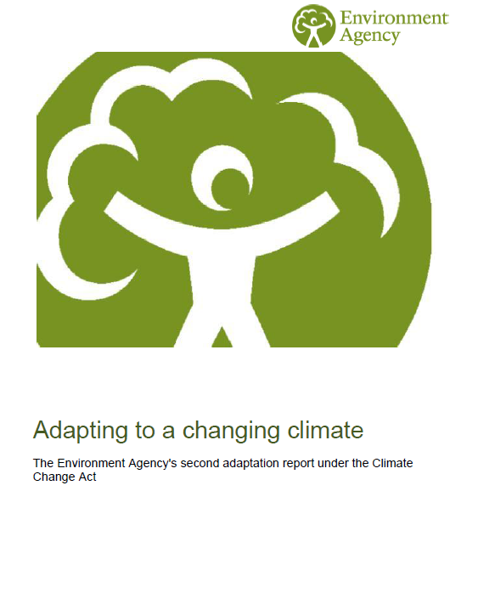
Our reporting experience
ARP2
Our key risks - Water resources, flooding water-based biodiversity, fish & angling
Our commitment:
Climate proof all new strategies and plans
Nearly 100 adaptation commitments for 5 year period
https://assets.publishing.service.gov.uk/government/uploads/system/uploads/attachment_data/file/526000/climate-adrep-environment-agency.pdf
Notes:
So given the risks are significant, we reported them. In the first round we were told to (!), in the second round we chose to. We’re keen to explore our climate risks and perhaps to inspire others to do the same, and in a similarly robust fashion. We also knew others would look to us to do a good job.
In our second report we looked at everything we do and identified our key risks.
We set about assessing these risks and planning to address them. We also came up with some big pledges – to climate proof all new strategies and plans. Which sounded ground breaking, but made a lot of sense – every organisation should.
We also set out about a hundred specific commitments for the reporting period. The Result – a very comprehensive identification and management of risks, but…
… not fully embedded into our business as usual. There is no doubt that reporting is seen as an additional burden at a time where there are a number of competing priorities.

Slide 15
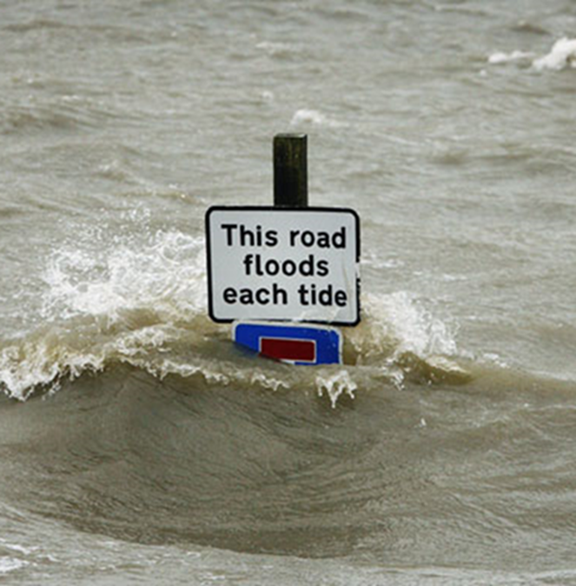
UK Infrastructure Operators Adaptation Forum
Spanning Industry
voluntary body, meets 3x a year
Major operators and trade bodies, Government, Regulators, Academia
Over 60 members
Shared Learning:
Align with other reporting requirements – to be most efficient and effective embed climate risks as a corporate risk. This allows alignment with TCFD requirements too.
Templates - perceived as restrictive but could be used to focus on sectors or interdependencies – helpful mostly for new reporters and new issues
Sector reporting – a great way of providing a sectoral snapshot of risk and reduce reporting burden, but at the risk of individual analysis and ownership of climate risks?
Don’t forget about inter-dependencies & cross-sectoral risks, in particular ICT, energy, transport connectivity

Slide 16
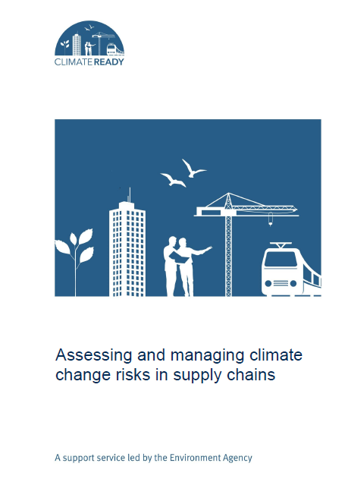
Supply chains
https://www.climatenorthernireland.org.uk/cmsfiles/Climate-change-risks-in-supply-chains---report.pdf
Notes:
We at the EA have spent time reviewing our processes and supply mechanisms to determine how resilient they are in a changing climate. Over ½ our operating costs are spent with our supply chain and will influence our ability to operate in a changing climate. Failure to understand climate risks on our supply chain could leave the Environment Agency exposed to supply chain disruption and price volatility, and ultimately, have quite significant impacts for our work.
For example, we require steel to build flood defences. Steel uses a large amount of water in the manufacturing process. Where this steel is manufactured in locations experiencing water stress (and therefore its ability to source the water required), we may see problems with its supply. One leading steel manufacturer identified that of their 134 steel plants 20 operate in areas already suffering from water stress or scarcity. This risk can also impact the organisation if conflict occurs. (Arcelormittal, 2014). Gold and copper mining in Peru was another example, a US$ 4.8 billion project was suspended due to violent protests from communities that feared that they would not have access to the freshwater they need.(CDP 2013)
The EA has experienced global issues effecting our own supply chains already, for example the Ebola crisis made goods tricky to get out of ports. This impacted our ability to source pumps, and the requirement for emergency purchases/contracts. Wider sustainability/economic normal requirements might be bypassed to get goods/services urgently.
We don’t know all our key climate risks in our supply chain, as we’ve not mapped it fully yet. Its come out as one of the key themes as part of the ARP3 (and ARP2) work. Our initial steps have been to work with our suppliers to better understand our supply chains, and what might influence our ability to maintain our statutory functions and day to day work. We’ve already changed our contracts and reporting to ensure that broader sustainability and adaptation issues are included and begun to be better understood.
We are also exploring our Net Zero ambitions too, and how this might be influenced by our supply chains.
We wrote a report (pic above) to help businesses to explore their supply chains in a changing climate: https://www.climatenorthernireland.org.uk/cmsfiles/Climate-change-risks-in-supply-chains---report.pdf

Slide 17
Supply Chain Examples
Notes:
So we’ve got a couple of examples of organisations who have followed these steps, or successfully managed a climate risk.
B&Q have undertaken an exercise to see where they may see risks and opportunities from a changing climate.
It started by assessing the climate risks to its properties – for example those in a flood plain, and have started to take action at higher risk sites. Its also been looking at potential changes in consumer demand – attempting to predict what might be required, for example, with more extreme weather events and providing for these needs. They’ve also gone further to include sourcing, and where they get their timber from, and if alternatives are available. It’s a work in progress.
Another example of climate impacts really effecting business is around mobile phones.
‘Nearly a decade ago, lighting struck a Philips microchip plant in New Mexico, causing a fire that contaminated millions of mobile phone chips. Among Philips’ biggest customers were Nokia and Ericsson, but each reacted differently to the disaster. Nokia’s supply-chain management strategy allowed it to switch suppliers quickly; it even re-engineered some of its phones to accept both American and Japanese chips, which meant its production line was relatively unaffected. Ericsson, however, accepted Philips’ word that production at the plant would be back on track in a week and it took no action. That decision cost Ericsson more than US $400 m in annual earnings and, perhaps more significantly, the company lost market share. By contrast, Nokia’s profits rose by 42% that year’
(https://procureinsights.wordpress.com/2011/05/18/managing-supply-chain-risk-the-nokia-and-ericsson-case-study/)

Slide 18
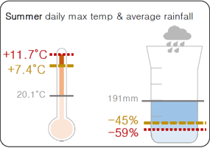
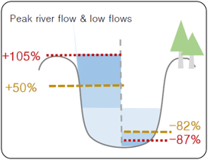
Adaptation Reporting Power (ARP3)
‘A report that will resonate across the organisation, showcasing our ambitious plan for tackling some of the country’s biggest climate risks, and setting out our strategic direction on adaptation’
Design a vision to resilience in a 2°C and 4°C world
Set out the big things we need to do differently
bold actions, strong leadership and clear routes for delivery.
pilot a place-based approach
Notes:
Drive from the organisation
We developed our second adaptation report back in 2015. We worked with RI to consider their risks, and what actions they needed to do to to address those risks. They form part of the adaptation KPI which we work with some of you to report on every other quarter.
Now, as we look forward, we need to consider the future:
We have a requirement from Government to prepare our 3rd organisational wide adaptation report. This will require every area of our business to consider what a resilient organisation would look like in a 2°C and 4°C world.

Slide 19
UK Climate Change Risk Assessment 2017
https://assets.publishing.service.gov.uk/government/uploads/system/uploads/attachment_data/file/584281/uk-climate-change-risk-assess-2017.pdf
Notes:
So to be more specific about our role in adaptation I share the summary of UK’s 2017 Risk Assessment. There are 6 main themes, and the EA has a key role to play in at least four of them. And arguably all 6.
Perhaps the biggest threat to the UK is in its increased flood and coastal change as a result of climate change. We have a huge role in flood risk, working with others to build defences and ensure businesses and communities are warned about flood risk before and during floods.
We also regulate water resources in England, ensuring there is enough for the environment and to support all its various uses. We anticipate climate change to reduce availability by 10-15% by 2050. In this time we expect populations to increase, driving demand.
We also play key roles in biodiversity and invasive non-native species, so climate change is a big deal for us.

Slide 20
https://www.gov.uk/government/collections/climate-change-guidance
Notes:
We acknowledge that climate data can be complex and confusing, so we have developed the above climate impacts tool to help our staff identify climate risks and impacts in our high level strategies and plans.
The climate tool illustrates a possible vision of potential future challenges in England, based on a high end (reasonable worst case) scenario that is consistent with a world in which there is at least a 4°C rise in global mean temperature by the end of the century.
The idea is to use it to start discussion around what the risks are on important areas of our work. Actions will then be need to manage those risks.
We have been using place-based tailored versions of this tool with our water resources stakeholders to help them understand future water availability challenges.
Final note: Our approach to how we make decisions and shape our planning in England is evolving fast. This is a really positive step in the right direction in order to maximise the benefits for people and nature, and ensure we are preparing for a changing climate.
For more info visit our Environment Agency Climate Change pages on Gov.uk (link on slide above)

Slide 21
Questions for consideration
What existing and planned adaptation measures to you currently have in place and what additional action do you need to take in the next 5 years?
Do you have a contingency plan in place for cascading failures? ie. when there is a failure in other sectors.
Are you considering the impact of multiple climate hazards: ie. Extreme precipitation and storms?

