Slide 1
    Building and empowering
    responsible AI
Trilateral Research
London, UK | Waterford, IE

Slide 2

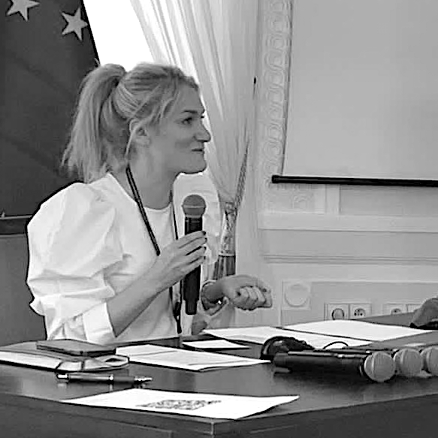
DR. JULIA MURASZKIEWICZ
Head of Programme for Exploitation and Violence at Trilateral Research Lecturer at University of Amsterdam
1 PhD
2 books
30+ publications
4 years working at safe houses
Co-designed 3 AI products for fighting TIP
15 large research THB projects
Trainer on THB issues
Evaluator of national legislation and policy: Europe & Asia

Slide 3
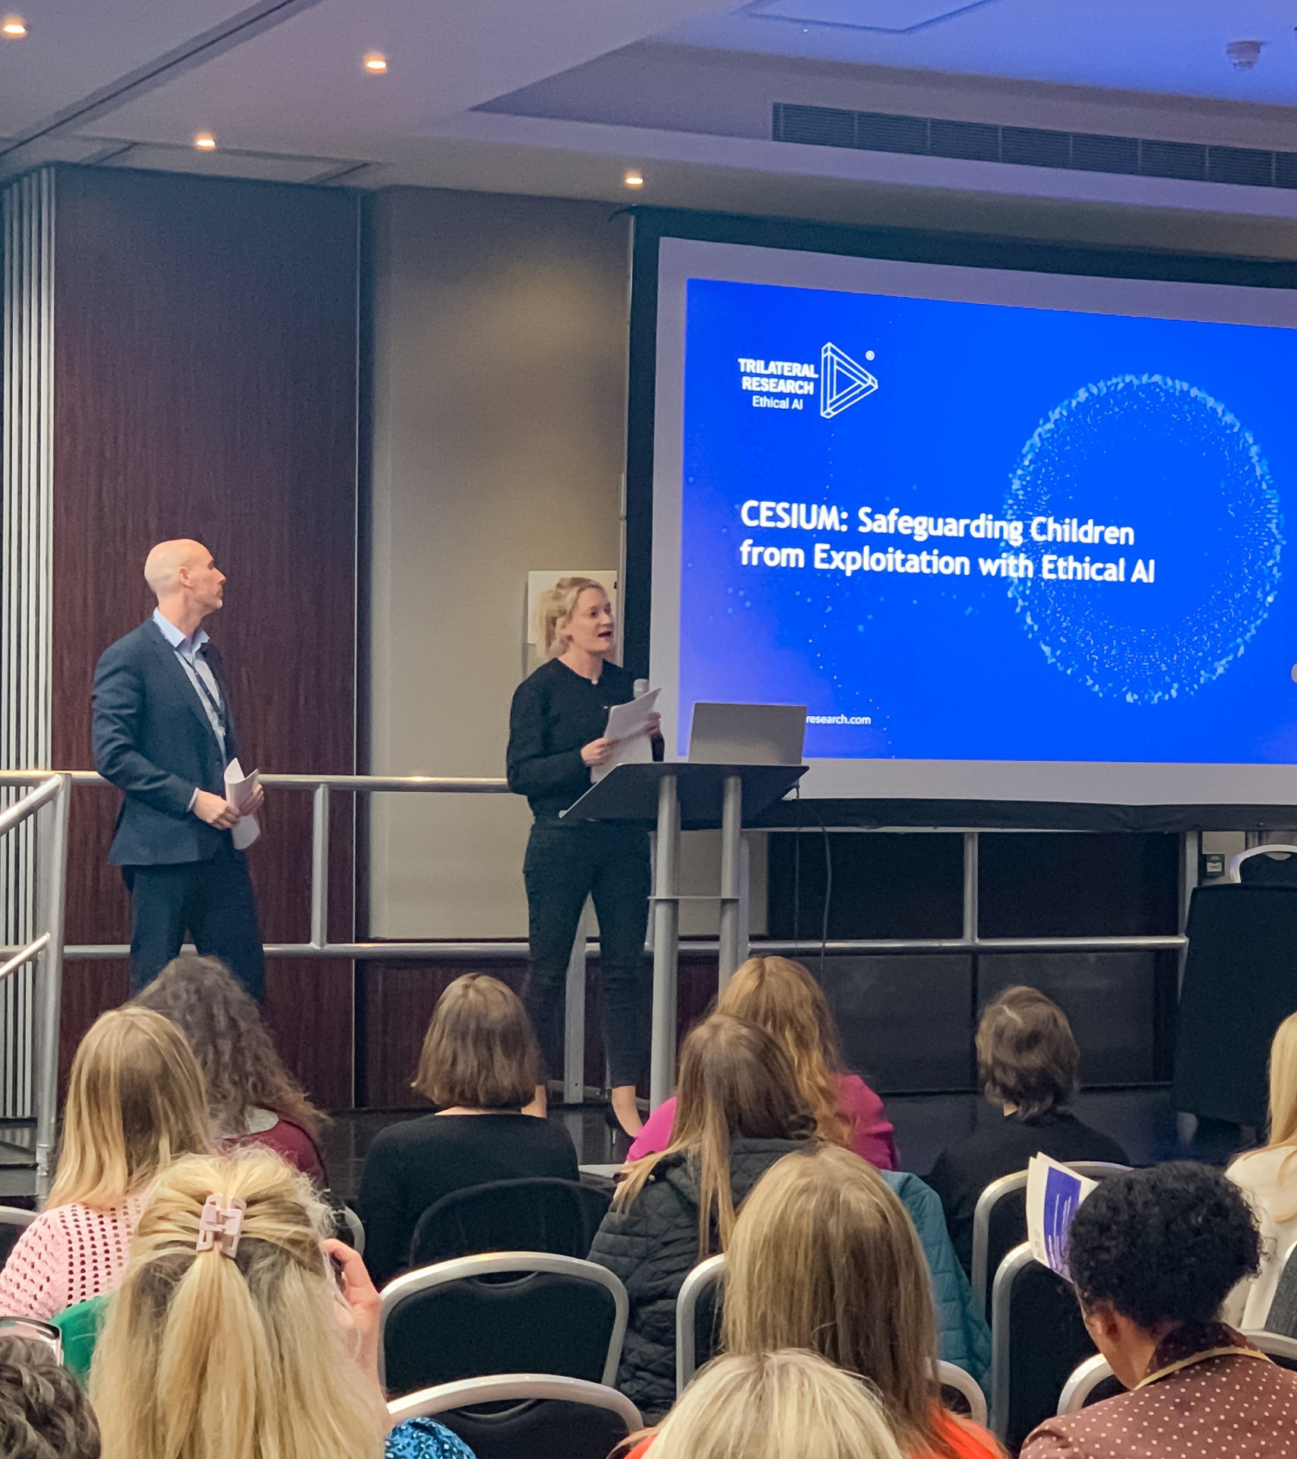


Who We Are
Global leader in Responsible AI (RAI)
20+ years’ experience
Pioneering AI development
Multi-award-winning solutions and services
100+ clients (commercial and government)
Partnerships with tech/data regulators in 40+ countries
Headquartered in London (UK) and Waterford (IE)

Slide 4

Digital Tools & AI for Supporting Human Trafficking Survivors

Slide 5
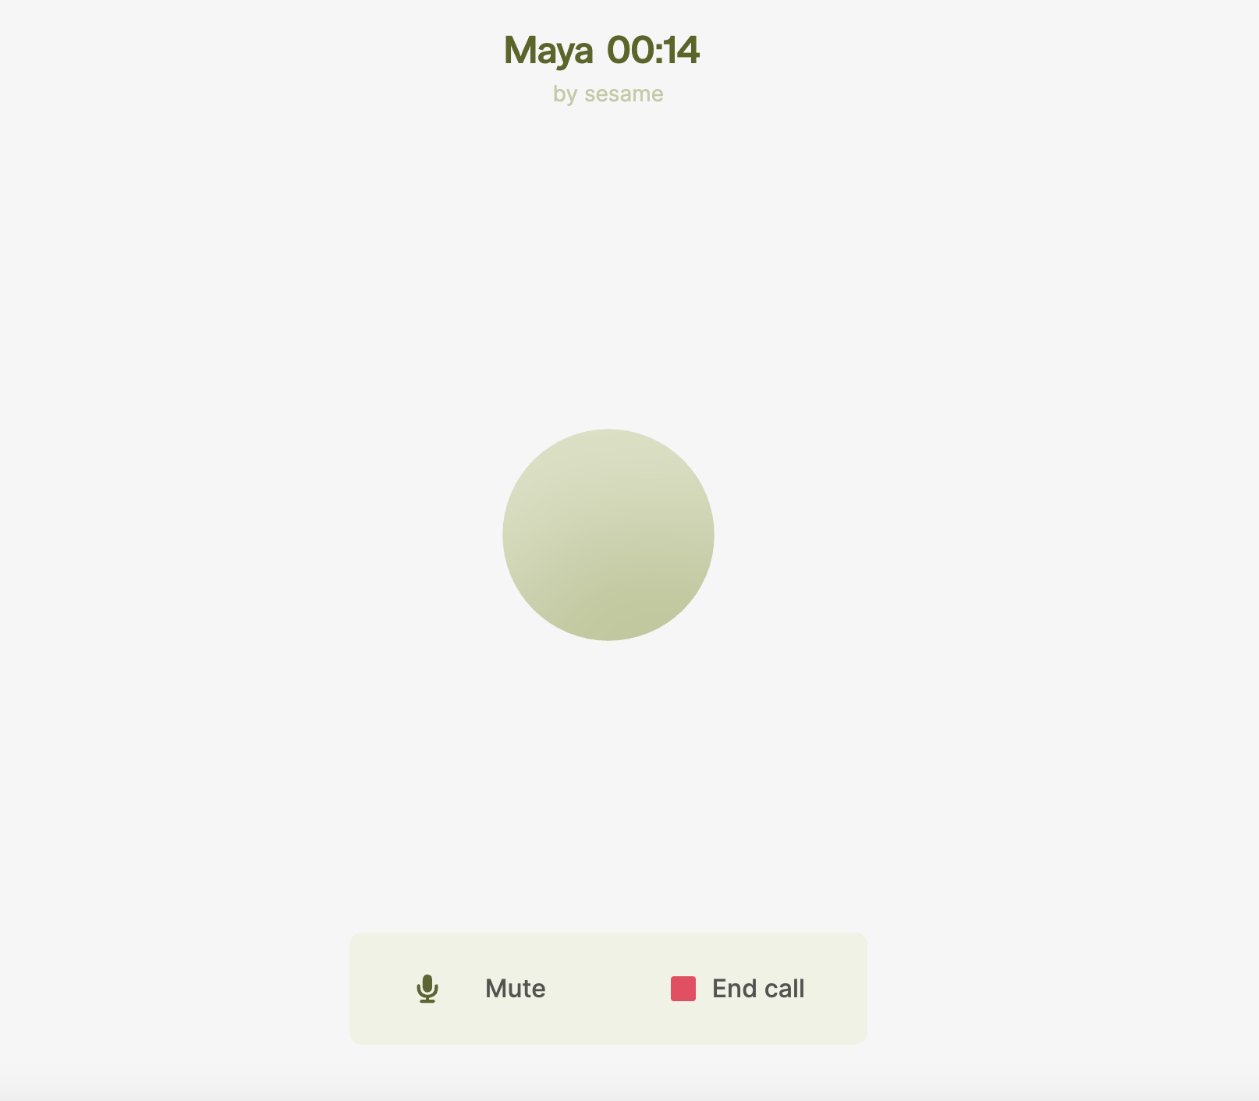

Slide 6
Why digital tools & AI
Speed & scale: sift huge data (ads, social media posts, survivors' stories)
Pattern recognition: supporting identification
Understanding language capabilities: can analyse large volumes of survivor stories to help us understand human trafficking
No Fatigue: AI never “sleeps”, it does not take breaks, it does not get traumatised
Whenever there is a requirement to analyse, synthesise, assess, categorise, label, generate, or visualise information, AI can greatly help.

Slide 7


Examples
Automated Translation: Google Translate, Microsoft Translator APIs embedded in chat platforms
AI-Driven Interpretation Bots: custom NLP models trained on regional slang and codewords
Limitation: machine translations can miss context or culturally-specific euphemisms, requiring human review
24/7 Helplines: AI chatbots enable anonymous, first-contact support when human counselors aren’t immediately available

Slide 8


Slide 9


RESTART
Analysis of existing stories
Journalling

Slide 10
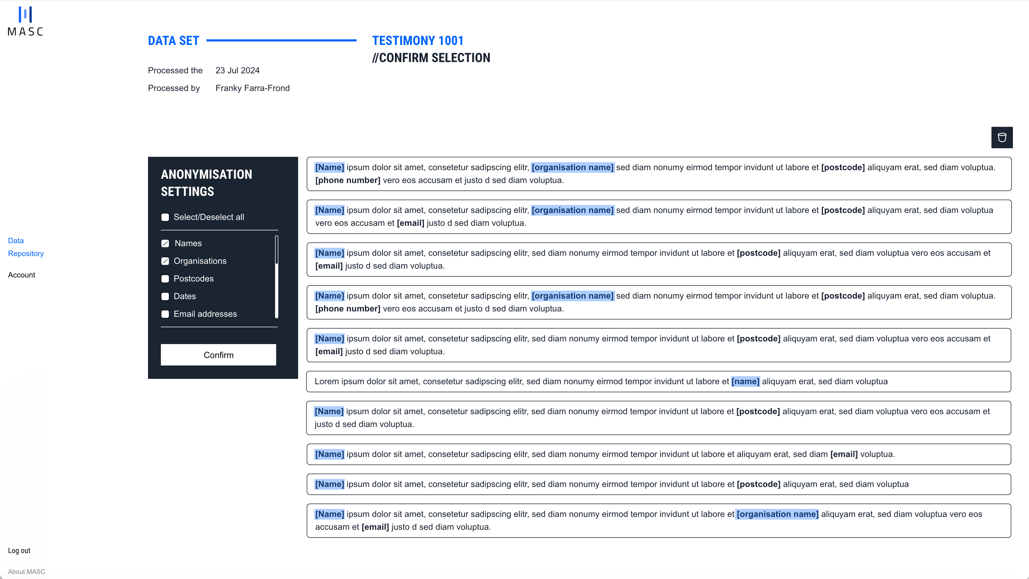
MASC
Problem
In order to leverage sensitive data or share it with partners, organisations first need to ensure this data is adequately anonymised to protect the rights of data subjects and comply with relevant regulations. However, data anonymisation demands place huge burdens on many organisations, with many lacking the capacity to anonymise their data and therefore leaving many insights locked away.
Solution + Impact
We developed an AI-powered data anonymisation tool that automates the process of data anonymisation to an incredibly high level of accuracy and confidence. Accessible via web app and secure API, the tool reduces the time and resources needed to securely anonymise sensitive data, thereby enabling organisations to more easily, quickly, and confidently get the right information to those who need it and unlocking its full potential.
MASC enables stakeholders to handle sensitive data securely and ethically, in order to leverage the power of this data while protecting victims' identities.

Slide 11
Where is the rest….

Slide 12
The end

Slide 13








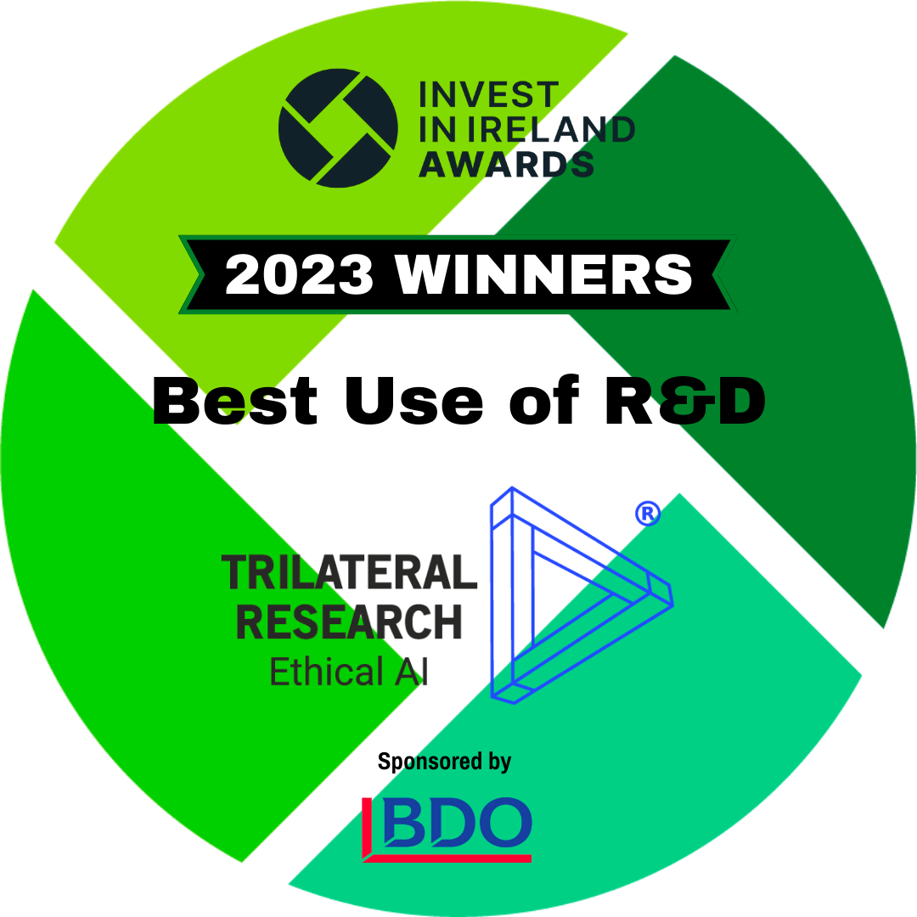


For more information, please contact
www.trilateralresearch.com
info@trilateralresearch.com
Trilateral Research
London, UK | Waterford, IE

