Slide 1


Climate Change Agreement for techUK
Note 06: Obligations under your CCA
including audits
August 2021
What are our obligations under the CCA?
Your obligations under the CCA are described in the Underlying Agreement and can be summarised into the following themes:
Reporting data to allow performance against the targets to be assessed; and
Keeping the underlying agreement up to date;
Maintaining audit trails to verify all quantitative and qualitative information used to comply with your CCA.
Further information on the first bullet can be found in Guidance Note 7 “Reporting data at each Target Period”. This note focusses on the last two bullets.
Variations
A ‘variation’ is the name of the process which facilitates a change to your Underlying Agreement because something has changed and hence the agreement is out of date. The list below shows when changes occur and hence a ‘variation’ may be needed.
Change of ownership – where a site or all sites in an agreement are sold by one company to another;
Change of company name and/or legal entity;
Change of site name or error in site or company address;
The contact details for the Responsible Person or Administration Contact changes;
Changes to the base year data due to ‘structural change’ – there are various scenarios of ‘structural change’ in the official definition however in practice, this includes
Ceasing the eligible process within the site or your 70/30 status changes from pass to fail (or vice-versa);
Changes to what you include under 3/7ths provision of the 70/30 rule;
An eligible process moves into or out of the site boundary .
Discovery of an error in base year data;
The UK/EU ETS permit number changes.
Certain changes needs to be notified to the Environment Agency (EA) within 20 working days so please contact us as soon as possible if any change may affect your CCA and we will advise you. Sometimes a change may not require a variation, however failure to notify the EA within 20 days could result in a penalty.
Climate Change Agreement for techUK Page 1 of 8 Obligations under your CCA

Slide 2
Variations (cont’d)
Changes that will not be allowed include:
A change to the percentage reduction applied to base year to derive targets;
Change to the base year dates;
Changing to another CCA (unless the eligibility of the sites changing and thus another sector is more appropriate).
Maintaining an audit trail – the ‘Evidence Pack’
An important requirement of your CCA is to make sure that comprehensive records are retained and kept up to date. You should keep all data and documentation relating to your CCA in an ‘Evidence Pack’. It is important that records are complete and current as this is the prime evidence base of compliance should you be audited by the Environment Agency (EA) or Her Majesty’s Customs & Revenue (HMRC).
The evidence pack could include the type of information below:
Copies of the documents you supplied for your CCA application (e.g. site plan);
Records of 70/30 rule calculations;
Details of sub metering;
Copies of your Underlying Agreement and any subsequent amendments;
Audit trails for energy data for Base Year and subsequent Target Periods, including weekly or monthly summaries, invoices and credit notes, explanation of where and how estimations have been used;
Meter calibration records (where appropriate);
Target period reporting data forms;
Any documentation relating to buy-out (if applicable);
Any documentation and evidence relating to variations (if applicable);
Copies of all PP10 and PP11 forms & any subsequent updates;
Internal procedures (e.g. for collecting, checking and storing data, energy policies, energy efficiency studies and projects implemented);
Correspondence with the sector association (i.e. techUK, SLR Consulting Ltd) or Environment Agency;
Copies of any audits undertaken at the site or company.
The above list is not exhaustive and you may not have/need records of all the items listed, however it can be used as an aide memoire for your record keeping process.
Climate Change Agreement for techUK Page 2 of 8 Obligations under your CCA

Slide 3
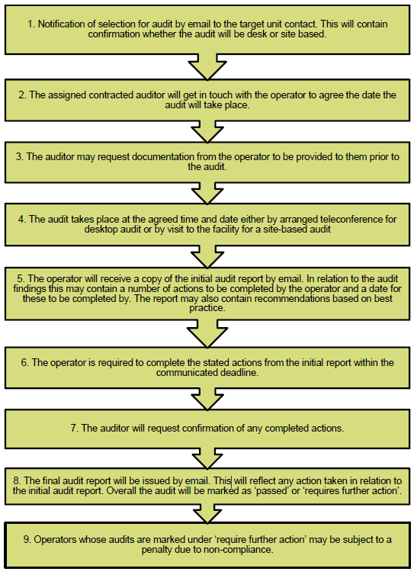
Audits
The EA and HMRC may choose to audit you to check that your CCA is correct or to check that you have correctly claimed the CCL discount.
Environment Agency Audits
The EA undertake audits to verify your eligibility for a CCA and your performance against the targets. These audits concentrate on eligibility, baseline data and any target period performance data. Selection for audit may be risk based or random selection. The EA audit process flow is shown below.
Climate Change Agreement for techUK Page 3 of 8 Obligations under your CCA

Slide 4
The following pages contain detail of what to expect from an Environment Agency audit. As the techUK Helpdesk and the Sector Association contact will be notified of planned audits, they can help you to prepare and provide specific advice in relation to queries.
How the EA carry out audits:
The EA will inform the operator of a facility (i.e. the company that runs the site) via an emailed letter to the administrative contact. The auditor will then contact the administrative contact to discuss and agree a date for the audit. They will also copy the sector association (i.e. techUK/SLR) into the e-mail.
There are two types of audit: a desktop audit or a full site audit. A desktop audit is intended to be less extensive than a full site audit and is normally used for lower risk or random audits.
Desktop audits:
The EA will ask the company selected for audit to provide them with data for the site before the agreed date of the audit. The auditor will review the data at their own place of work and hold a phone call on the agreed audit date with the company being audited. A desktop audit phone call typically takes a few hours.
The auditor will then produce an initial report based on the data supplied and the responses obtained during the phone call. If issues are identified that cannot be resolved over the phone or by email within an agreed follow-up period, the EA may escalate the facility to a full site audit. A final report will be sent once the deadline for resolving any issues from the desktop audit has passed.
Full site audits:
When the auditor arranges the audit date, they will ask the company being audited to provide data for the site based on the risk(s) identified or outstanding issues from an escalated desk-based audit. The company should provide this information by an agreed date in advance of the site audit. The auditor will then visit the site to examine the data and facility eligibility in greater detail.
The auditor will produce an initial report detailing their findings and setting out any recommended actions by the site. This report will also contain a deadline by when any remaining actions need to be completed. When this deadline passes the auditor will check that these actions have been completed and will then produce a final report which states the final audit outcome.
During both desktop and site audits, the auditor will ask about the site's eligibility, baseline and target period performance data. Companies must provide evidence on request to answer the auditor's questions (for example calculations to support compliance with the 70% rule). The operator needs to keep records throughout the duration of the agreement and for a period of four years following the termination of the agreement. If not, they should ensure the sector or their consultants retain a copy.
Climate Change Agreement for techUK Page 4 of 8 Obligations under your CCA

Slide 5
What will the EA’s auditors be looking for and what questions may be asked during an audit?
Eligibility
This will assess documentation supplied during scheme application and supporting information, especially the process description and a site plan, will be examined. In some cases the EA will already hold these documents, if not you will be asked to supply copies.
This should include:-
  what areas of the site/process meet the eligibility criteria;
  evidence that the site boundary is correctly defined in the eligibility calculations;
  how much of the site is eligible to claim the CCL discount, including the 70% and any additional 3/7ths or energy included in the eligible facility;
  clear identification of the directly associated activities which support the eligible process;
  where a site fails the 70/30: evidence that permanent sub-metering is recording kWh of energy used by either the eligible, directly associated or ineligible activities.
The 70/30 Rule
For eligibility there should be a clear analysis of the eligible and non-eligible energy use on the site to demonstrate whether the site meets the 70/30 rule.
Where the eligible energy use is very high and well over 70%, the site may choose to demonstrate this by a calculation, preferably in a spreadsheet showing a list of the non-eligible equipment, the energy ratings (for example in kW), the relevant hours of operation and the level of utilisation (that is, how long each item of equipment is used during the hours of operation). All of this can be reasonably estimated. Alternatively the site may have used temporary meters to check actual eligible or non-eligible energy for a period.
Where the eligible energy use is less than 70%, it must be sub-metered and recorded. This data must also be current as per the requirement to review the PP10/11 forms annually.
CCA Governance
The audit will look at the processes and procedures that companies have for managing their CCA data collection and reporting and checking the accuracy of the data before submission.
Climate Change Agreement for techUK Page 5 of 8 Obligations under your CCA

Slide 6
What will the EA’s auditors be looking for and what questions may be asked during an audit? (cont’)
Data Management and retention
This will include the energy and throughput data for base year and each target period. The review of the data will include an examination of:
the energy units, calorific values and conversion factors used for each fuel or energy source;
meter information or records for each fuel or energy source in the baseline;
a clear audit trail to account for the figures reported in the register (via techUK);
evidence of standards of accuracy;
evidence of calibration of meters (if necessary).
The Environment Agency only hold data for the total target unit (i.e. a site or group of sites). Hence if a site chosen for audit is in a ‘bubble’ (i.e. a target unit with a number of sites), the auditor will expect to see evidence of how the data for the site fits into the overall target unit’s data.
The auditor will expect to see primary evidence records of energy use such as supplier invoices or the site’s own meter/fuel gauge readings, and sample records from the IT load data.
If a significant error is found in the energy or throughput data the auditor may raise an action for the operator to correct this through a variation.
If the company has an energy management system or quality system accredited to a recognised standard, then it will be used as the starting point of the audit to recognise this good practice and check it is being used effectively.
UK/EU ETS
If a site is in UK/EU ETS the auditor will ask for evidence of which areas of the site are covered by ETS. Questions will include:
Was the site included in Phase II and is it included in Phase III of ETS?
What's the difference between the energy consumed in Phase II and III (if any)?
Is ETS consumed energy accounted for correctly in the CCA baseline?
Climate Change Agreement for techUK Page 6 of 8 Obligations under your CCA

Slide 7
Possible audit outcomes
An audit has two possible outcomes:
Pass – no further action required
Requires further action – the report will contain recommendations to address current issues and to reduce future risks of non-compliance (for example, the need for one or more variations to the agreement)
The audit report will be sent to the companies. techUK/SLR as the sector association will be informed of the audit outcome.
What happens next
If the facility passes the audit, no further action is required by the company.
If follow-up actions are recommended, the Environment Agency will work with the company to agree a timescale for those actions. They may suggest a follow-up meeting and possibly carry out a further audit depending on the severity of the issues requiring attention.
If the company does not take action in response to the audit's recommendations within the agreed timescale, it is possible that the EA may impose a penalty on the operator or, in the worst case, terminate the agreement due to non-compliance.
Climate Change Agreement for techUK Page 7 of 8 Obligations under your CCA

Slide 8
For further information please contact SLR’s techUK CCA helpdesk:
+44 (0)844 800 1880
techUK@slrconsulting.com
or visit www.techuk.org/developing-markets/data-centres.html
The full suite of techUK CCA Guidance Notes are listed below and can be accessed via contacting the helpdesk or visiting the website.
Guidance Note | Title
1 | What is a CCA
2 | Transferring Ownership of a CCA
3 | techUK CCA Administration Charges
4 | Completing HMRC PP10 and PP11 Forms
5 | Timetable of techUK CCA Activities
6 | Obligations under your CCA including audits
7 | Reporting data at each Target Period
8 | How CCAs interact with other schemes
9 | Glossary and Abbreviations
10 | What happens if...
11 | Submetering and base year
12 | Measuring Generator Fuel
13 | State Aid Transparency reporting
14 | Penalties for non compliance
15 | Application Documentation
16 | Datacentre CCA eligibility
Climate Change Agreement for techUK Page 8 of 8 Obligations under your CCA

